Slide 1
Famous figures in Croatian Art and History

Slide 2
ART

Slide 3
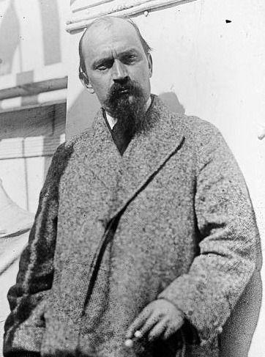
Ivan Meštrović
Born on August 15 1883 in Vrpolje
A famed sculptor, architect and writer
Works in the spirit of Secession

Slide 4
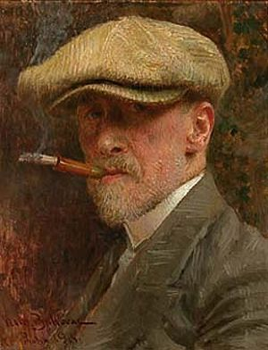
Vlaho Bukovac
One of the most important Croatian painters
5 different phases
Early work, San Francisco 1874 – 1877
Paris phase 1877 – 1893
Zagreb phase 1893 – 1898
Cavtat intermezzo 1898 - 1903
Prague period 1903 - 1922

Slide 5
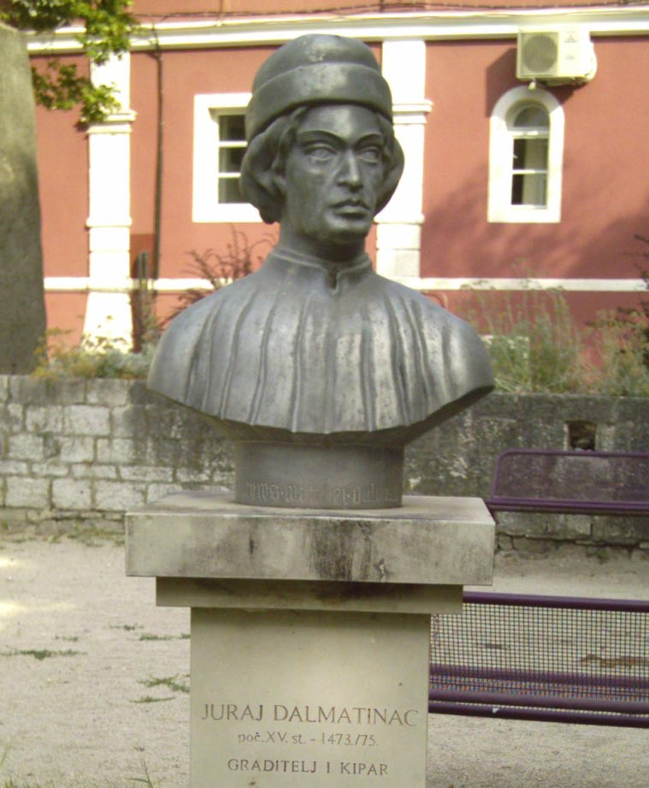
Juraj Dalmatinac
Juraj Matejev Dalmatinac was a sculptor and an architect
He was suspected to have helped make the decorations in Scuole di San Marco
Not much is known about him

Slide 6
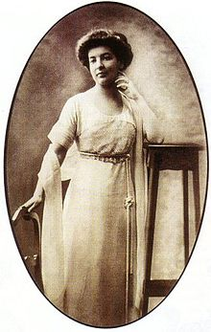
Dora Pejačević
Maria Theodora Paulina Sophie von Lumbe was a famed Croatian musician
She made compositions for vocals, the piano and orchestra
https://www.youtube.com/watch?v=3A2kKPtRd9o

Slide 7
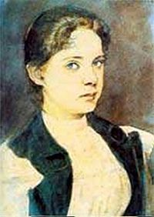
Slava Raškaj
She was a Croatian painter
She did her work in crayon technique and aquarelle
She met her end when she was only 29, in an asylum

Slide 8
History

Slide 9
Barbara of Cilli
Holy Roman Empress by marriage, and the Hungarian queen
Instrumental in creating the Royal Order of the Dragon
Actively involved in economics and politics

Slide 10
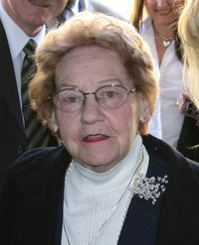
Savka Dabčević Kučar
Leader of the national-reform efforts during Hrvatsko proljeće
"The Croatian Spring" ended with her being pulled off duty in 1971., and a massive anti-croatian persecution of people known as Proljećari

Slide 11
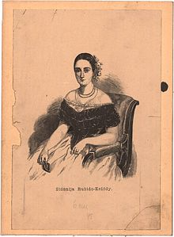
Sidonija Erody Rubido
She was a countess and a Croatian opera singer
With the help of her sister she established the first Croatian institution for abandoned and orphaned children

Slide 12
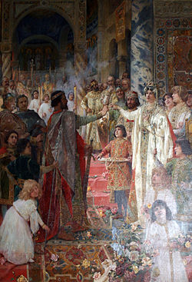
Dmitar Zvonimir
He was a croatian ban, Herceg, and king
He was, along with his predecessor, one of the mightiest kings
When he died, a bloody war commenced, which resulted in Croatia losing its independence

Slide 13
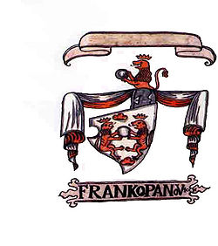
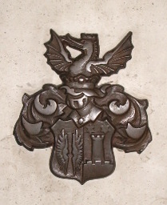
Zrinski i Frankopani
They were old Croatian noble families
They were the most important and known families, which stood up against both the Ottoman conquerors and the Habsburg absolutism

Slide 14
Thank you for your patience :)

Slide 15
This project has been funded with support from the European Commission. This publication [communication] reflects the views only of the author, and the Commission cannot be held responsible for any use which may be made of the information contained.

