Slide 1
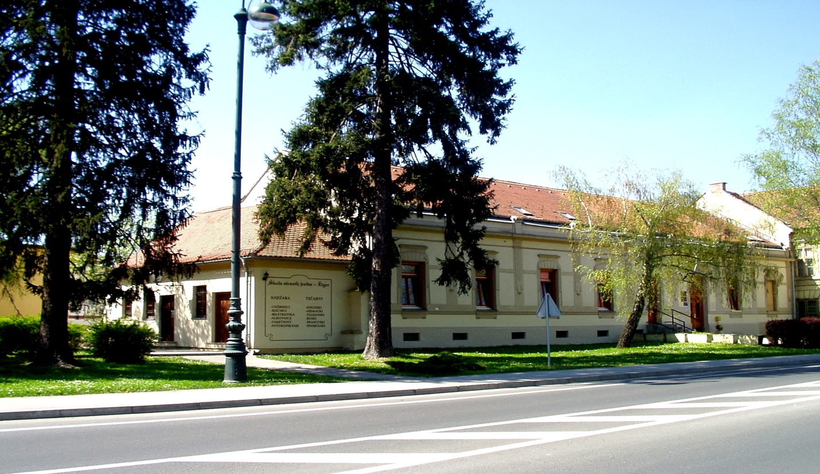
PRIVATE VARAŽDIN GRAMMAR SCHOOL

Slide 2
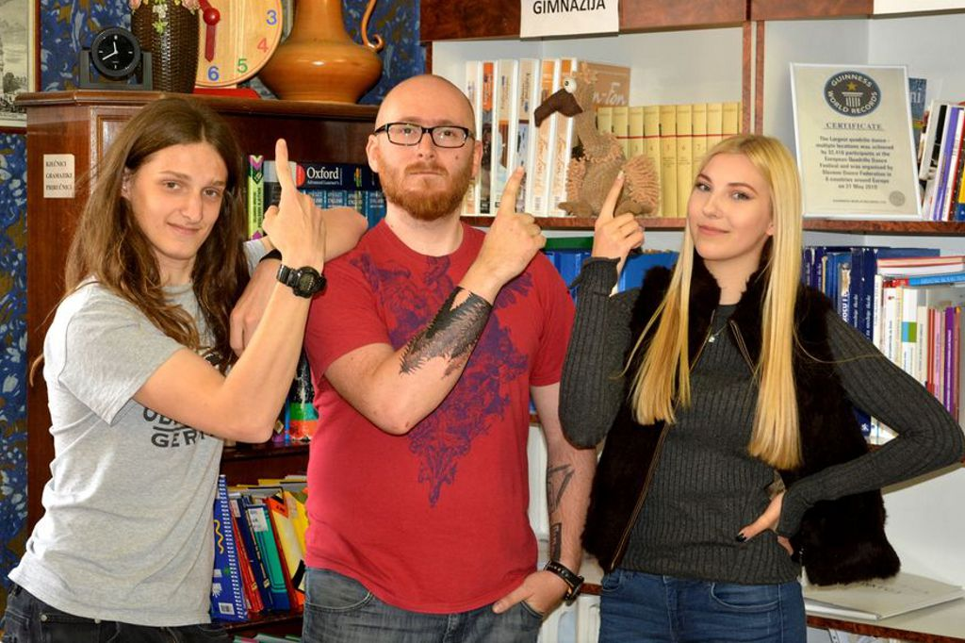
PROGRAMMES:
General
Linguistic
Bilingual: Biology, Chemistry, History, Geography
Programme complemented with optional subjects: Rhetorics, Film art and third foreign language
19 teachers
40 students

Slide 3
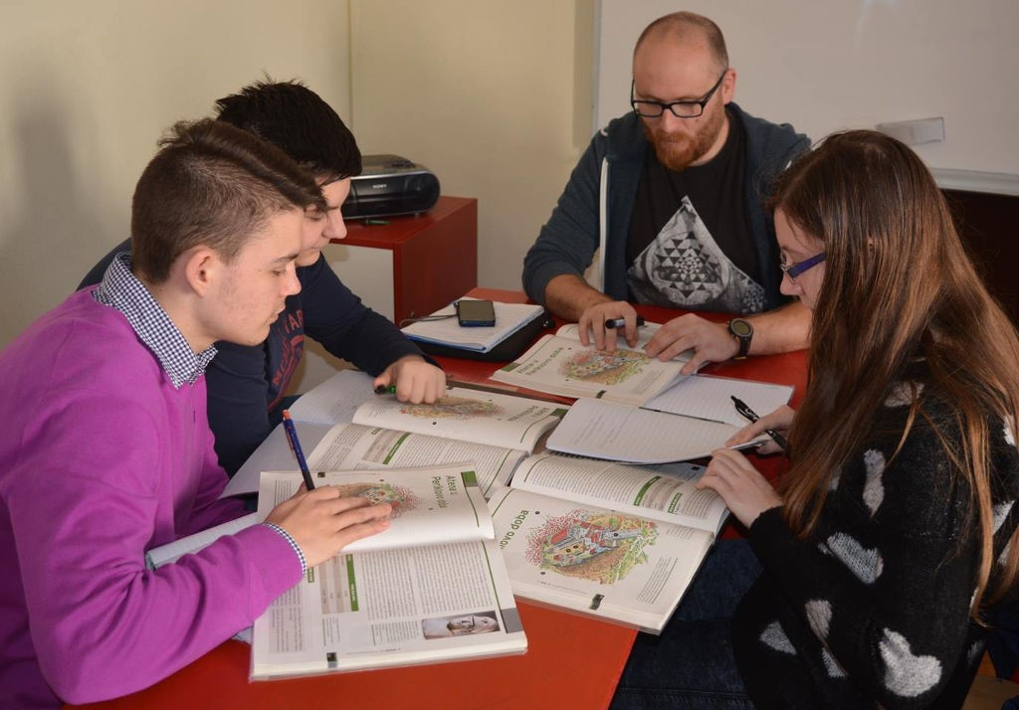
School Philosophy:
Student is the centre of the teaching procesess
Engaging student’s intellectual potential aimed at achieving maximum results

Slide 4
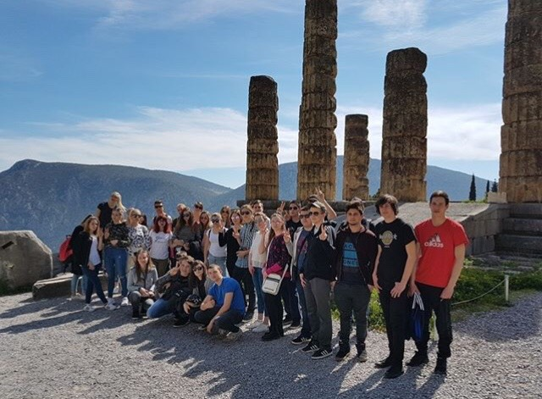
EXCURSION
Two excursions per year ; the first one is one day excursion in Croatia and the second one is several days in a foreign country
Last year we visited Greece and
this year we are going to visit Italy

Slide 5
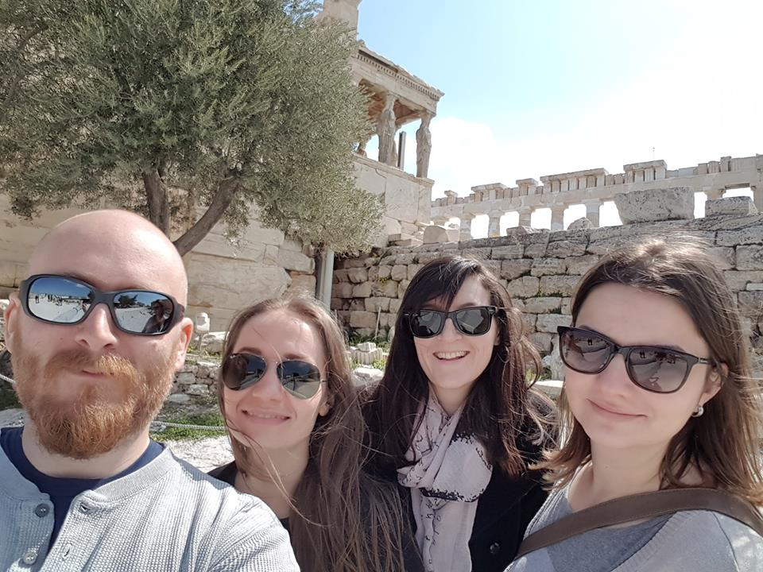
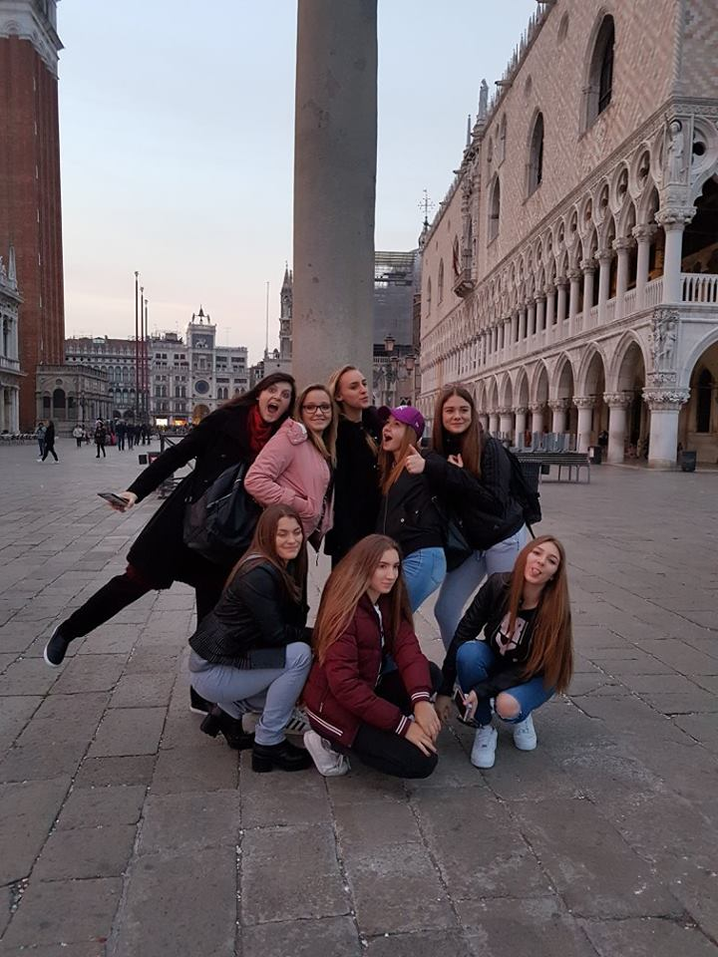
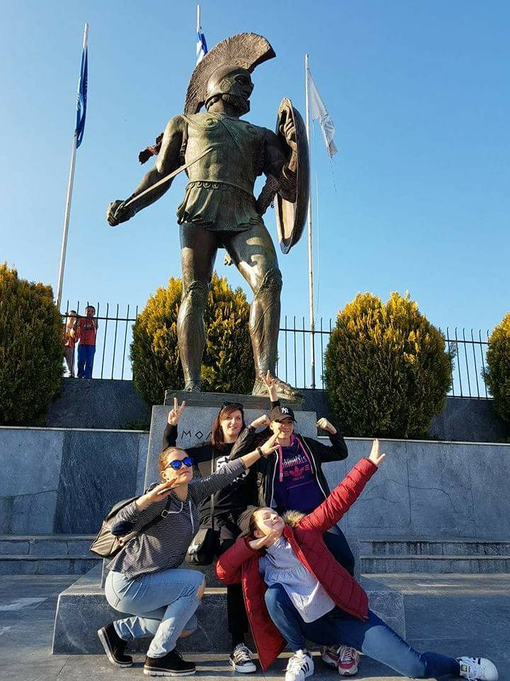

Slide 6
EU PROJECTS
Two EU projects:
Linking up culture
We all smile in the same language
Student exchange

Slide 7
OUR SCHOOL’S ADVANTAGES
Maximum 15 students per class
Teachers offering supplementary assistance to students in each subject
Individual study classes and mentoring classes
Extra foreign language classes in the evening for those who want more or who want extra practice
Morning – shift classes
Free weekend

Slide 8
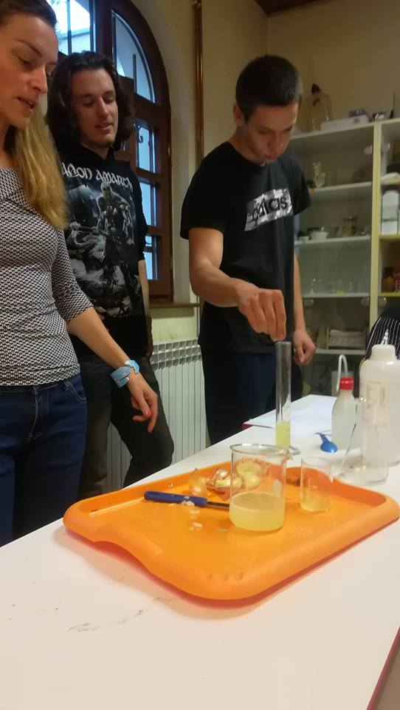
SCHOOL EQUIPMENT
Computer room
Equipped lab for science classes

Slide 9
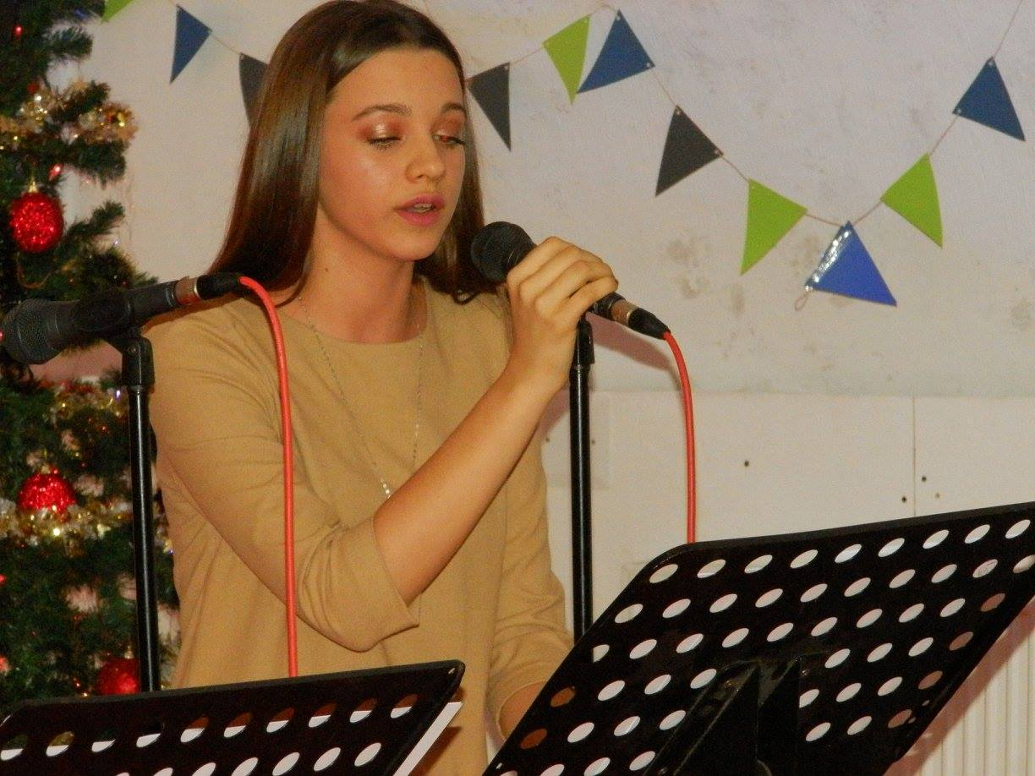
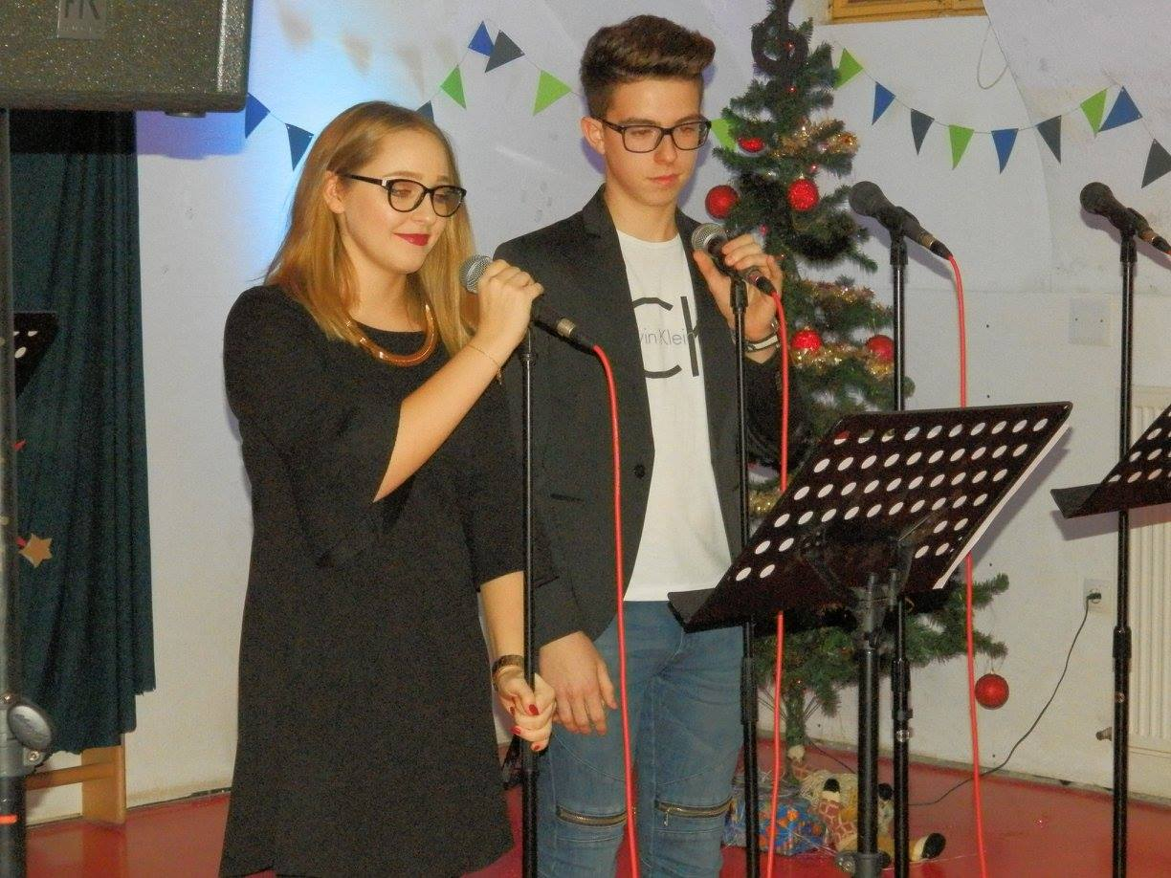
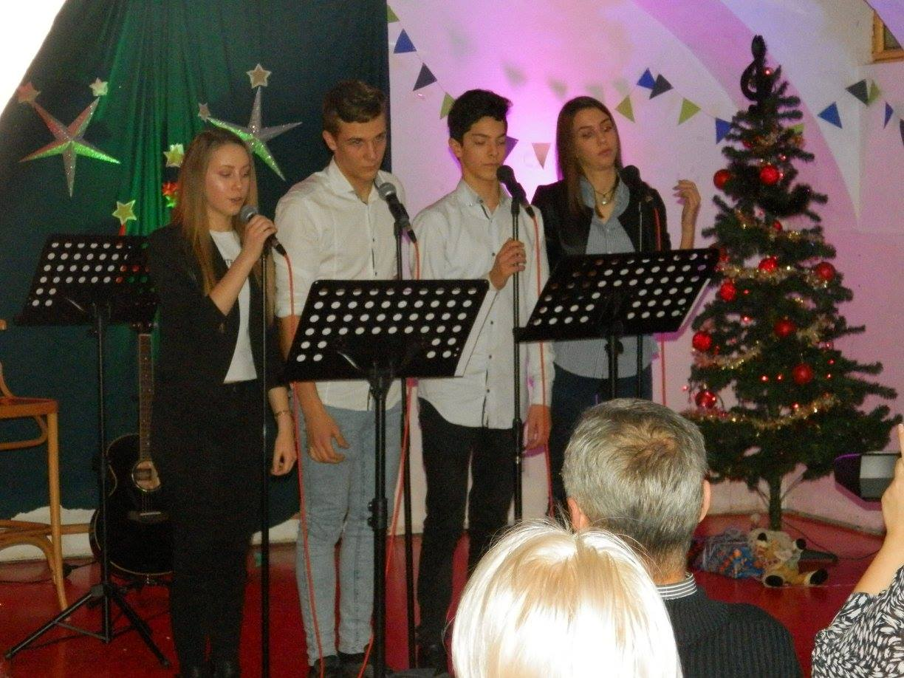
HUMARITY ACTIVITES

Slide 10
THANK YOU FOR YOUR ATTENTION ;)

Slide 11
This project has been funded with support from the European Commission. This publication [communication] reflects the views only of the author, and the Commission cannot be held responsible for any use which may be made of the information contained.

