Slide 1
CROATIAN RELIGIOUS TRADITIONS

Slide 2
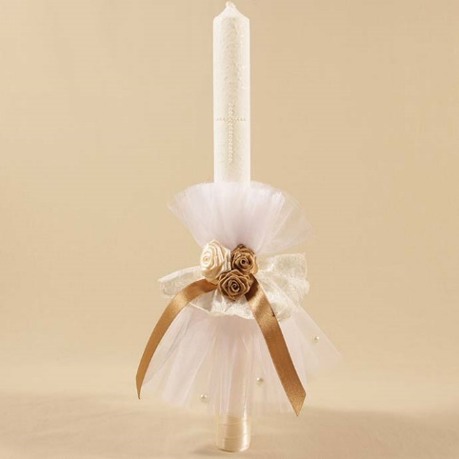
CHRISTENING
white clothes
parents choose godparents for their child
child is baptised in Holy water
meal (dinner) after ceremony
special candle

Slide 3
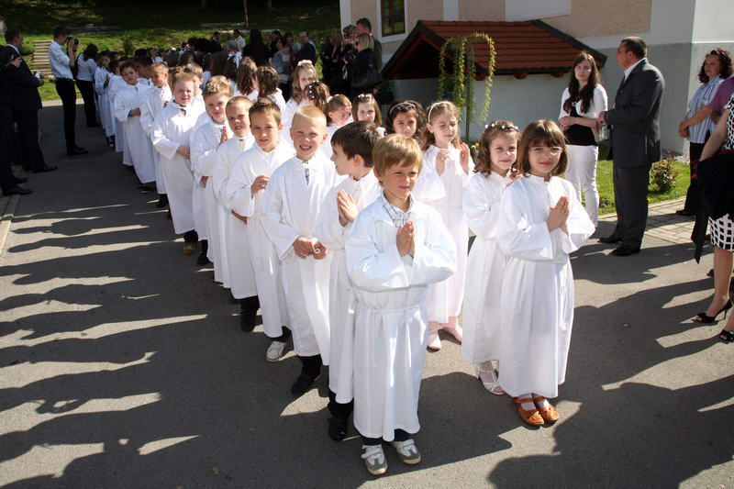
HOLY COMMUNION
third grade of elementary school
child receives sacramental bread, body of Christ
all children usually wear white robes
meal (dinner) after ceremony

Slide 4
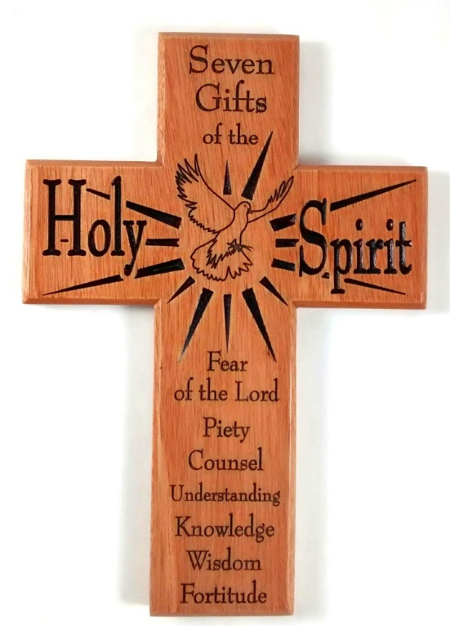
CONFIRMATION
eight grade of elementary school
confirmation godfather
or godmother – a must for the ceremony
young people receive seven gifts of the Holy Spirit
they are all formally dressed
Notes:
Stvaiti sliku križa preko ove slike gdje je biskup. To staviti na kraju kad prezentacija bude gotova i budu se stavljale animacij.e i prijelazi

Slide 5
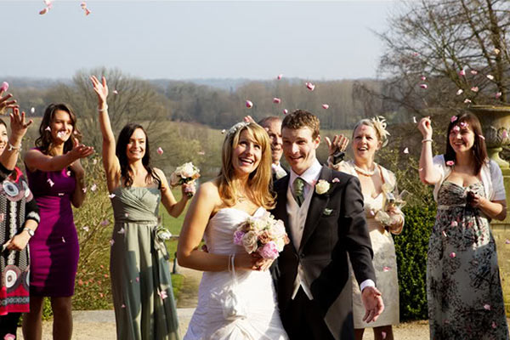
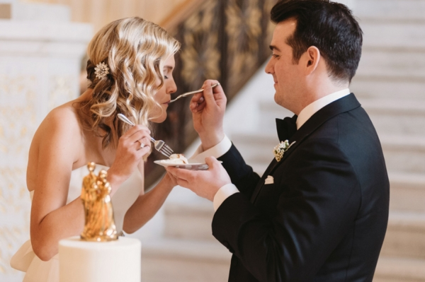
WEDDING
After a ceremony in Church people throw flower petals on the newly married couple
bride and groom feed each other cake
groom takes off brides garter blindfolded with his teeth
ceremony: 1) starts at home – 3 p.m.
2) mass in Church
3) party all night until morning

Slide 6
FUNERAL
everybody is dressed in black
everybody brings wreaths
brass band plays at the funeral

Slide 7
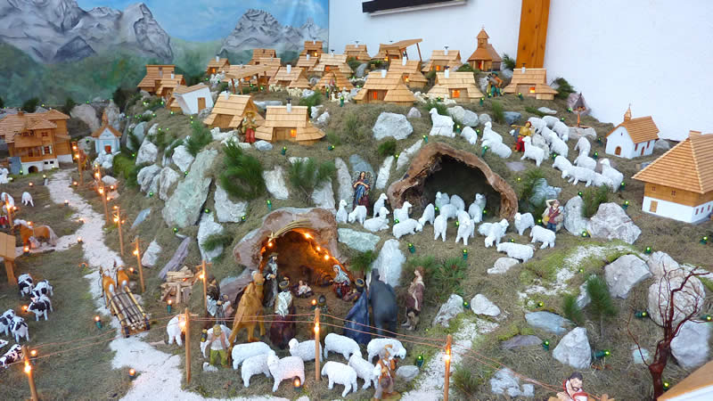
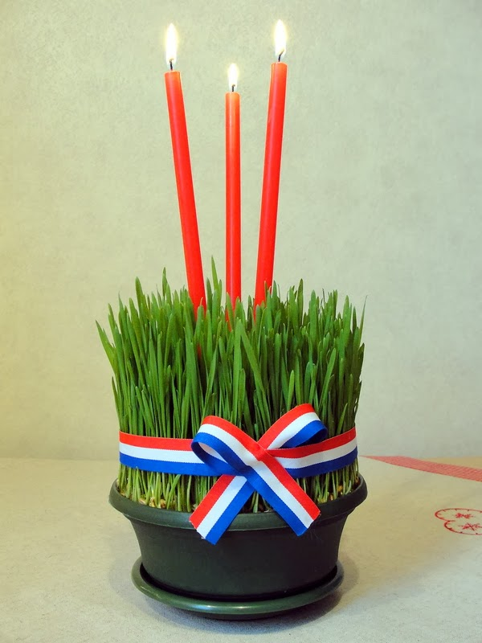
CHRISTMAS
advent wreath
planting decorative wheat
St. Lucy‘s day – 13th December
nativity scene
Midnight mass

Slide 8
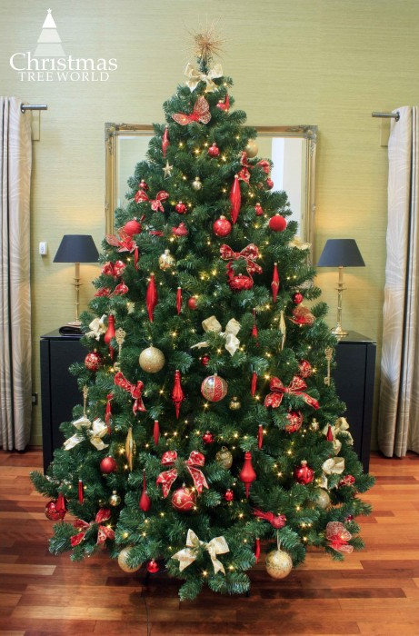
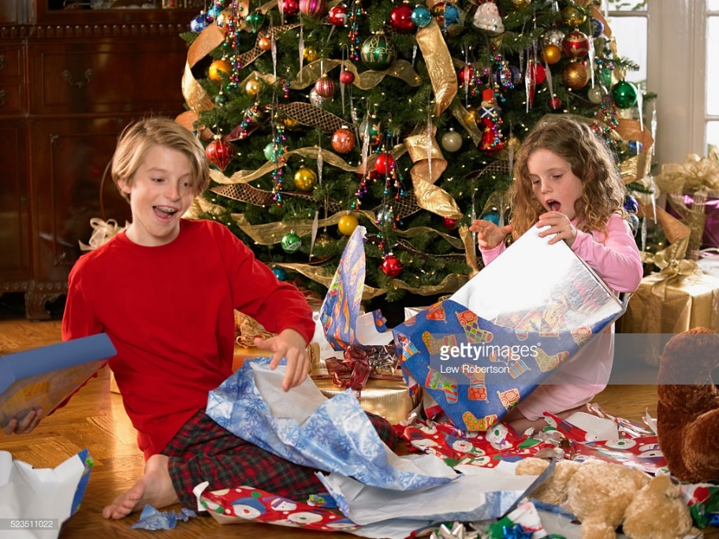
CHRISTMAS
family is decorating the Christmas tree – Christmas eve
opening presents on Christmas morning

Slide 9
EASTER
LENT
preparing for Easter
disavowal from something you like (food, curse words...)
HOLY THURSDAY, GOOD FRIDAY AND HOLY SATURDAY
mass
spending time with family

Slide 10
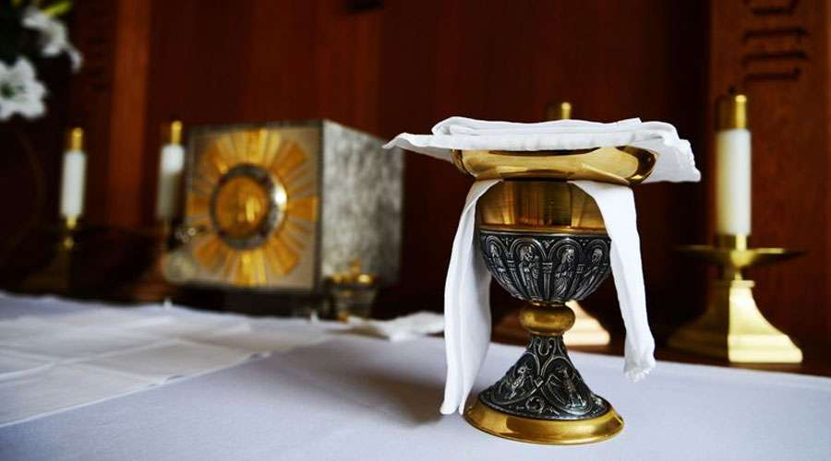
EASTER
lunch and spending time with family
mass in the evening

Slide 11
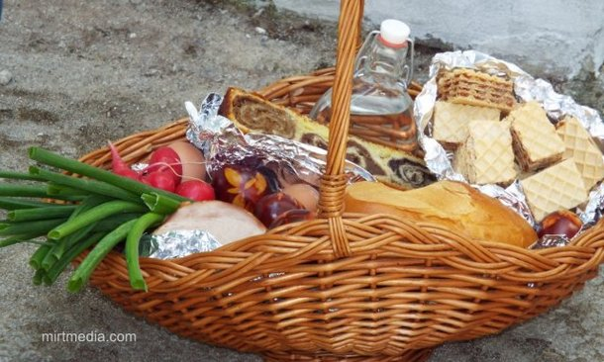

Slide 12
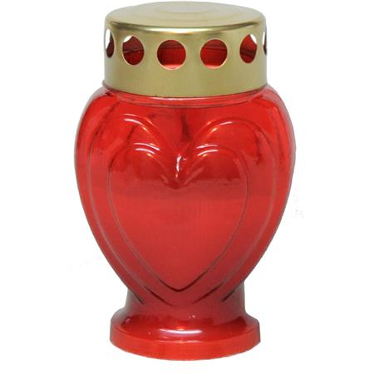
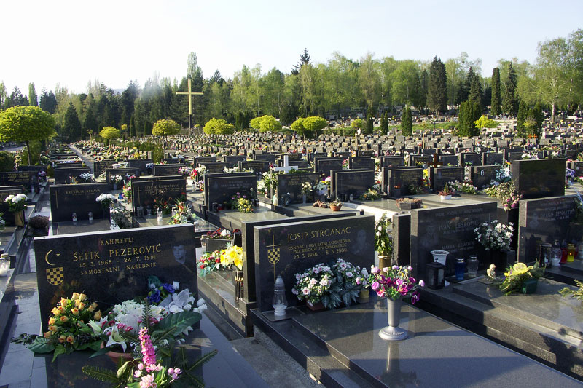
ALL SAINT’S DAY
going to the cemetery
visting graves of our beloved and lighting candles

Slide 13
This project has been funded with support from the European Commission. This publication [communication] reflects the views only of the author, and the Commission cannot be held responsible for any use which may be made of the information contained.

