Slide 1
Dissemination of project results
Project meeting in Italy,
October, 22th – October, 26th

Slide 2
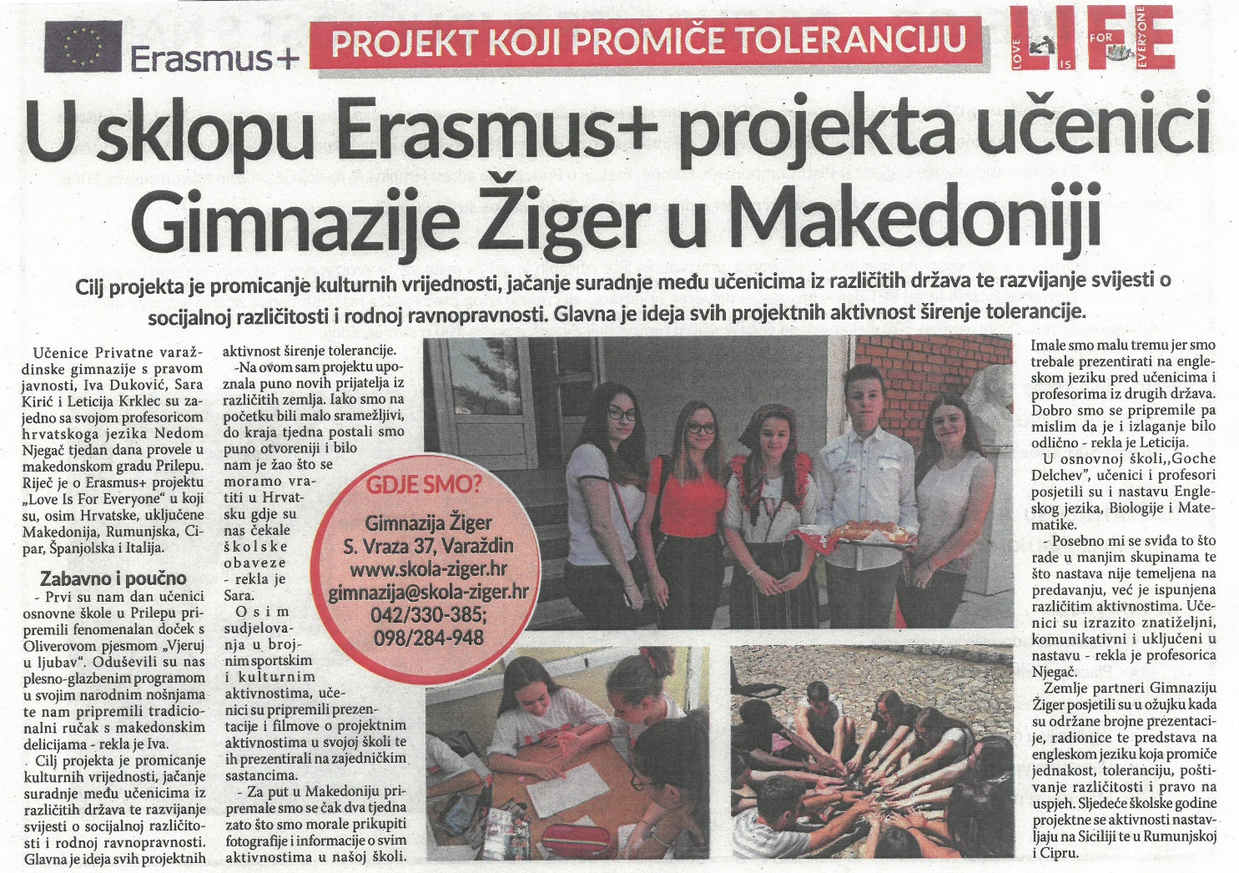
Dissemination in the local newspaper

Slide 3
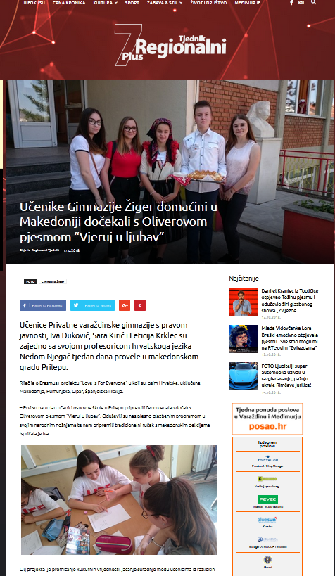
Dissemination on local webportals
https://regionalni.com/ucenike-gimnazije-ziger-domacini-u-makedoniji-docekali-s-oliverovom-pjesmom-vjeruj-u-ljubav/

Slide 4
Dissemination on local webportals
https://varazdinski.rtl.hr/vijesti/skolski-kutak/3212769/u-sklopu-erasmus-projekta-ucenici-gimnazije-ziger-boravili-u-makedoniji/

Slide 5
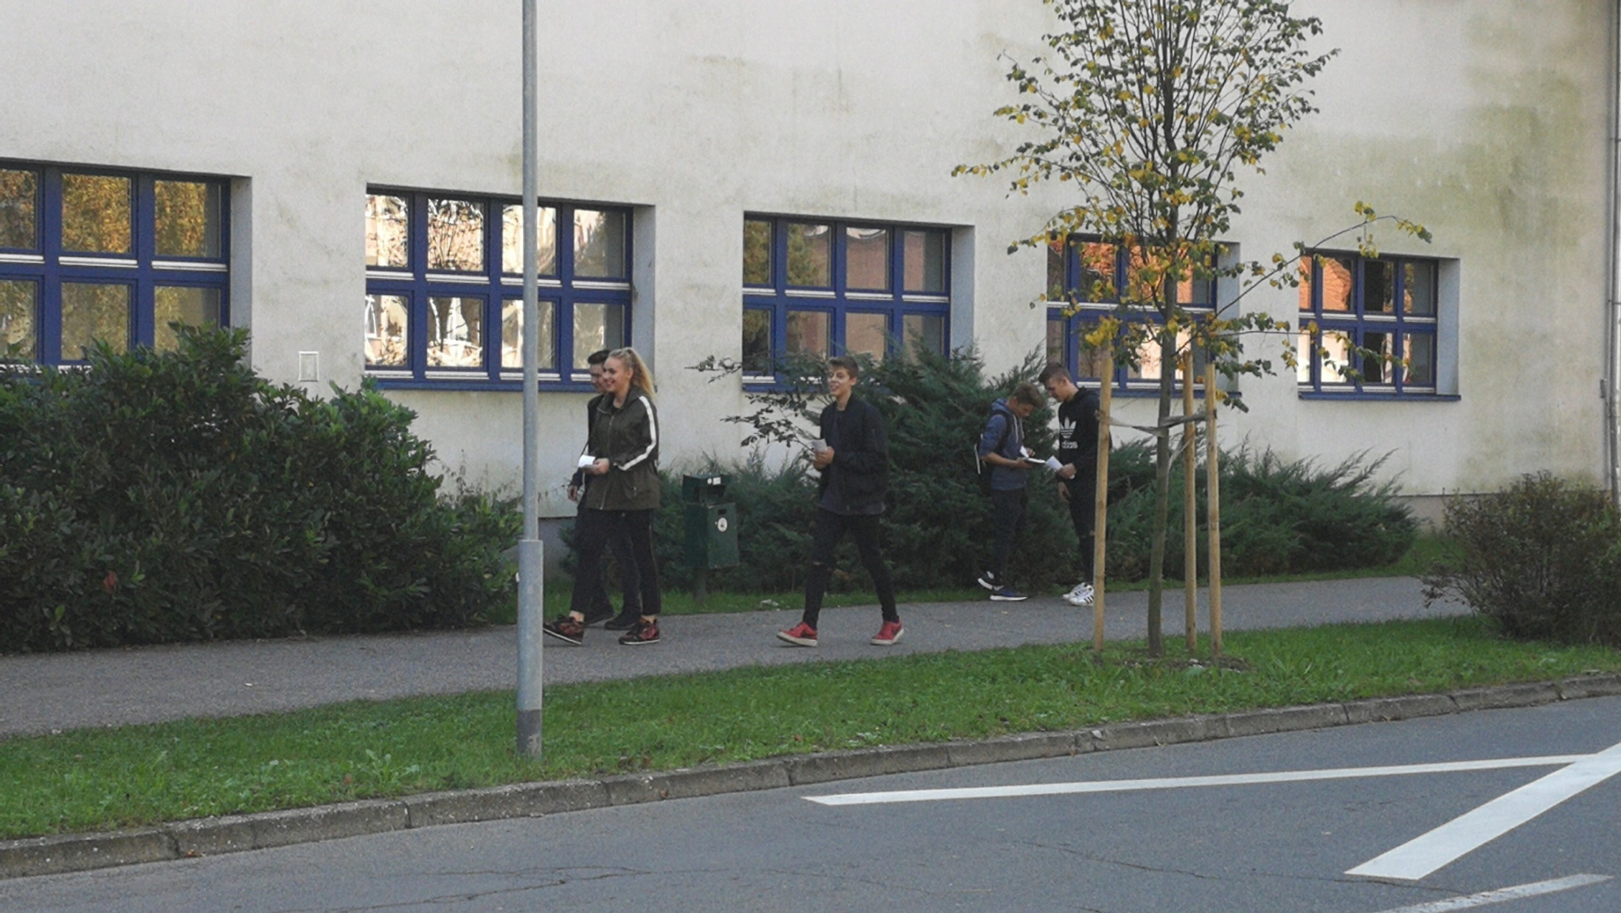
Street campain

Slide 6
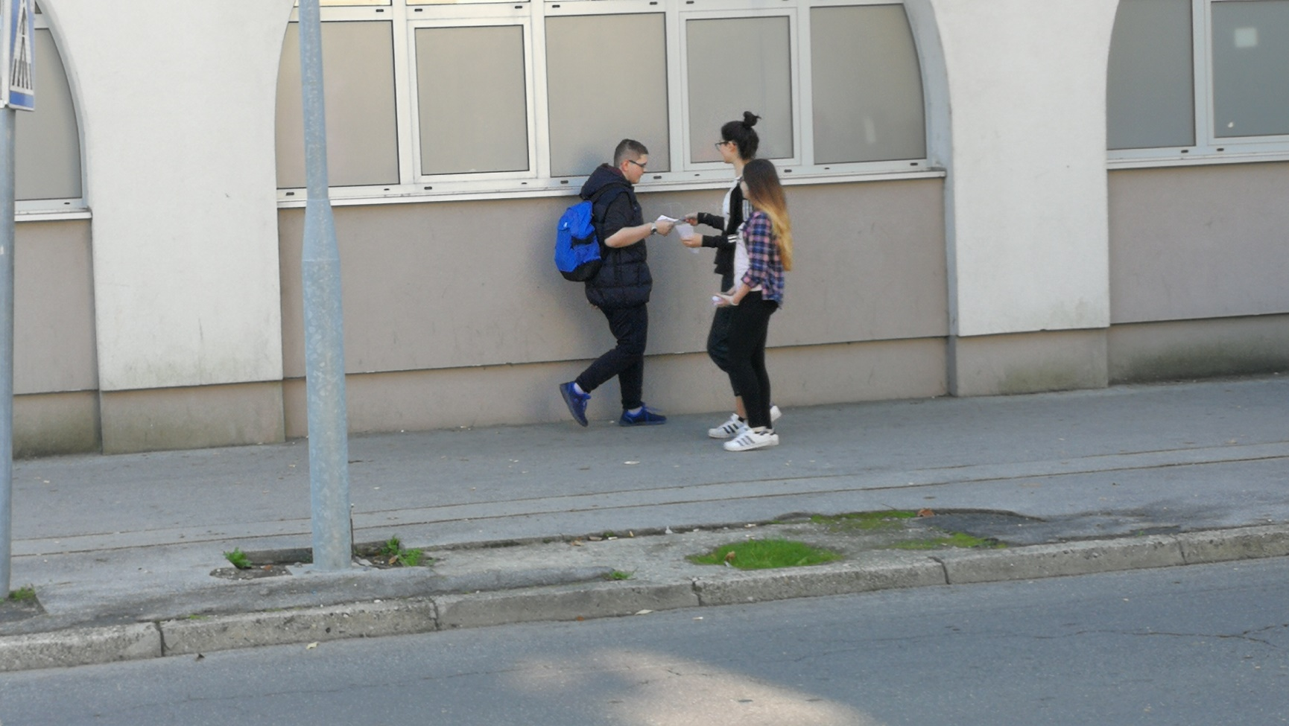
Street campain

Slide 7
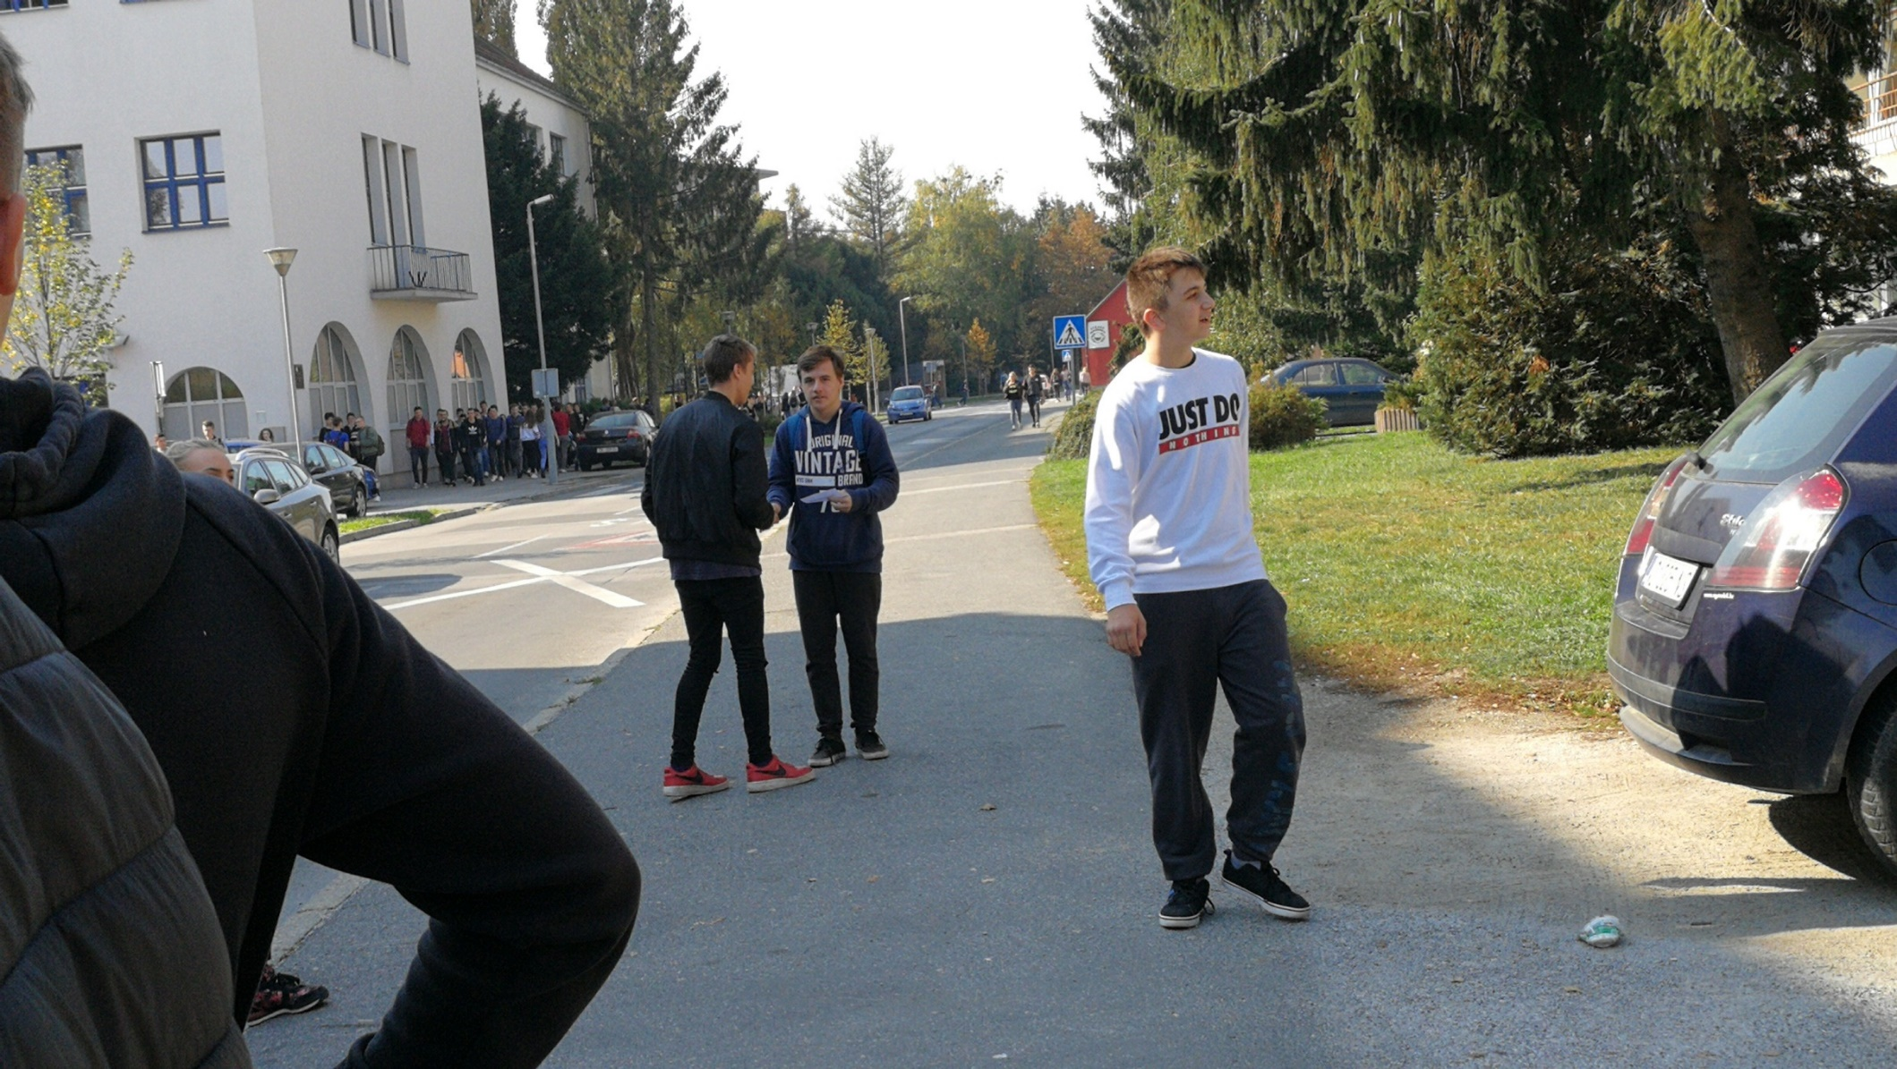
Street campain

Slide 8
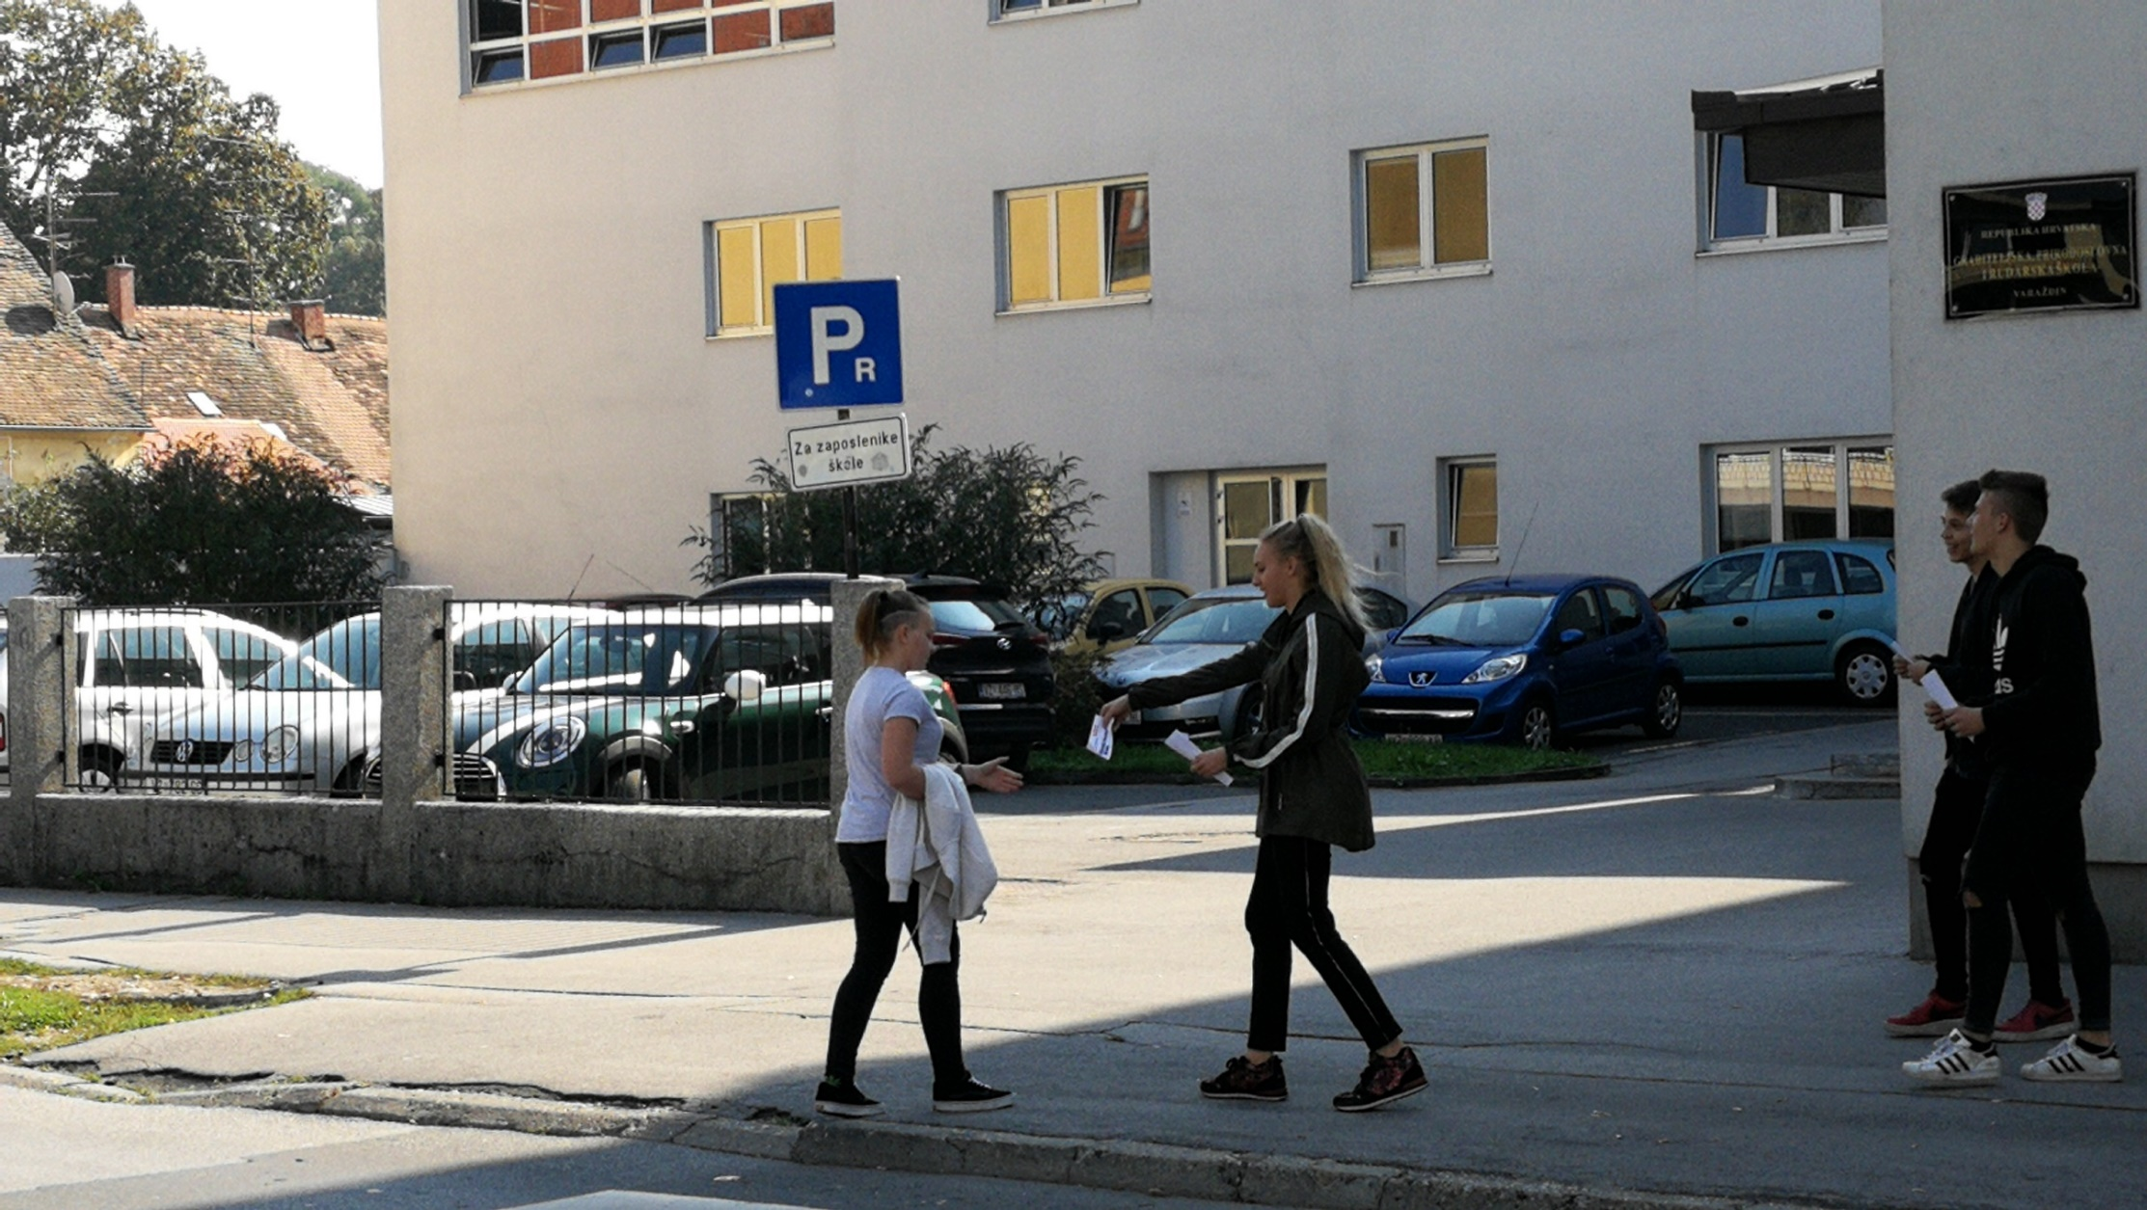
Street campain

Slide 9
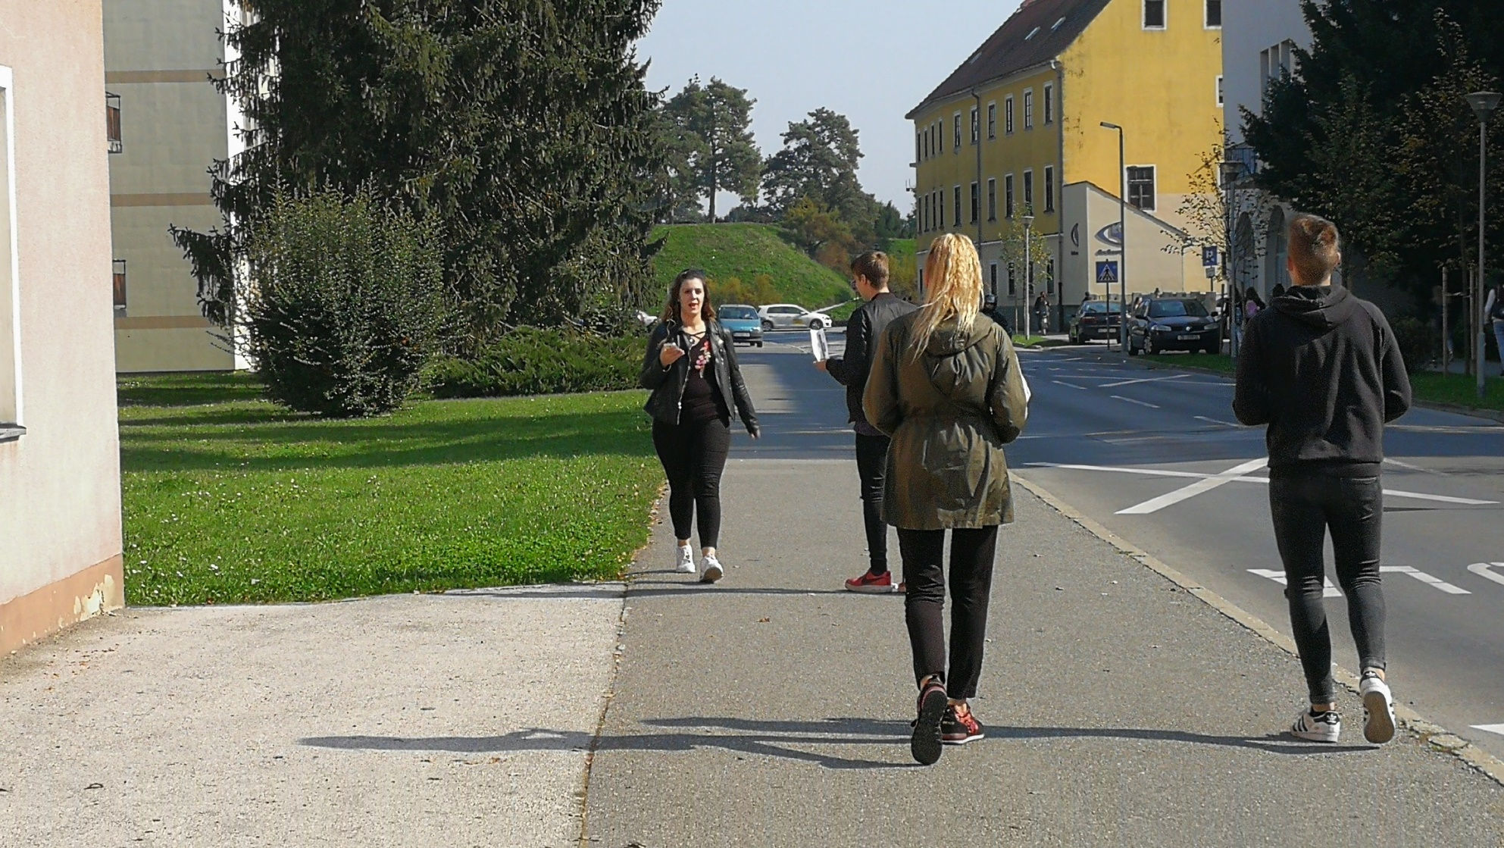
Street campain

Slide 10
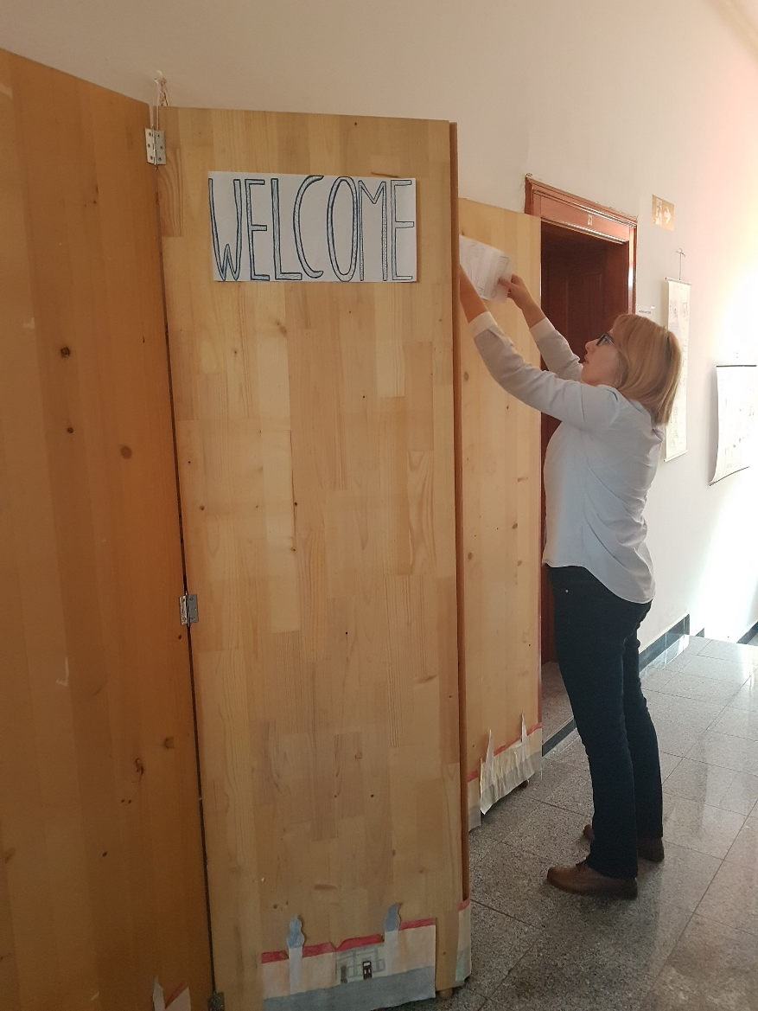
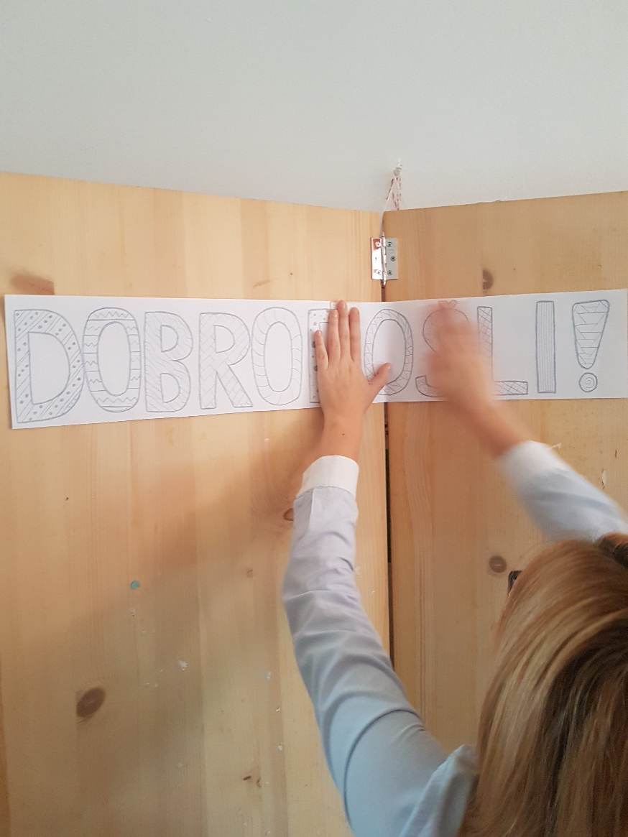
Erasmus+ corner exibition

Slide 11
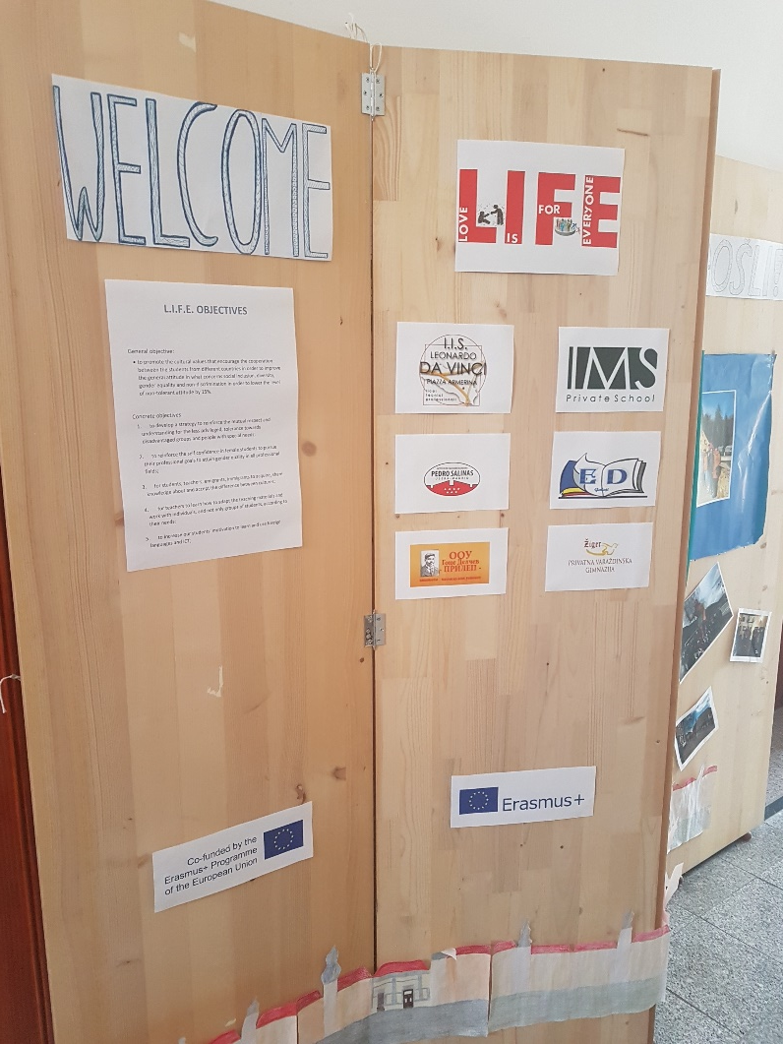
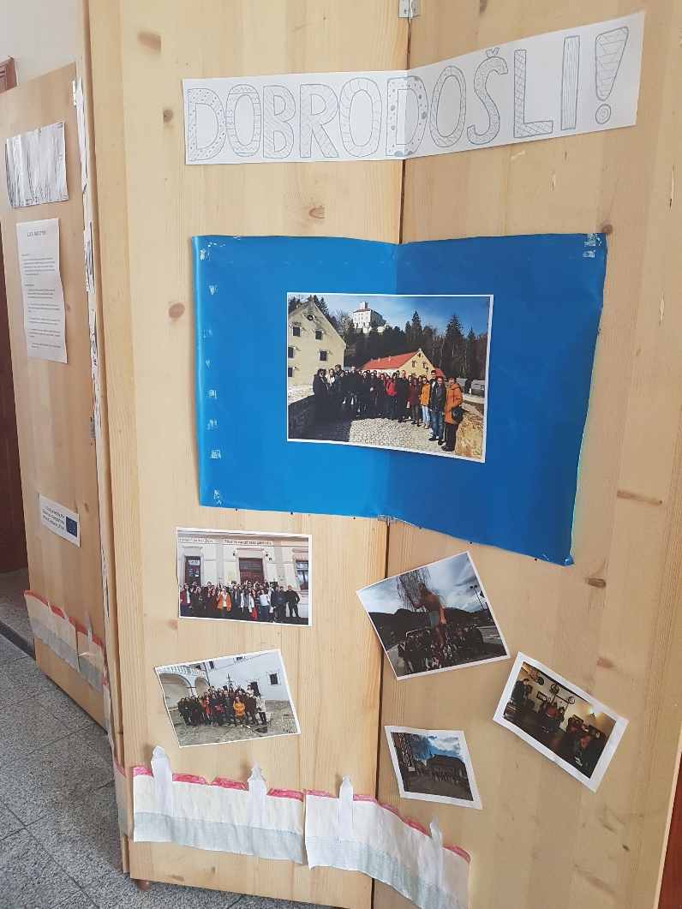
Erasmus+ corner exibition

Slide 12
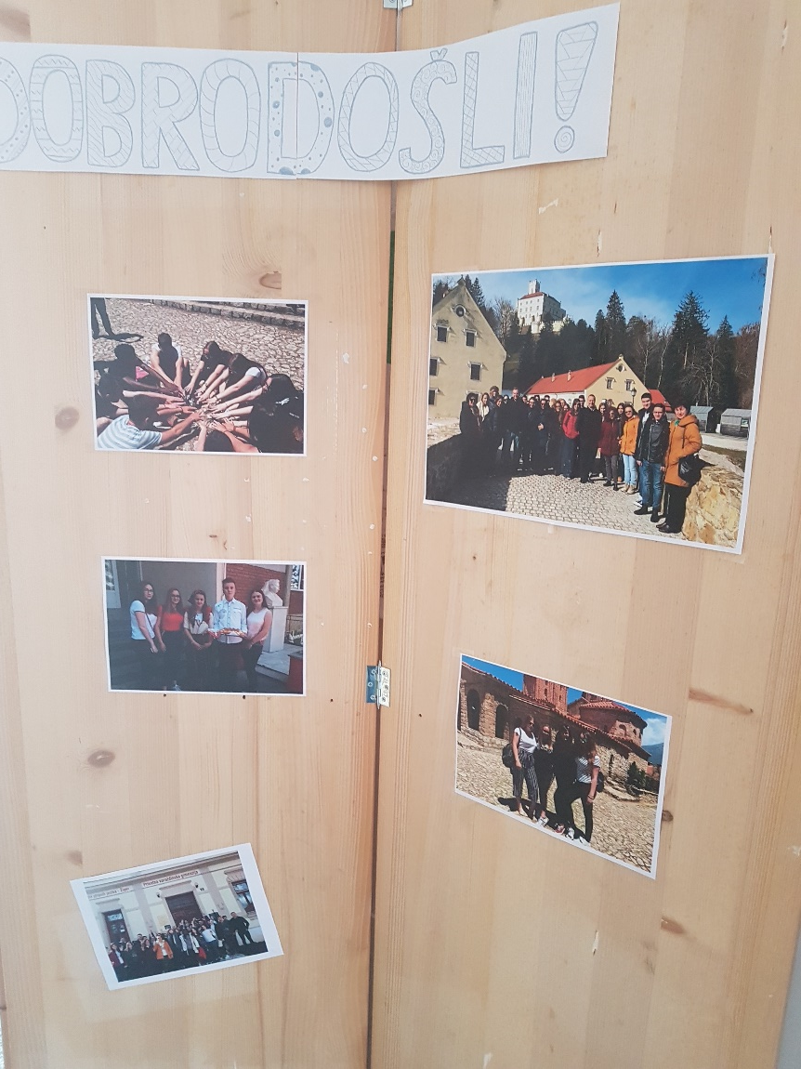
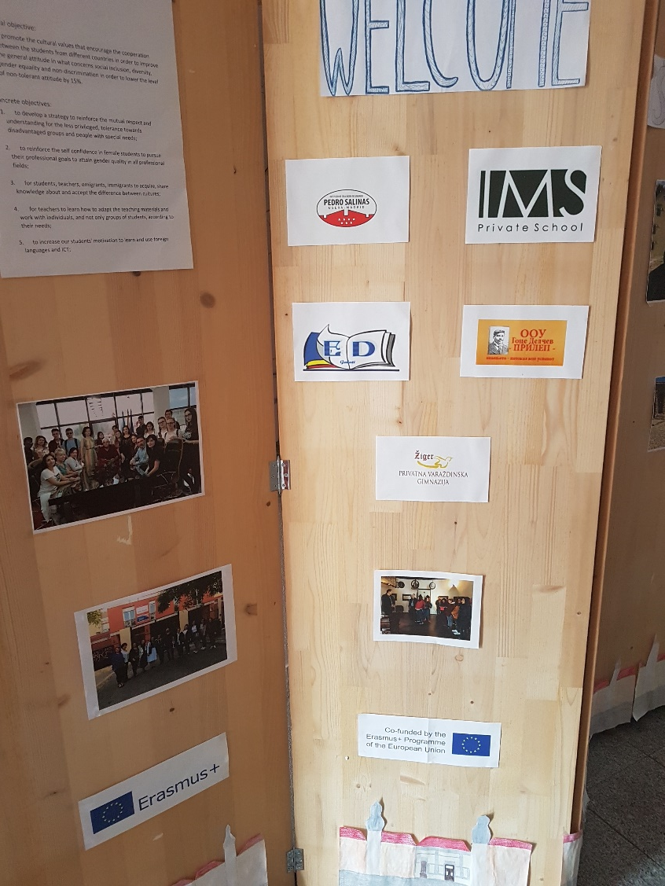
Erasmus+ corner exibition

Slide 13
This project has been funded with support from the European Commission. This publication [communication] reflects the views only of the author, and the Commission cannot be held responsible for any use which may be made of the information contained.

