Slide 1
Life events traditions
Zrinka Premuš, Marta Marciuš, Emina Ajhler

Slide 2
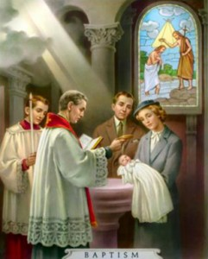
Christening
white clothes
parents choose godparents for their child (they carry a special candle)
child is soaked in Holy water
meal (dinner) after ceremony

Slide 3
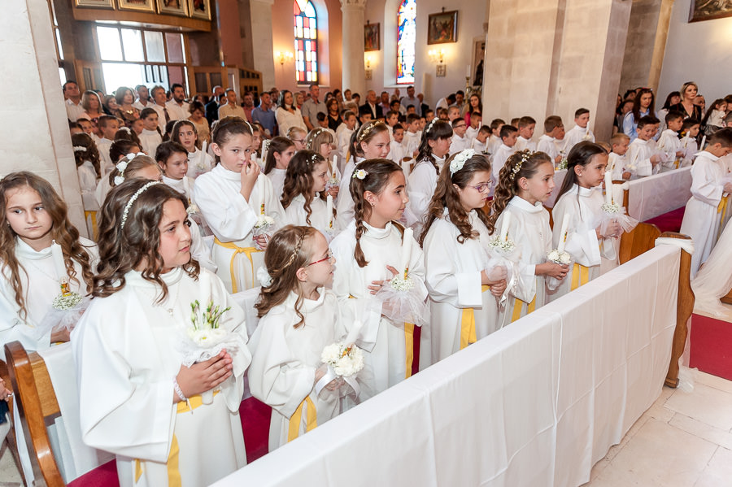
Holy Communion
third grade of elementary school
child receives sacramental bread (body of Christ)
all children wear white dresses

Slide 4
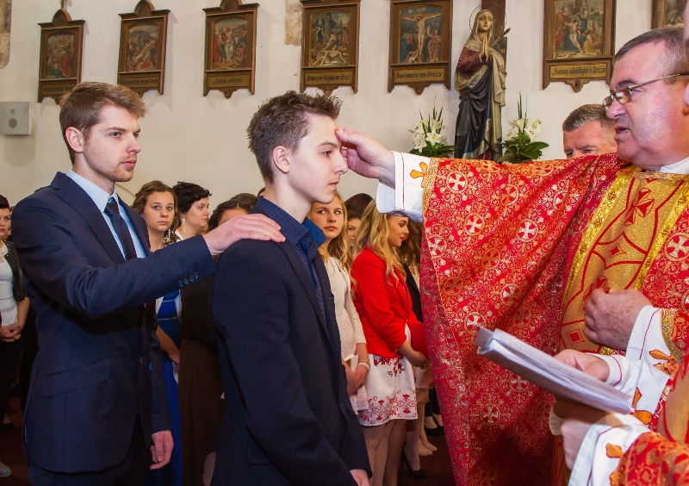
Confirmation
eight grade of elementary school
young people receive seven gifts of the Holy Spirit
they are all formally dressed
must have confirmation godfather
or godmother

Slide 5
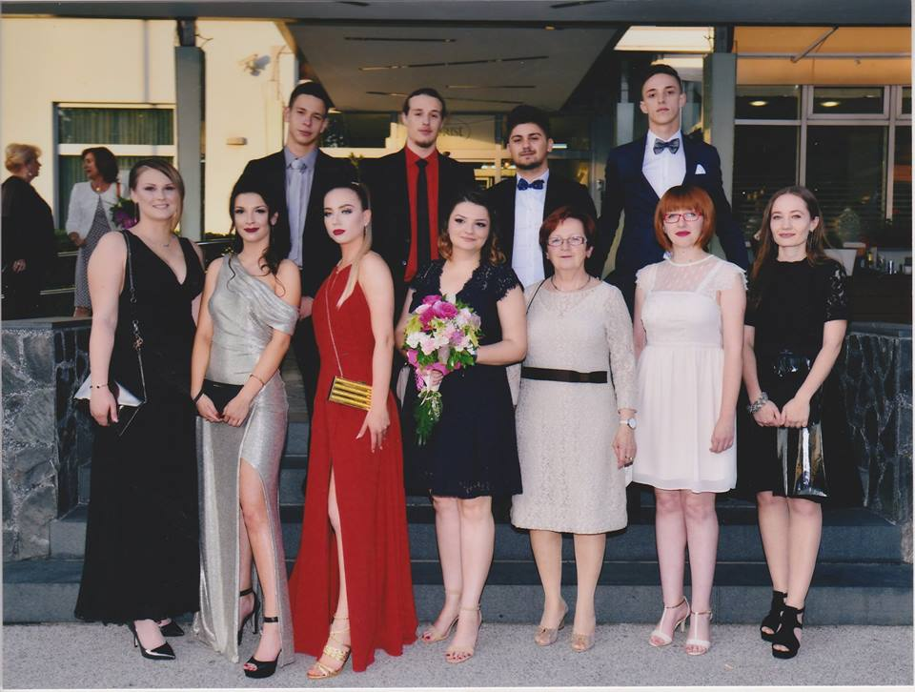
Prom
after highschool
formal dress-code
every class has a photoshoot in their dresses and suits
at the end of the day there is a party

Slide 6
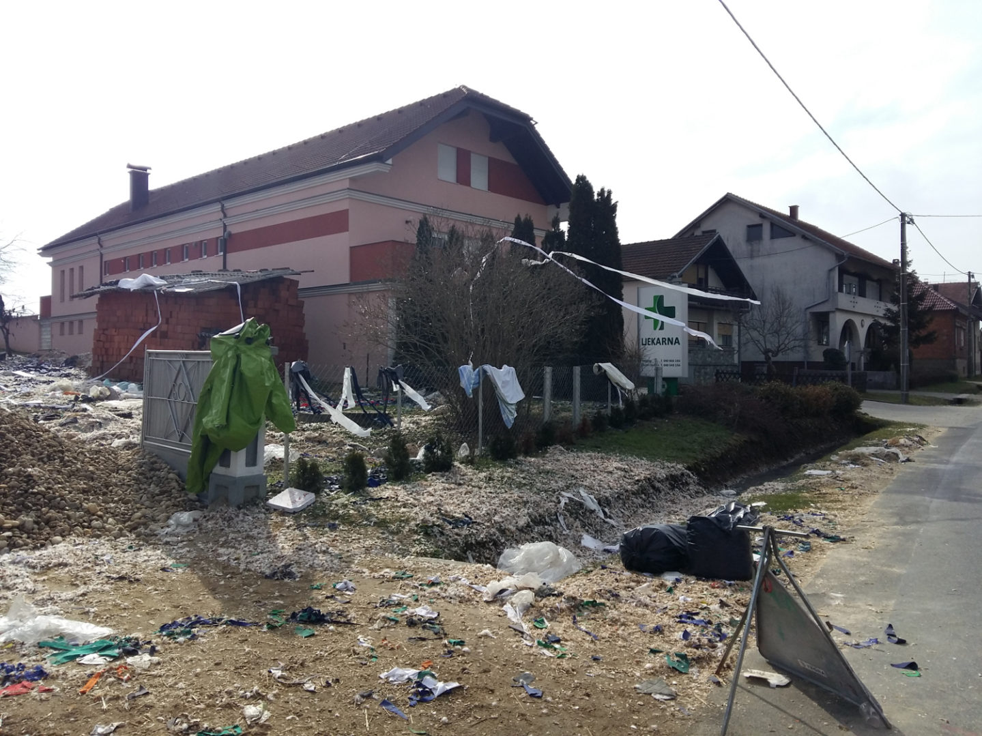
Wedding
„potepanje” – people throw feathers and garbage on the couples' yard
after ceremony people throw flower petals or rice on the newly married couple
bride and groom feed each other with cake
groom takes off brides garter blindfolded with his teeth

Slide 7
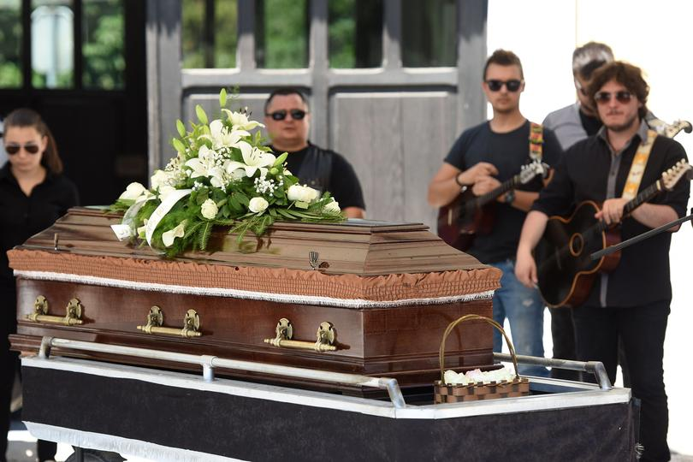
Funeral
everybody is dressed in black
everybody brings wreaths
brass band plays at the funeral

Slide 8
This project has been funded with support from the European Commission. This publication [communication] reflects the views only of the author, and the Commission cannot be held responsible for any use which may be made of the information contained.

