Slide 1
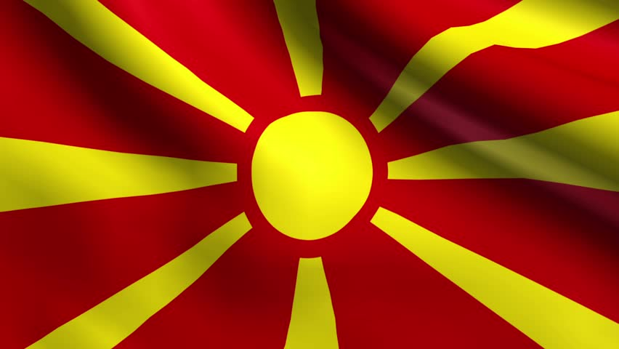
CULTURAL TRADITIONS SPECIFIC TO MACEDONIA

Slide 2
GALICHNIK WEDDING FESTIVAL
The Galichnik Wedding Festival is an annual festival held in the Macedonian village of Galichnik near the city of Debar in which a selected couple gets married in the traditional "Galichka" style wedding. Traditionally the wedding lasted for 5 days with the main activities on St. Peter's Day (12 July) every year. It was the only period of the year when couples got married. Today it is part of the festival "Galichko Leto" (Galichnik Summer) and it is a two-day event held on the weekend nearest to 12 July and it serves as a cultural and tourist attraction.
During the wedding, men dance Teškoto, symbolizing the suffering of the Macedonian people through the centuries.
Each year, couples from all over Macedonia enter a competition run by the organizers to be the couple that gets to have a "Galichka" style wedding. Every year, a new couple gets the opportunity.

Slide 3
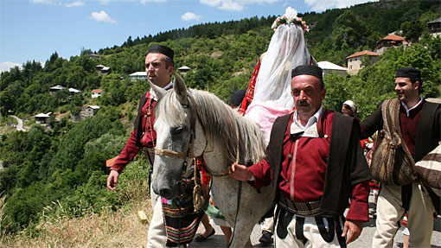
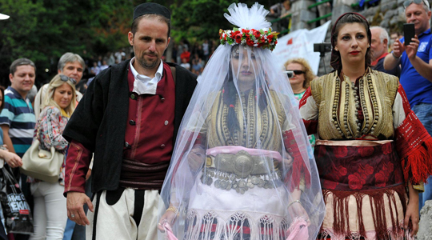
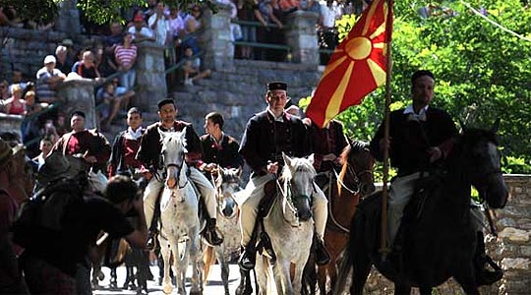

Slide 4
VEVCHANI CARNIVAL
One of the most famous village festivals held in the Balkans is the Vevchani Carnival. It is believed that the custom is over 1,400 years old. It is based on old Pagan beliefs and rituals. Essentially the Carnival is the ritual of calling after Saint Basil the Great, which coincides with the Twelve Days of Orthodox Christmas and the Orthodox New Year. The festivity is dedicated to Saint Basil the Great. Traditionally, this year from 12th to 14th January will be held Vevchani Carnival which is one of the oldest cultural events in Macedonia, which traditionally celebrates the arrival of the New Year according to the old calendar. The participants of the Carnival are known as “Vasilichari”. Vevchani Carnival as an event unites all forms of expression of our traditional culture, transforming the needs of contemporary society, treating topics from today. The annual carnival is a mix of pagan customs translated into modern language.

Slide 5
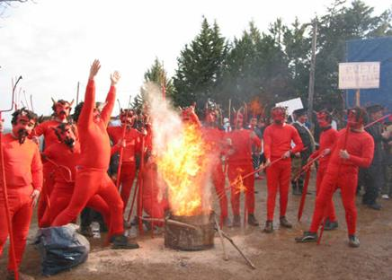
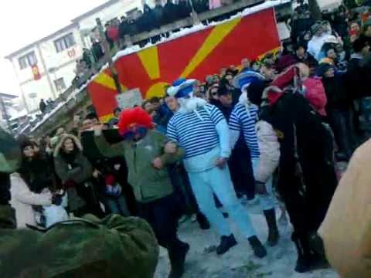
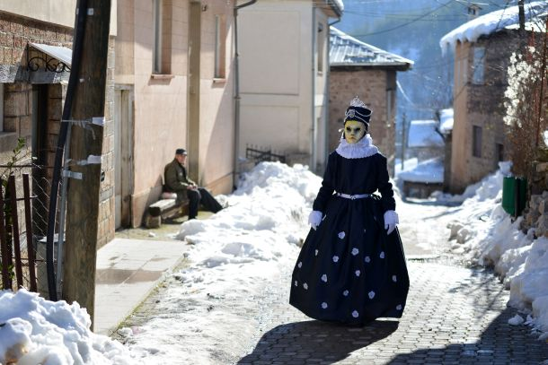

Slide 6
Macedonian national costumes
Macedonian national costumes are part of the material culture of the Macedonian people and they are important branch of the Macedonian folk art. Macedonians wore 70 different types of national costumes, depending on the region where people lived, such as: Skopska Blatija, Skopska Crna Gora, Upper Polog, Lower Polog, Prilep-Bitola Plain, Upper Prespa, Lower Prespa, Ohrid Plain, Struga Plain, Drimkol, Malesija, Mariovo, Ovche Pole, Maleshevo and many others. Every type of folk costume has its own characteristics, but common for all is the presence of the red, black and the white colour and the geometrical shapes on it.

Slide 7
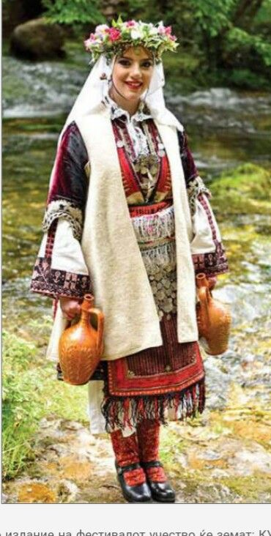
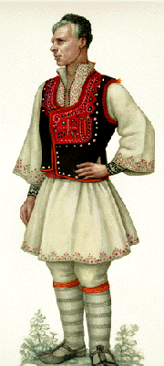
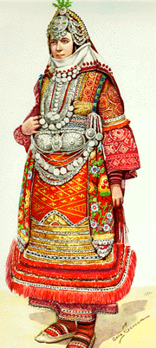
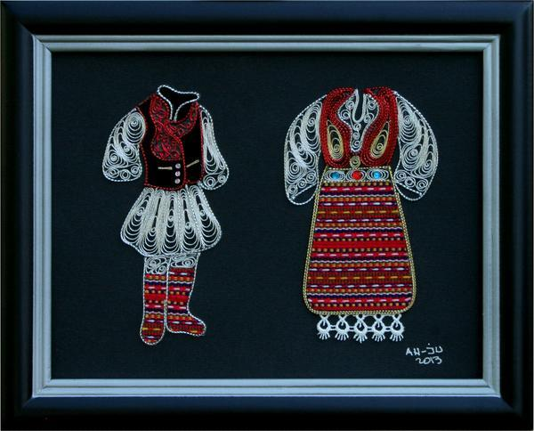
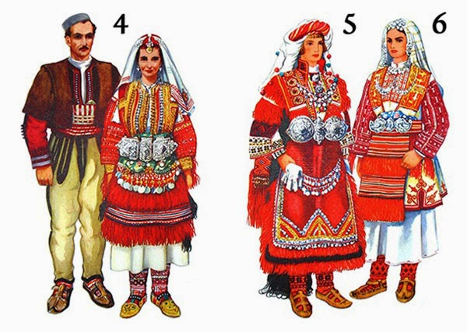

Slide 8
MACEDONIAN TRADITIONAL FOOD
Macedonian cuisine an aspect of Balkan cuisine, is the traditional cuisine of the Macedonia. It reflects Mediterranean and Middle Eastern influences and shares characteristics of other Balkan cuisines. The relatively warm climate of the country provides excellent growth conditions for a variety of vegetables, herbs and fruits. Macedonian cuisine is also noted for the diversity and quality of its dairy products, wines, and local alcoholic beverages, such as ”rakija”. Tavche-gravče and mastika are considered the national dish and drink of the Republic of Macedonia.

Slide 9
TRADITIONAL MACEDONIAN MEALS ARE:
AJVAR
SHTIPSKA PASTRMAJLIJA
TAVCHE GRAVCHE
PRILEPSKI SHIRDEN
TURLI TAVA
KEBAPI
STUFFED BELL PEPPERS
MALIDZANO

Slide 10
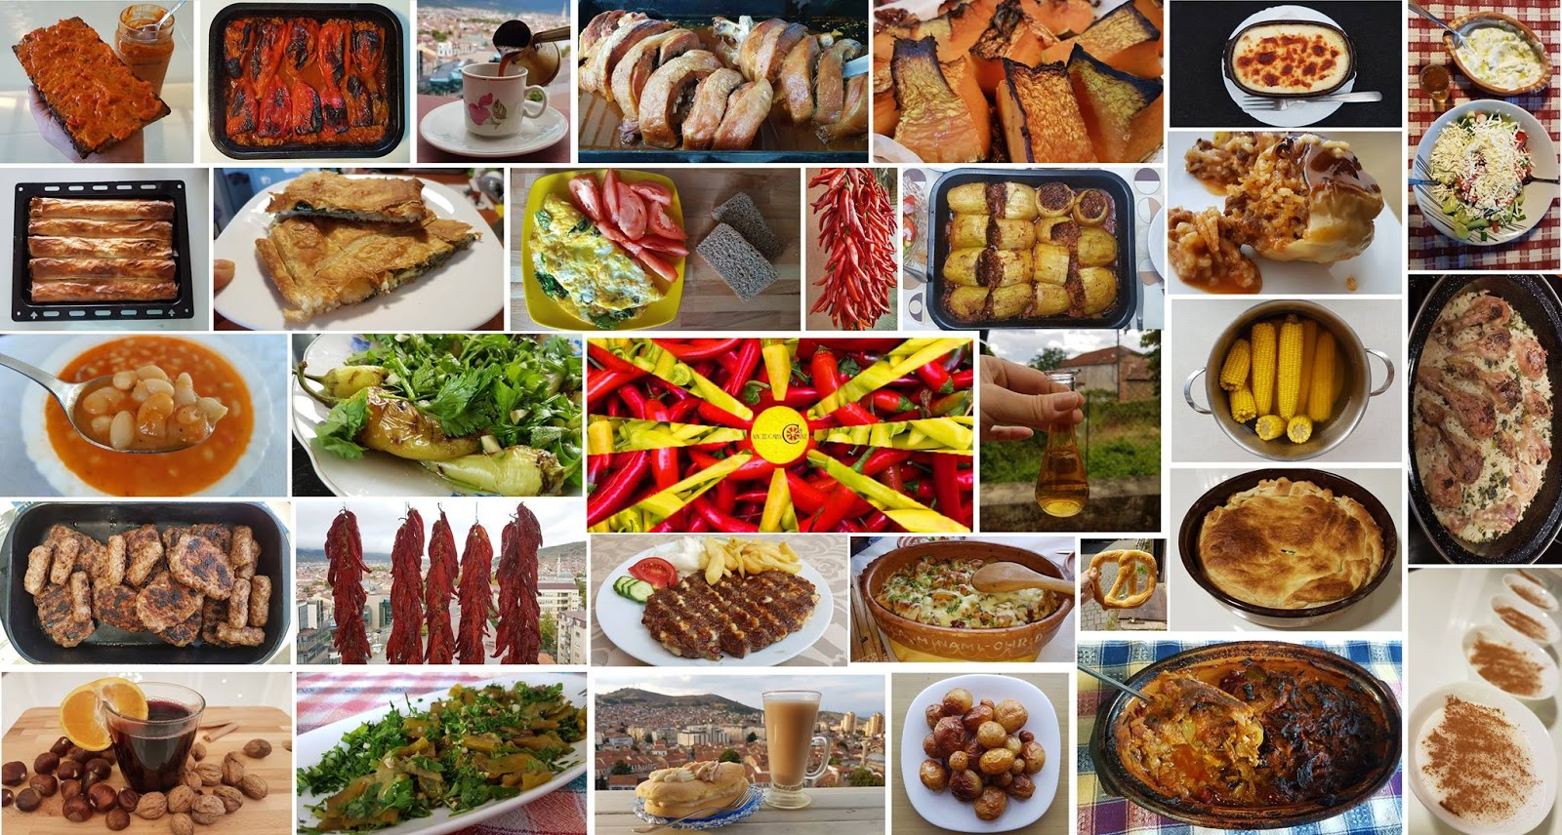

Slide 11
ILINDEN
Ilinden or St. Ilija - a great Macedonian national and Orthodox holiday, which is celebrated on August 2. Ilinden has special significance for the history of the Macedonian people, because the Ilinden Uprising began in 1903 on August 2, and in 1944 the First Session of ASNOM was held. Today, the Ilinden tradition is intertwined with patriotic, folk and religious symbols, making Ilinden one of the most important holidays in Macedonia.

Slide 12
