Slide 1
HOUSEHOLD CUSTOMS IN MACEDONIA

Slide 2
Macedonia, officially the Republic of Macedonia, is a country on the Balkan Peninsula in Southeast of Europe. It is one of the successor states former Yugoslavia, from which it declared independence in 1991. It is famous for its natural lakes, rivers, marble, mines, tobacco e.t.c

Slide 3
Religion in Macedonia

Slide 4
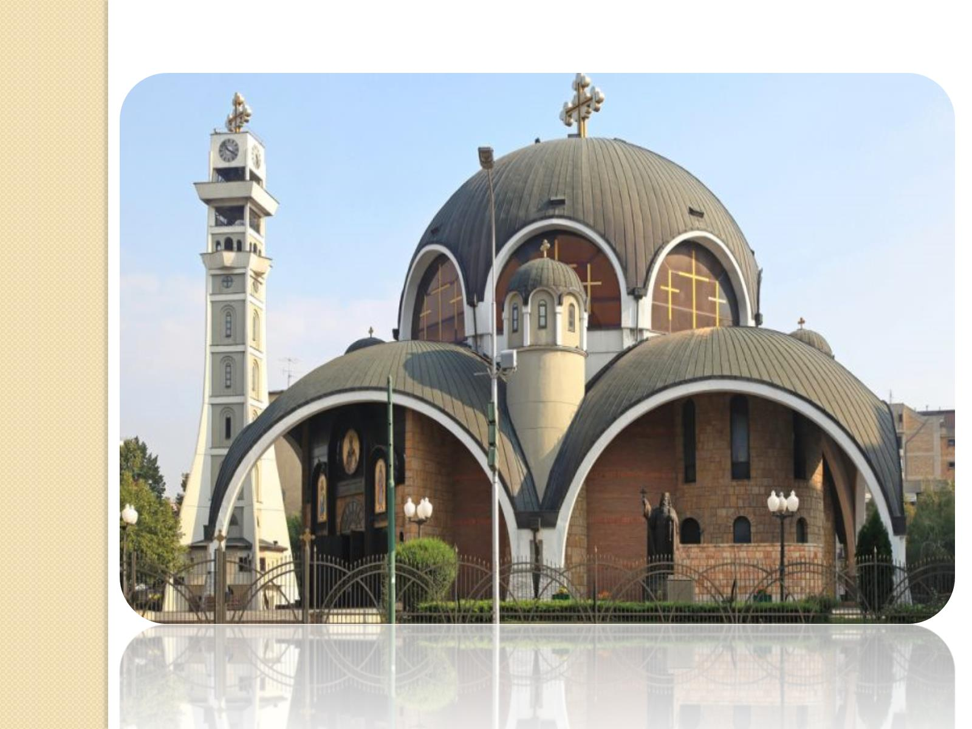

Slide 5
Households in Macedonia

Slide 6
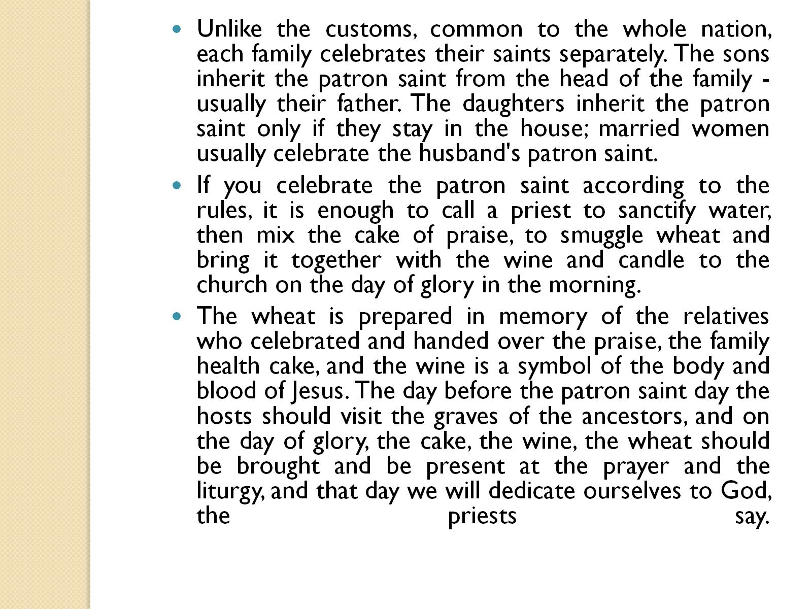

Slide 7
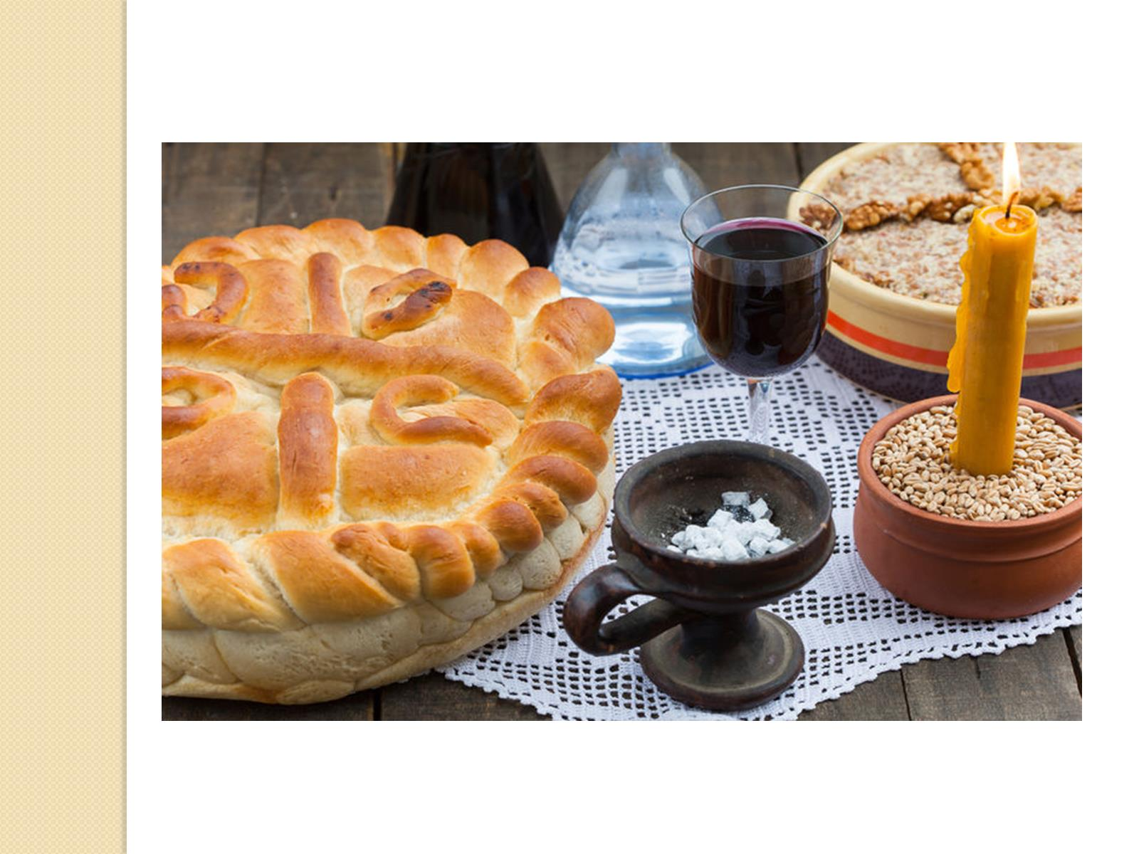

Slide 8
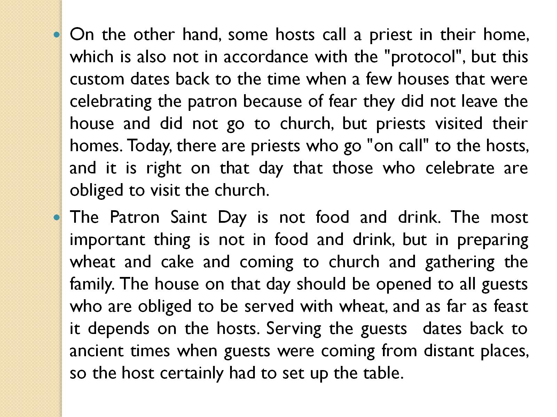

Slide 9
The way of cooking SARMA:

Slide 10
Here is a photo of our famous sarmas

Slide 13
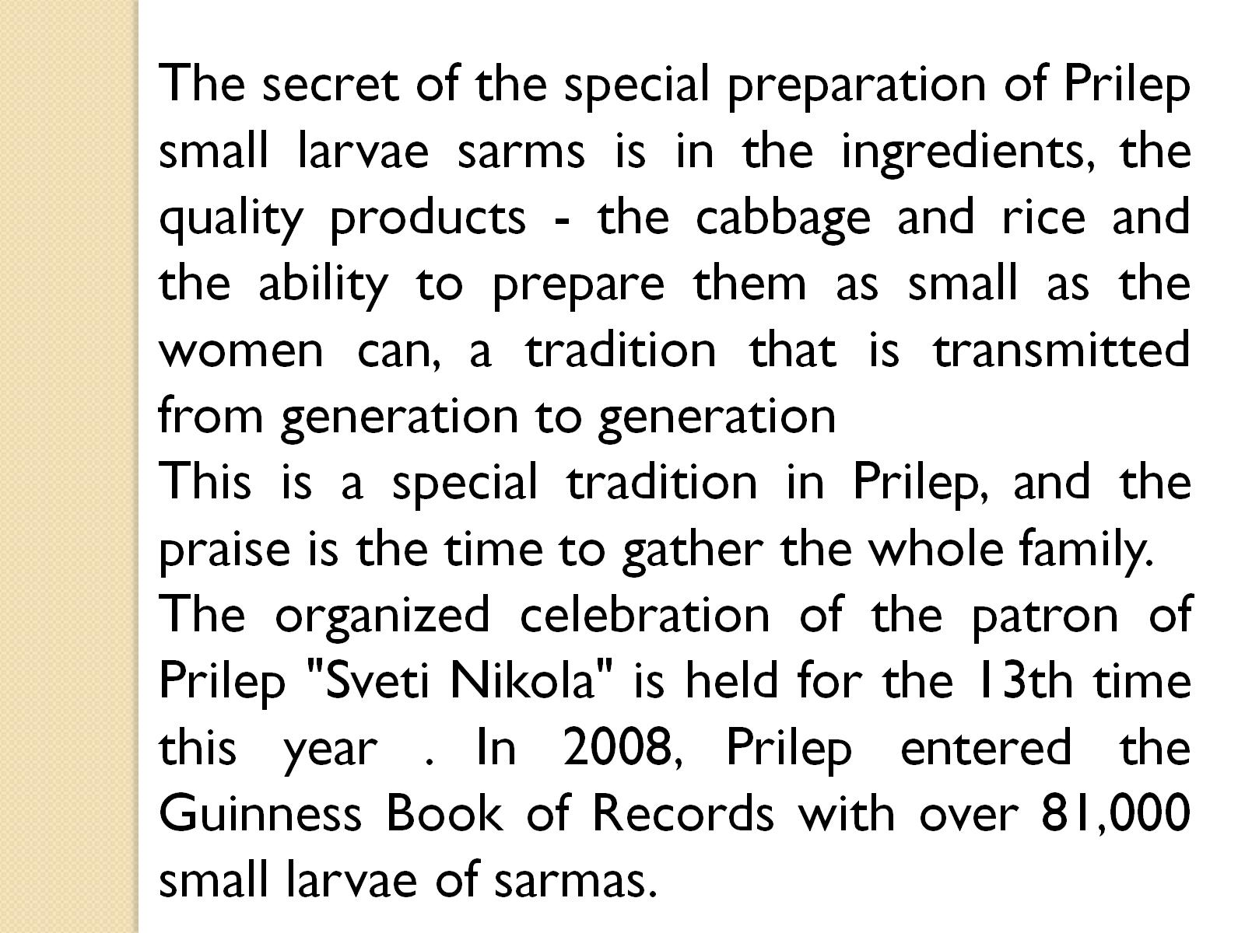

Slide 14
EPIPHANY

Slide 15
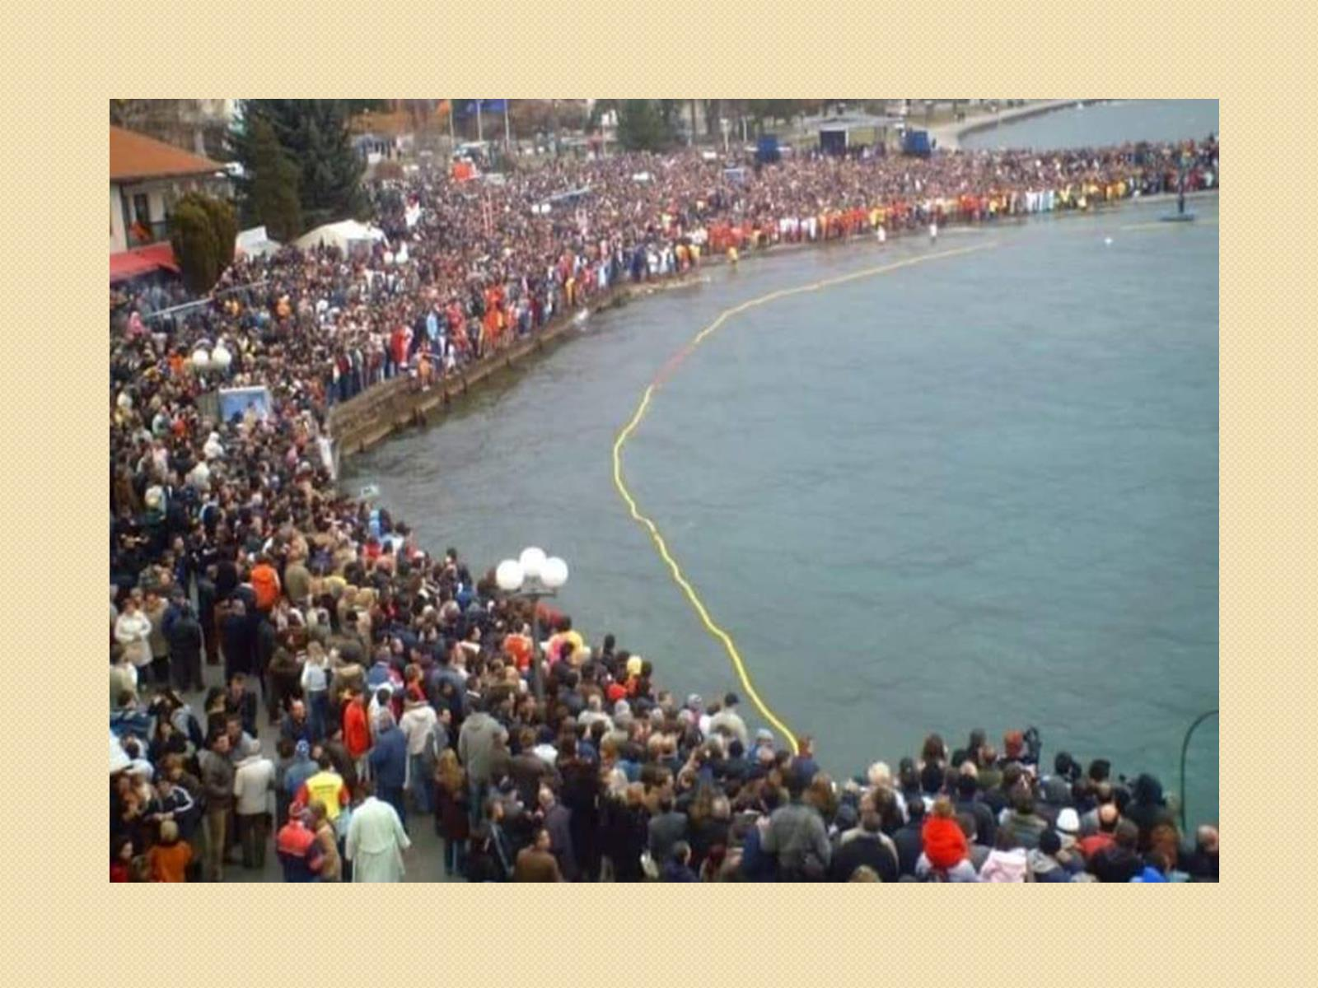

Slide 16
THIS IS HOW THE CROSS IS THROWN IN THE LAKE

Slide 17
Baptism

Slide 18
When he was 30 years old, Jesus came to the river Jordan and was baptised by St.John.

Slide 19
While Jesus was Baptized , the Holly Spirit came from the sky in dove, but from the heavens chucks “this is my Son who is in my will”. This is the calling from St.Third. The Son was Baptized, The Father publishes, and the Holly spirit is coming down from the Sky.

Slide 20
WORKED OUT BY:

