Slide 1
Dissemination activities
LIFE – Love is for Everyone
Erasmus+ kA219

Slide 2
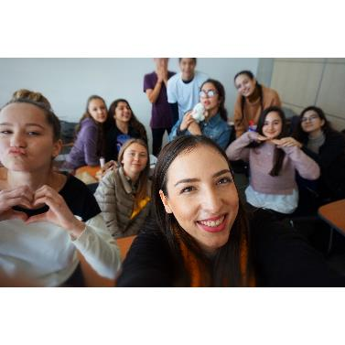
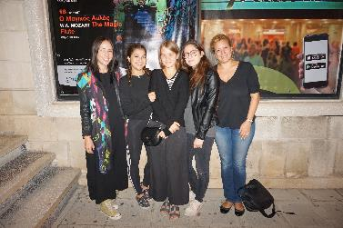
LiterarY Circles
Notes:
Our Literature Lessons = Literary cicles
Texts are about female empowerment & Society / purple hibiscus / handmaids tale etc.
Go to the theatre and watch plays that are taught

Slide 3
Charity Event: Giving Is Receiving
All proceeds will go to people with financial difficulties
Notes:
This year, the theme of your Fundraiser, will be ‘Giving is Receiving’ which is very fitting for the Erasmus project.
Students and teachers will provide material and students/teachers/parents will be encouraged to buy
The title is fitting to the Erasmus project goa;s

Slide 4
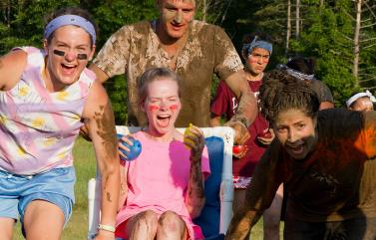
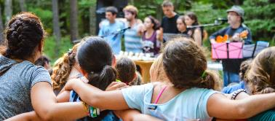
Let’s Play together
Notes:
During the summer break – we organized a day out in the mountains between some of our students and some special needs students from an institution in Limassol
During that day, we organized a variety of team building activities which aimed at promoting inclusion – games, singing and relay races.
What we learnt?

Slide 5
Erasmus+
Eramsus corners all around the school
Visible by students & Guests daily
Notes:
And we are also involved in cultural and social Erasmus projects just like this one, L.I.F.E. and "Tell Us About Yourself which aims at Exploring and Celebrating Ethnic and Cultural Diversity in Schools and Local Communities Across Europe.

Slide 6
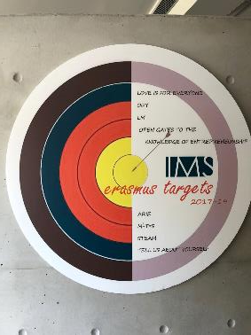
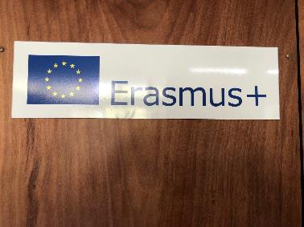
Erasmus+ &
Notes:
Through all these projects we try to remain connected to our European identity through multiple disciplines and culturally, socially, & technologically wide the horizons of our students, especially since 42% (as seen in the questionnaires) consider themselves as migrants – thus it is vitally important for us to enrich their individual cultural identities

Slide 7
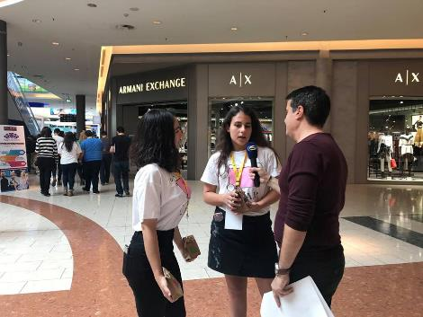
Leaflet Campaign
Gave out leaflets and informed people of our ERAMUS+ project

