Slide 1
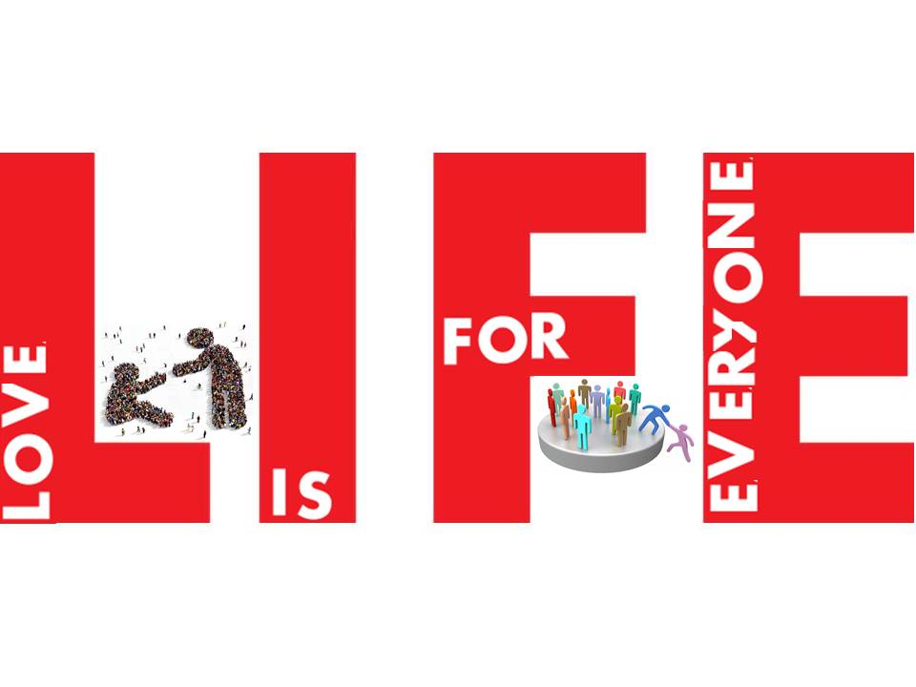
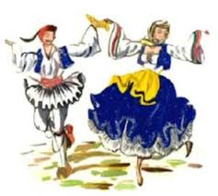
Traditional Cypriot Costumes
LIFE – LOVE IS FOR EVERYONE
ERASMUS+ KA219

Slide 2
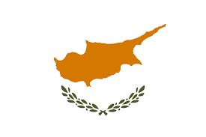
Generally. . .
The Cypriot clothing offered comfort, beauty and grace to those wearing it.
Traditional costumes are a fundamental fragment of the Cypriot culture.
They reflect the lifestyle and habitual behaviour of the people.
The designs and fabrics used for the clothes revealed the social class of the owner.
The materials used to produce traditional Cypriot clothing were cotton and silk of local production.

Slide 3
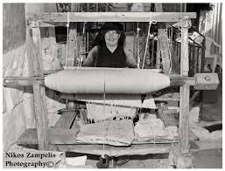
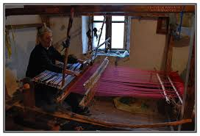
Womens’ Garments
Made from a fabric called ‘Alatzia’, which basically was cotton .
Every item was made by the women themselves on the ‘Argalio’ or ‘Voufa’ (an instrument used to make fabric).

Slide 4
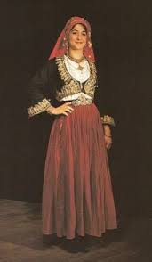
The cotton was dyed by the women themselves.
Just like men, rich women had the economic ability to make outfits from silk, not just cotton.
The skirt had many folds, for the purpose of making it as loose as possible in order to conceal the woman’s figure. In addition it was so long it usually touched the ground, something that made the outfit less practical and efficient in terms of walking.
The shirt worn inside the main dress was long sleeved so as to hide as much of the woman’s skin as possible.
The hair was braided and covered with a piece of cloth- ‘mantili’- that was hand-stitched by the woman herself. The mantili had to cover the braided hair and ears well.

Slide 5
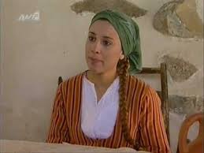
The outer part of the outfit was the ‘alatzia’, that made of cotton,and usually had a white base with vertical stripes of either deep red, blue, orange or green colour

Slide 6
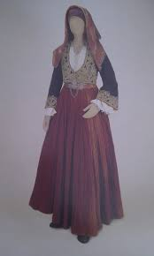
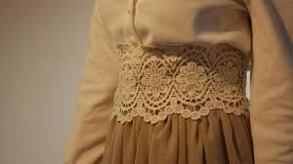
Even though the skirt was loose to conceal the bottom half of the figue, the waist was tied with a cloth, usually lace, to create a feminine effect.

Slide 7
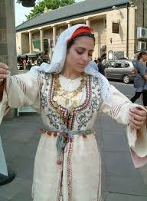
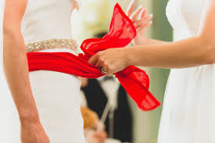
As for the wedding outfit, poor women usually wore their everyday dress but with a red mantili, so that the bride would stand out, and plenty of jewellery.

Slide 8
Mens’ Garments
When thinking about Cypriot traditional outfits, the first thing that comes to most people’s minds is the ‘vraka’. This was the equivalent of trousers.
The vraka ws made of cotton, and assembled with the aid of a ‘voufa’ or ‘argalio’.
A lot of fabric was needed, in order to achieve the baggy look.
Tied around the waist was the ‘zonarin’ which was a long strand of wool serving as a belt. It’s also where men kept their wallet- ‘poutzin’ -and knife.
Accompanying the vraka were the tall boots- ‘podines’ - which were very practical considering the fact that men worked in the fields.

Slide 9
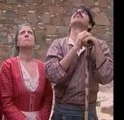
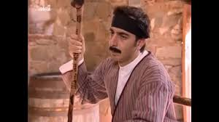
The shirt- ‘poukamiso’ - was usually dark coloured and made from cheap, fabric, but in weddings the groom would wear a white, silk shirt. Gradually, a collar was also added to the shirt.
On top of the shirt they wore a ‘gileko’ which was a dark coloured, vest decorated with embroidered details and made of either velvet or wool.
They tied on their forehead a ‘fesi/mantili’.
Shepherds and field workers also tended to hold a ‘verka’
stick on which they leaned on when tired or bored.

Slide 10
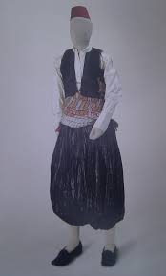
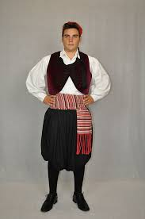
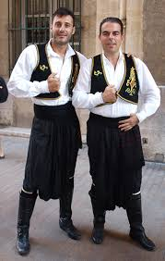

Slide 11
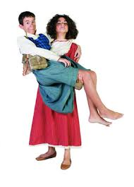
Children’s Clothing
Young children wore cotton dresses, regardless of their gender.
When they reached the age of 5-6 years old, they started to follow the same dress code as the adults.

Slide 12
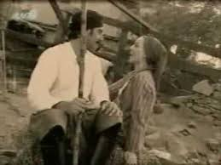
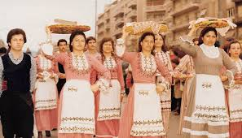
What happened to them?
These traditional outfits were abandoned at the beginning of the 20th century.
This was mostly a consequence of the British domination because at that time a large amount of cheaper clothing was imported into Cyprus. It was easier to buy clothes rather than make them on the argalio.

Slide 13
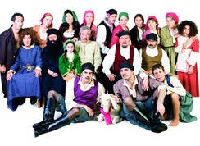
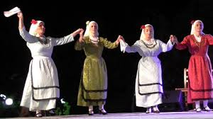
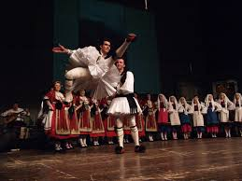
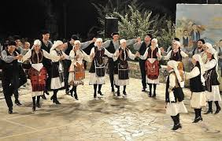

Slide 14
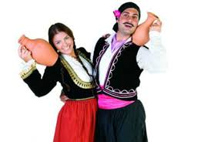
Thank you!

