Slide 1
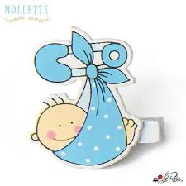
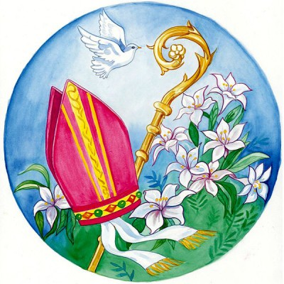

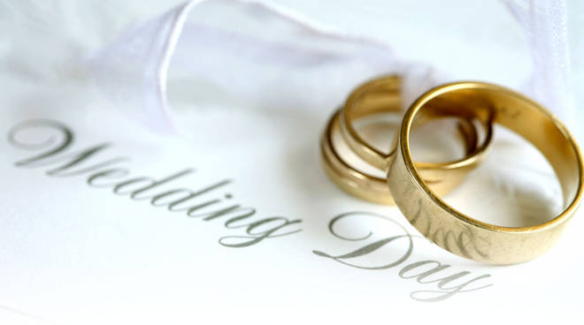

EVENTS
TRADITIONS

Slide 2
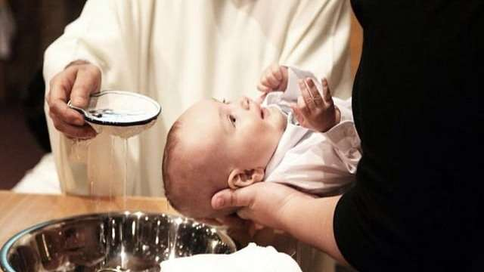
What is the Baptism?
Christian Baptism is considered a sacrament, it is the immersion of a believer in water in the name of the Father, the Son, and the Holy Spirit.

Slide 3
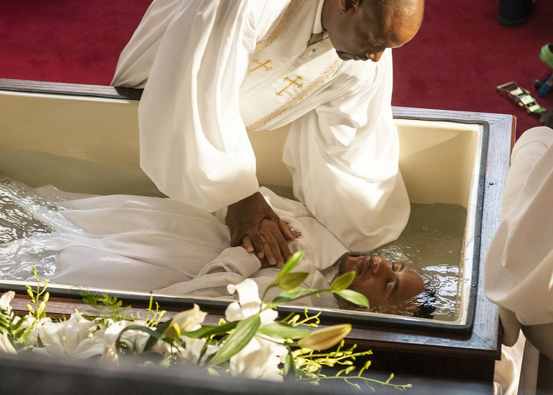
The usual form of Baptism among the earliest Christians involved the candidate's immersion, either totally or partially.

Slide 4
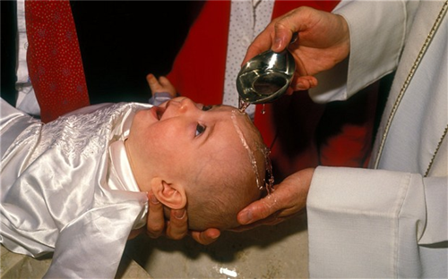
Other common forms of Baptism now in use include pouring water three times on the forehead, a method called affusion.

Slide 5
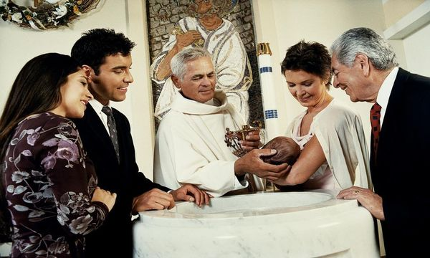
The parents choose the godmother and the godfather who have the function of accompanying the first steps of the new baptized, and above all of helping the parents in the Christian education of the child.

Slide 6
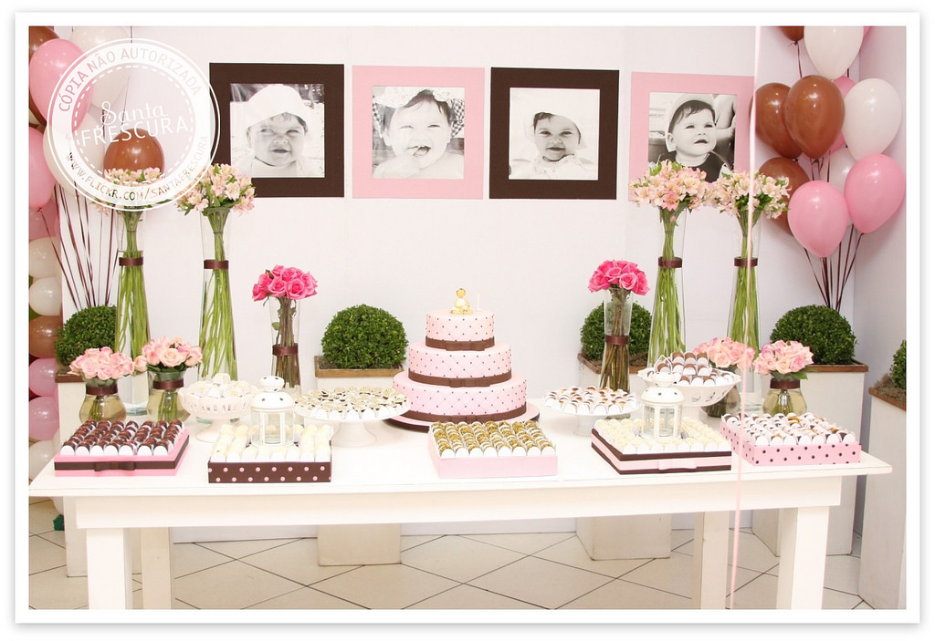
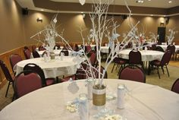
At Baptism, in addition to mum, dad, godfather, godmother and grandparents will be present uncles with their children and those who are really close to the couple and the baby.
After the ceremony the participants will be invited to their home or restaurant.

Slide 7
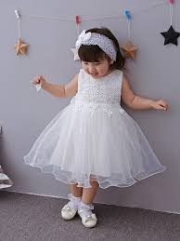
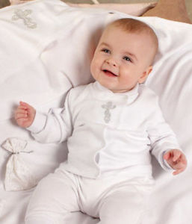
The clothing required for the guests is certainly sober: complete suit with jacket and tie for gentlemen and tailleur or suit for the ladies. During the ceremony, the baby will wear the symbolic white dress but for the remaining time he/she will be dressed according to the taste of the parents .

Slide 8
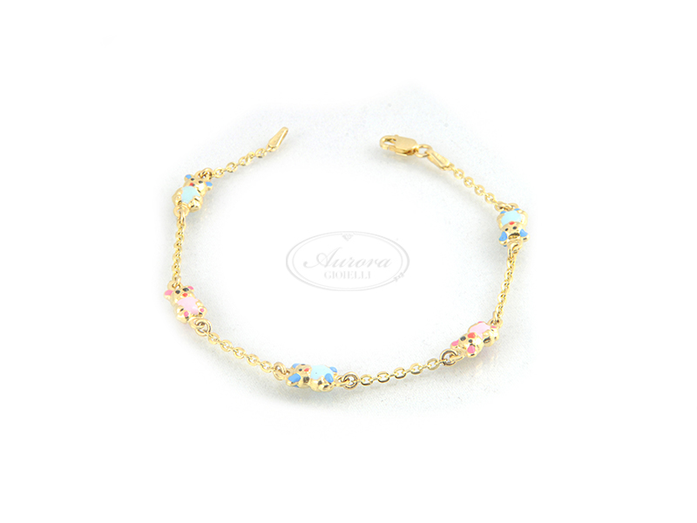
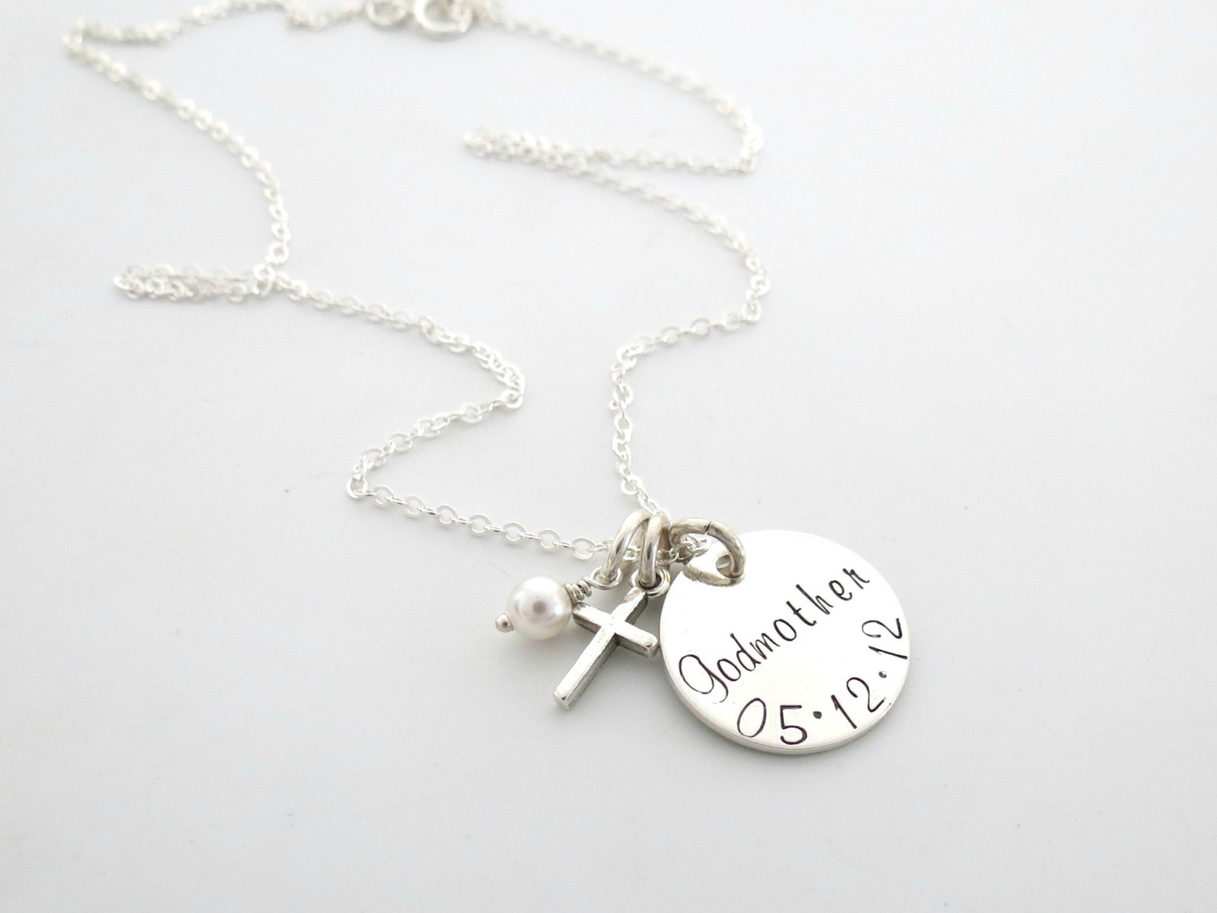
The tradition wants that the people invited to the baptism offer a gift, such as golden necklaces or other jewellery, to the child.

Slide 9
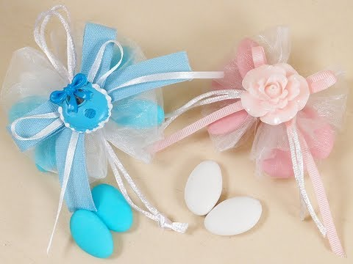
The parents will offer small bags with pink or blue
sugared almonds, according to the newborn sex, to
those who took part in the ceremony.

Slide 10
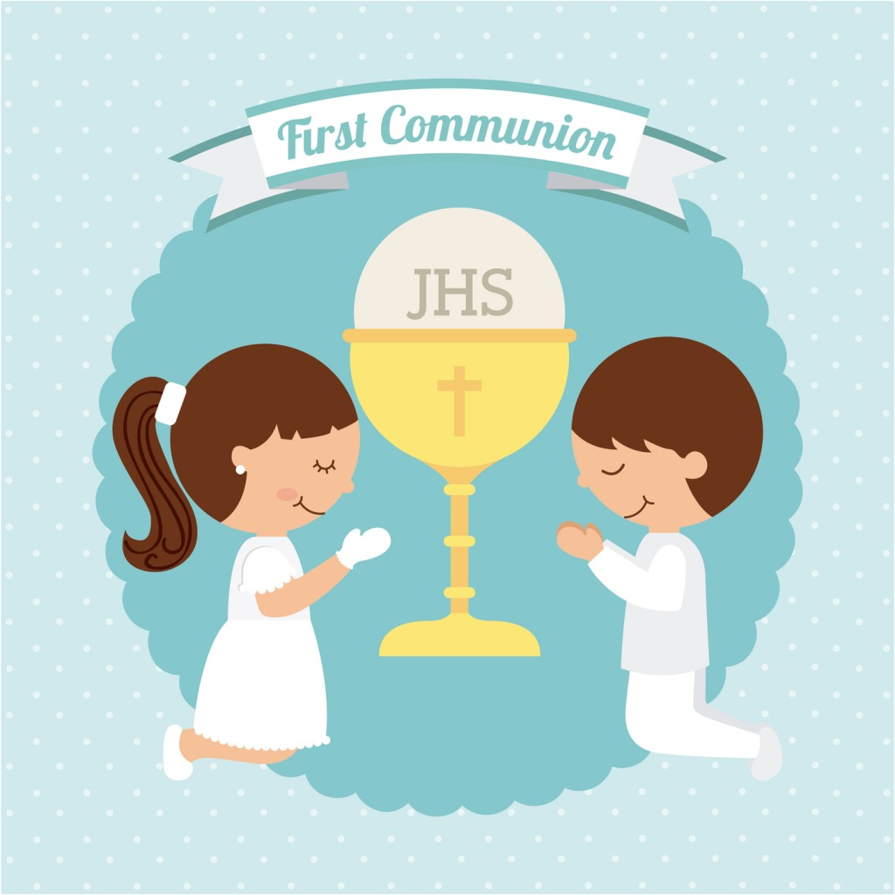

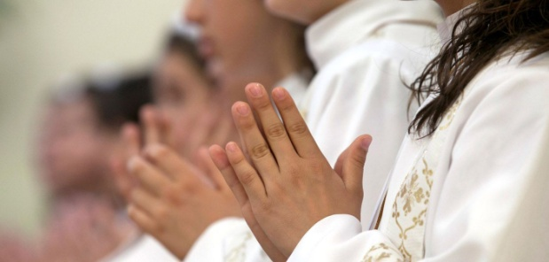
THE FIRST COMMUNION
The first communion, in the Catholic religion, is the moment when the children approach the sacrament for the first time.

Slide 11
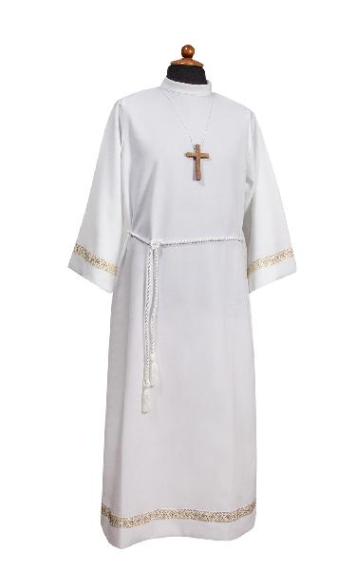
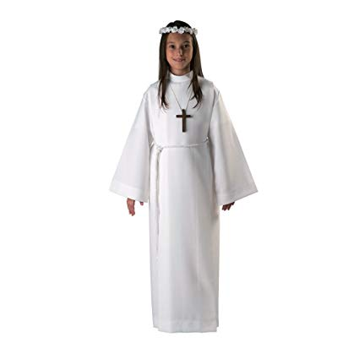
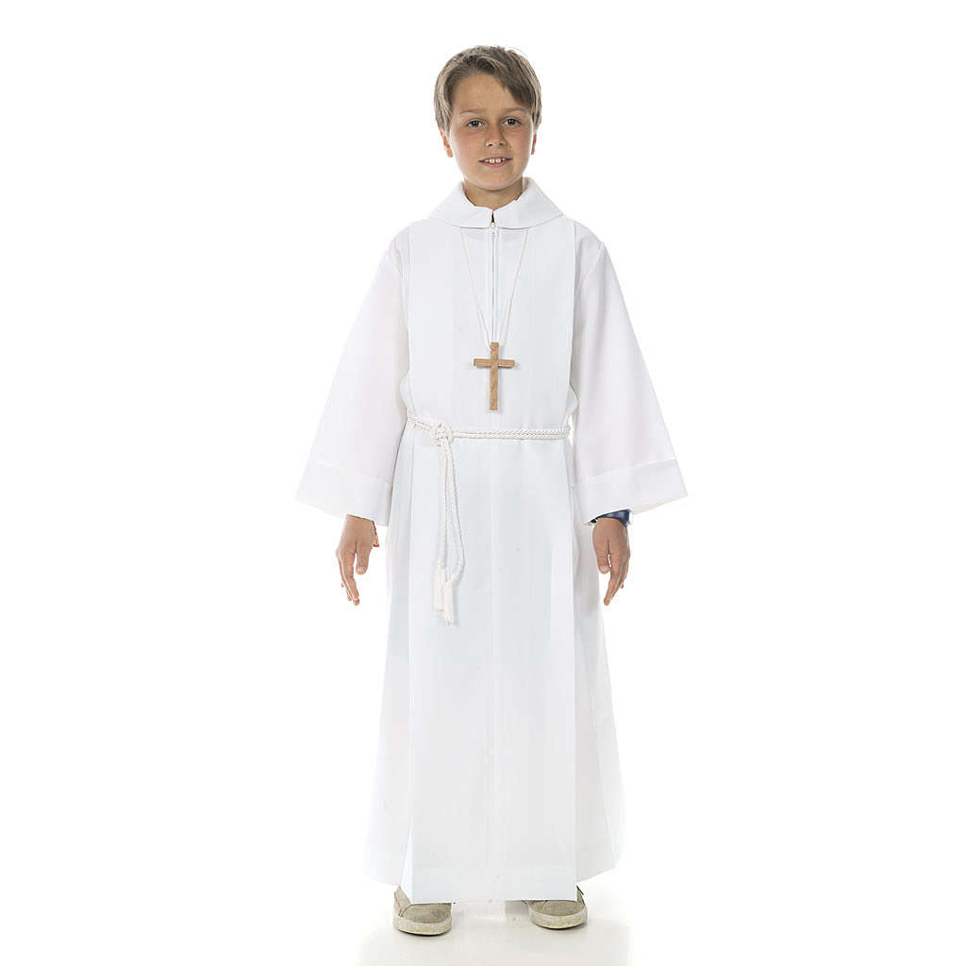
THE CLOTHES
For this event the children wear a white tunic with a cord tied to the waist and a cross at the neck.

Slide 12
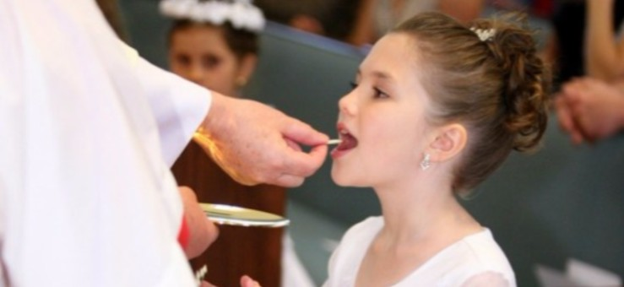
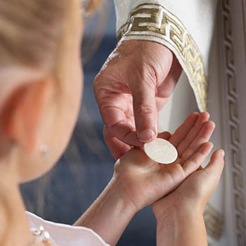
THE RITUAL
After their first confession the children are ready to receive the host of Jesus Christ at their first mass.

Slide 13
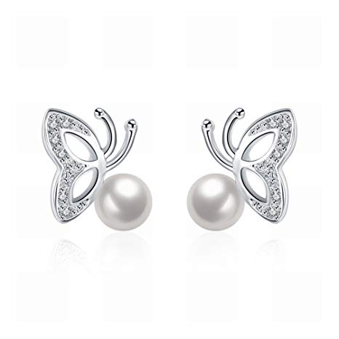

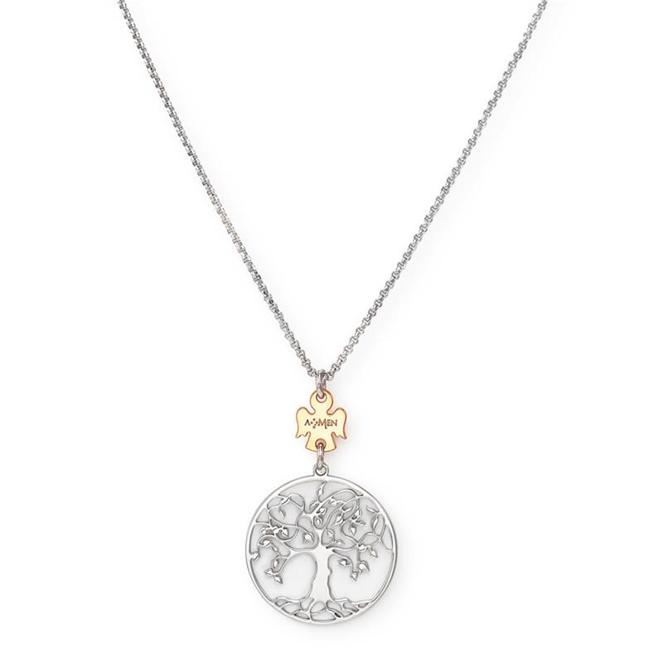
THE PRESENTS
After the ceremony, the communion is usually celebrated with relatives and friends. The guests commonly buy gifts for the children. They usually give jewelery or money.

Slide 14
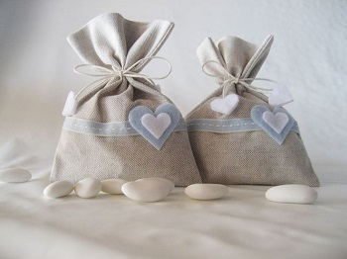
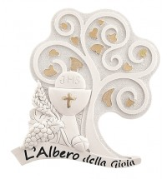
THE FAVORS
At the end of the reception, the parents thanks the guest with favors . Inside these gifts you find sugared almonds and an object symbolising the Communion.

Slide 15
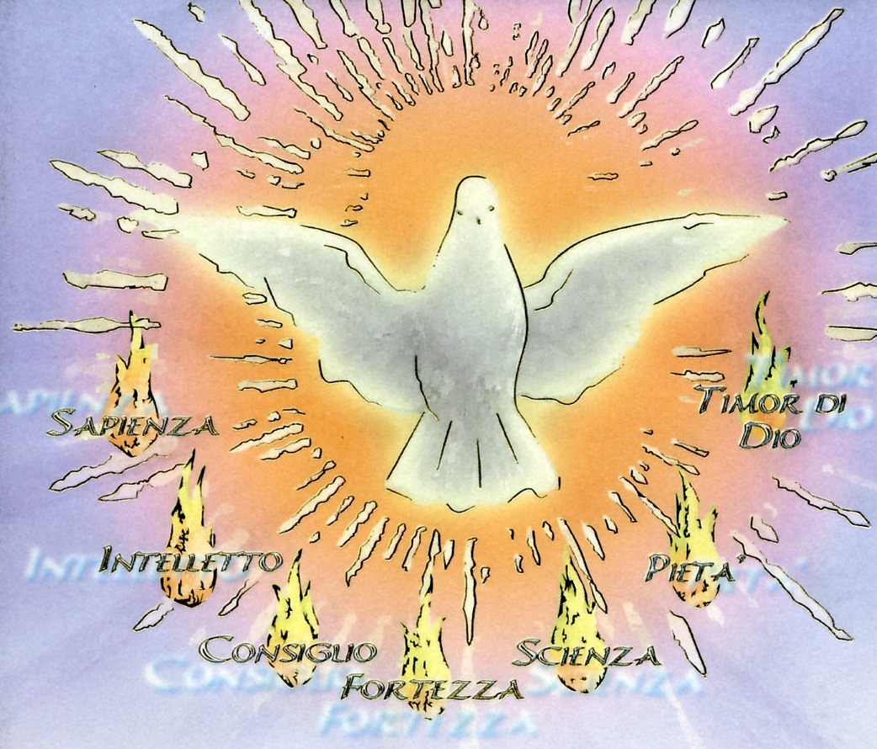
THE CONFIRMATION
The confirmation is a sacrament of the Catholic and Orthodox church that expresses the descent of the Holy Spirit on believers.

Slide 16
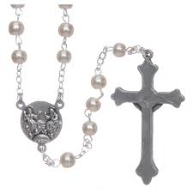
The Christians receive this sacrament because without it the christian initiation remains incomplete.

Slide 17
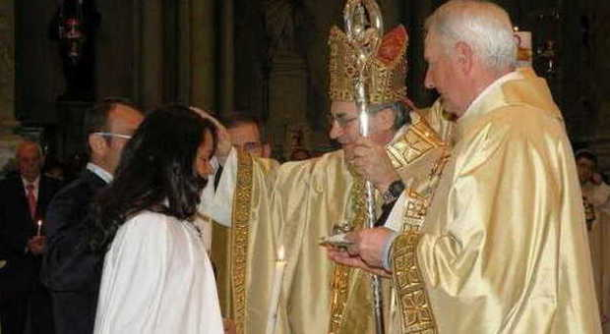
The Confirmation takes places initially as a normal mess after the homily,the baptismal promises are renewed,afterwards the bishop or the celebrant makes the laying of the hands,imposing the hands on all the confirmants who are lined up with the godparents waiting to receive the sacrament.The Holy Spirit is finally received.

Slide 18
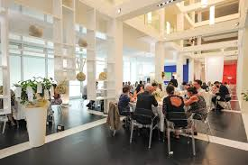
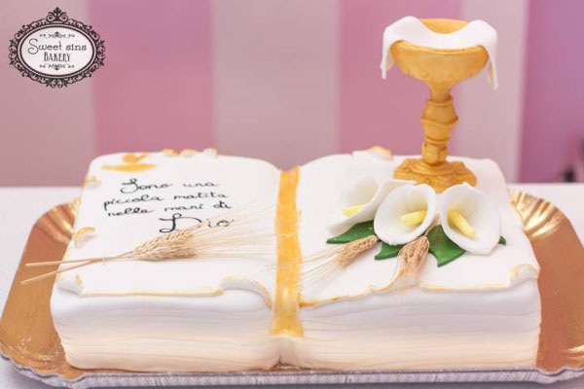
Usually after the church ritual,the celebration moves on to the restaurant with all the family.

Slide 19
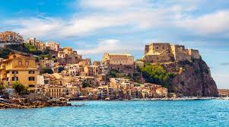
Sicilian marriage
«Ama a cu t’ama si vo’ aviri spassu, c’amari a cu nun t’ama è tempu persu»

Slide 20
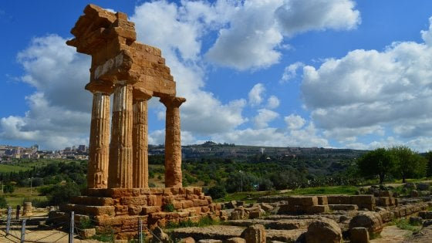
TRADITIONAL WEDDING IN SICILY
Sicily is one of the richest regions of culture, tastes and costums. This culture is fascinating not only for the people from Sicily but also for the people from around the world.

Slide 21
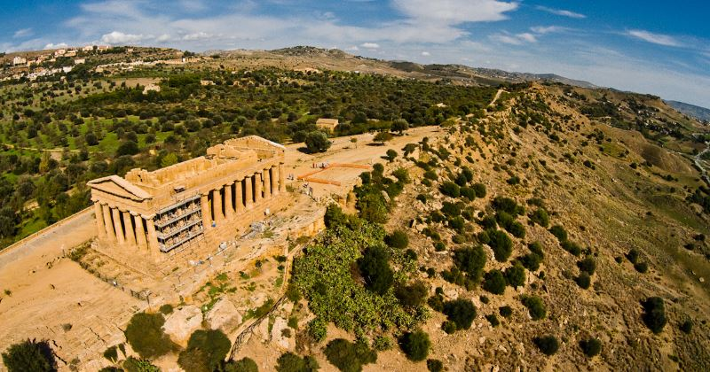
THE LOCATION

Slide 22
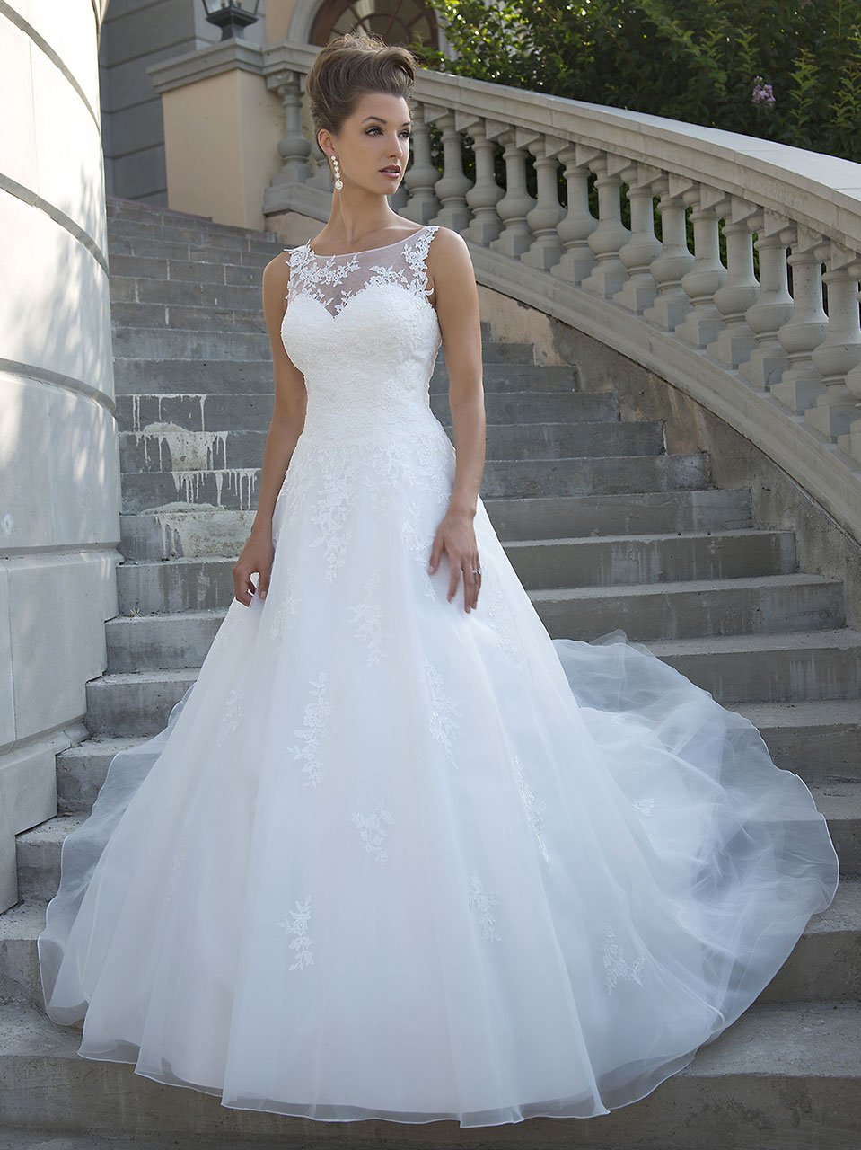
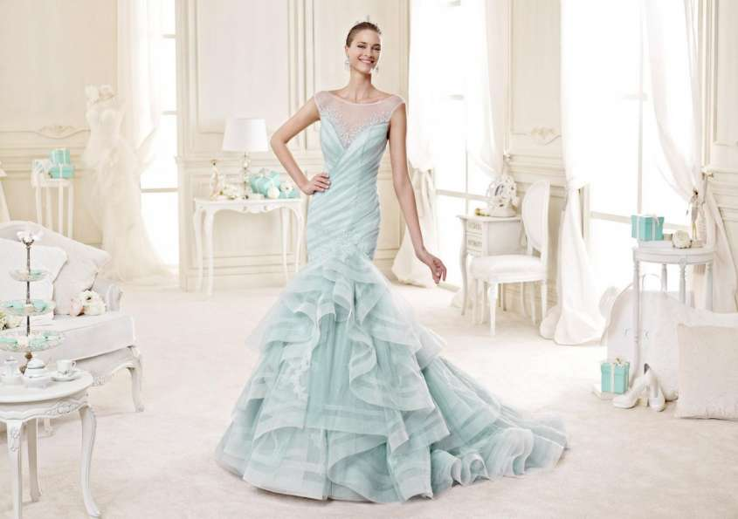
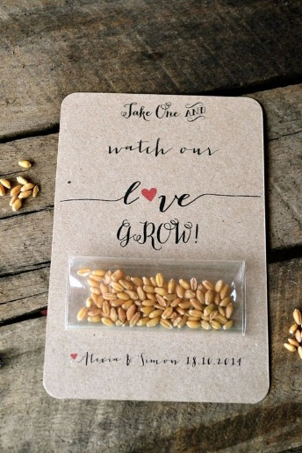
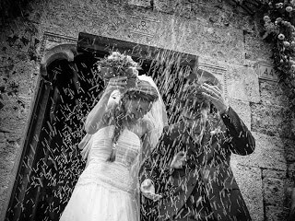
THE BRIDE'S DRESS AND OTHER CURIOSITIES.
Today the bride's is strictly white , but a nineteenth-century tradition wants that in some country the bride's dress should be light blue. Other tradition in some areas of Sicily was to pour wine in front of the newlyweds' houses , while in Mazara del Vallo instead of throwing the classical rice is thrown wheat.

Slide 23
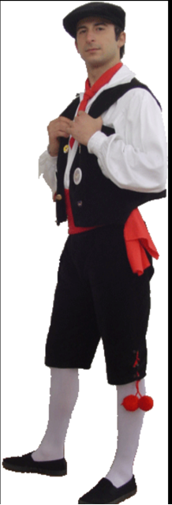
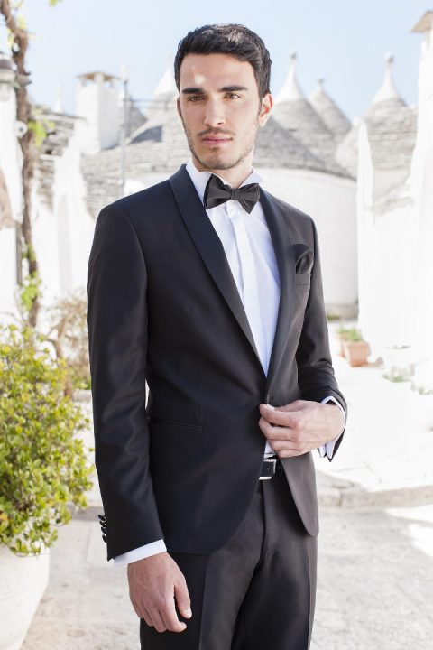
THE WEDDING SUIT
In the past in Sicily the male wedding suit changed according to the social class.
Nowdays it’s different , many people wear the usual black suit, but there is still someone who wants to preserve the tradition and wear a traditional Sicilian wedding suit.
An important example of how poor people married is the pastoral wedding suit. It consists in a coat and a pair of trousers, all made with goatskins.

Slide 24
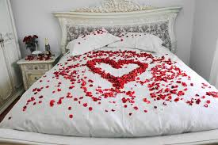
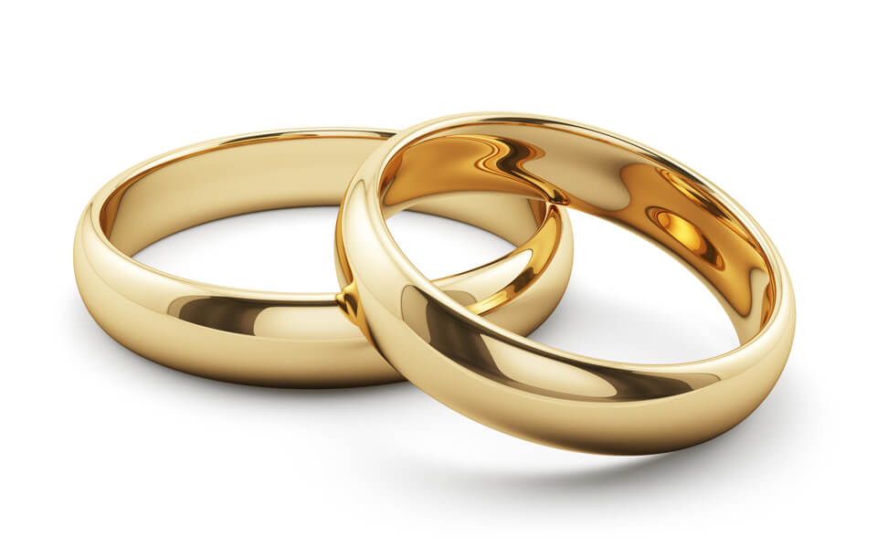
NEWLYWEDS'S BED
The tradition also wants that the newlyweds’ friends, after the reception, accompany the couple in their new love nest where the bride's mother has prepared the marriage bed with new sheets and above these there is a nuptial pillows with wedding rings.

Slide 25
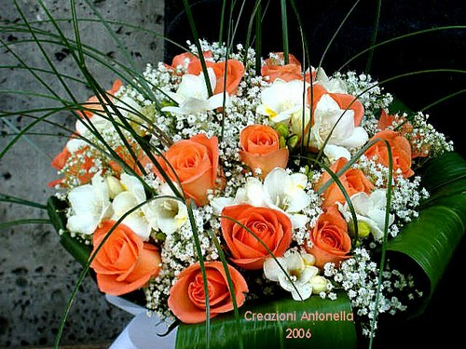
THE FLORAL DECORATION
The perfumes of Sicily are also found in the floral decorations
with orange and almond flowers to honor this land.

Slide 26
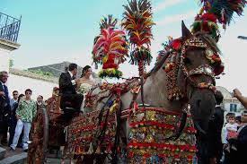
THE SICILIAN WEELBARROW
Other tradition wants that the newlyweds, instead of a modern car use the famous Sicilian weelbarrow decoreted with flowers and other rich decorations.

Slide 27
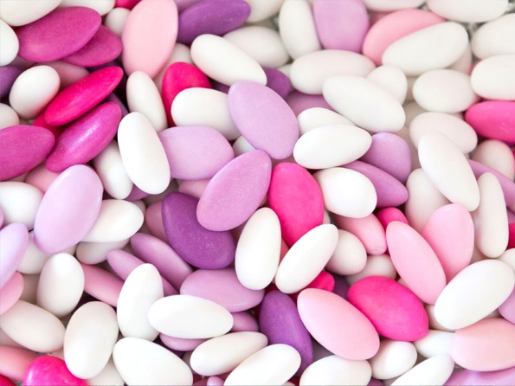
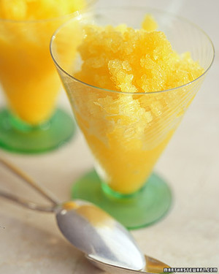
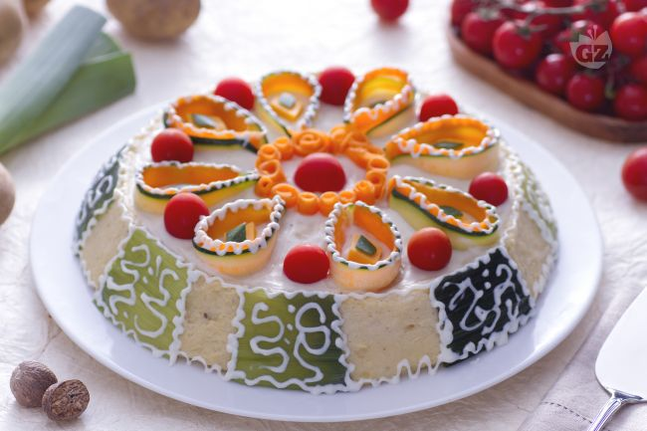
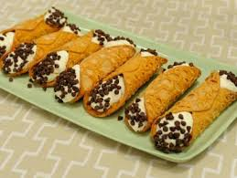
THE SWEETS
In a perfect wedding in Sicilian style cannot miss
among the sugared almond, sweets, slushies, brioches, almond, milk, orzate, cassate and cannoli.

Slide 28
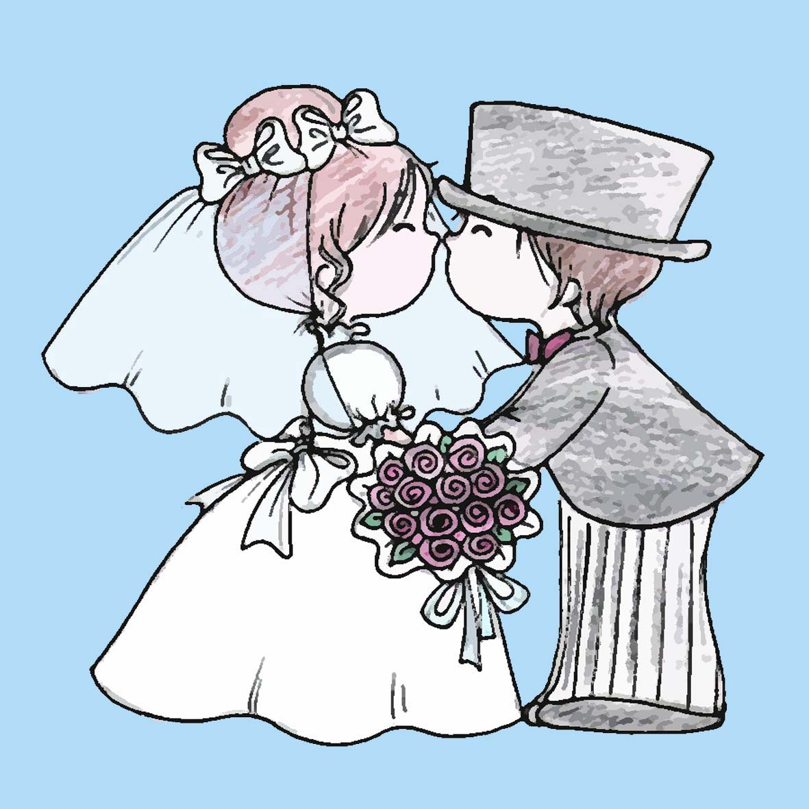
THE PRESENTS
According to an ancient custom, still spread today,
the Sicilian wedding presents are shown by the married
on a table and, when they are delivered by the invited,
these receive by the married dragees and sweets.

Slide 29
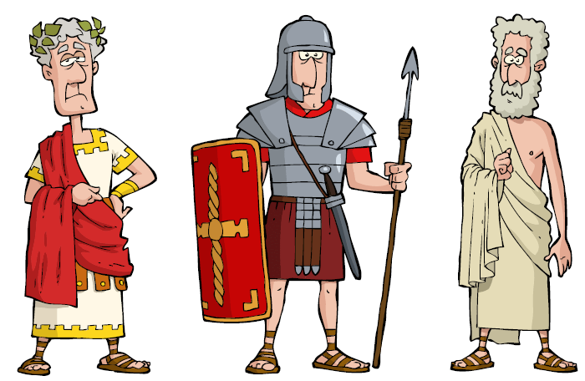
WHEN TO GET MARRIED
In Sicily the tradition wants that you can’t marry in the
months of August and May, because in these months the Romans used to commemorate their dead people.

Slide 30

WE HOPE THAT
YOU ENJOY!

