Slide 1
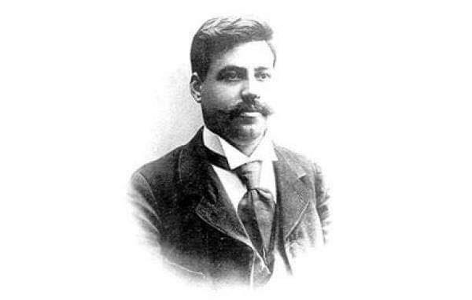
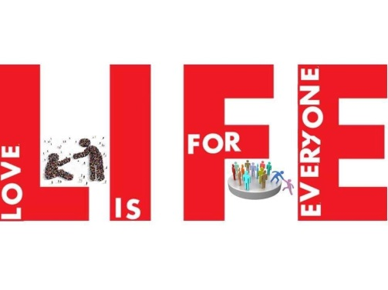
Traditional Christian Orthodox wedding in Macedonia

Slide 2
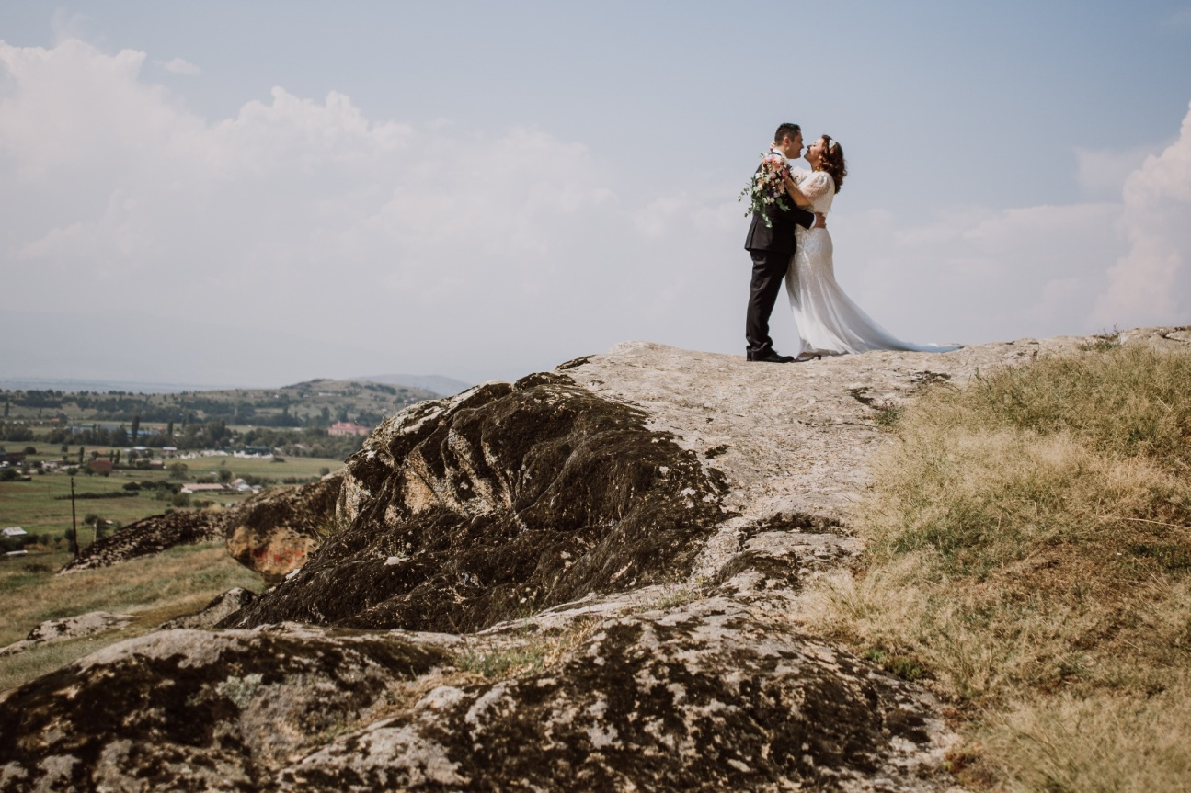
Wedding customs are part of the tradition of every nation. They make every wedding different and special. In Macedonia each region or a town has different cust- oms. It’s a celebration full of dancing, food, joy and respecting the old traditions.

Slide 3
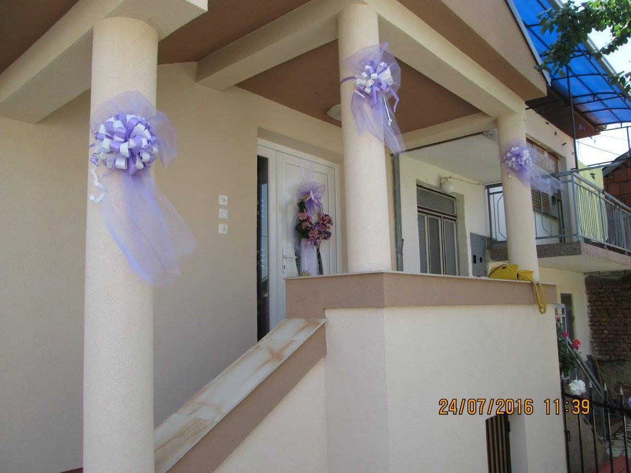
On Thursday we decorate the bride and groom’s homes. This decoration will remain for a period of six weeks as a sign that the family has recently celebrated a wedding.

Slide 4
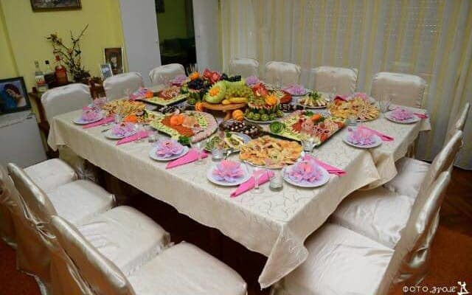
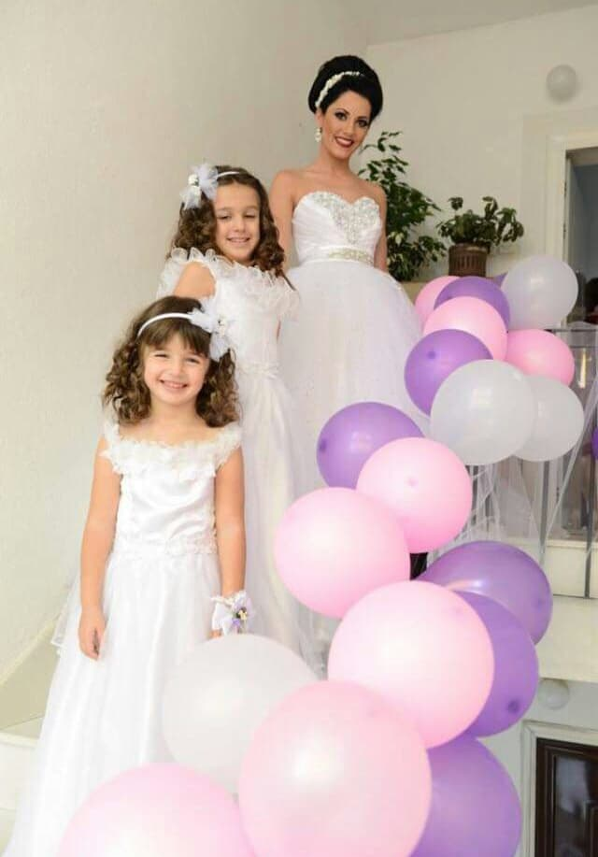
There families set up a table with lots of food for the guesst at the Groom and the Bride house.
All of them sit on the table to make a toast.

Slide 5
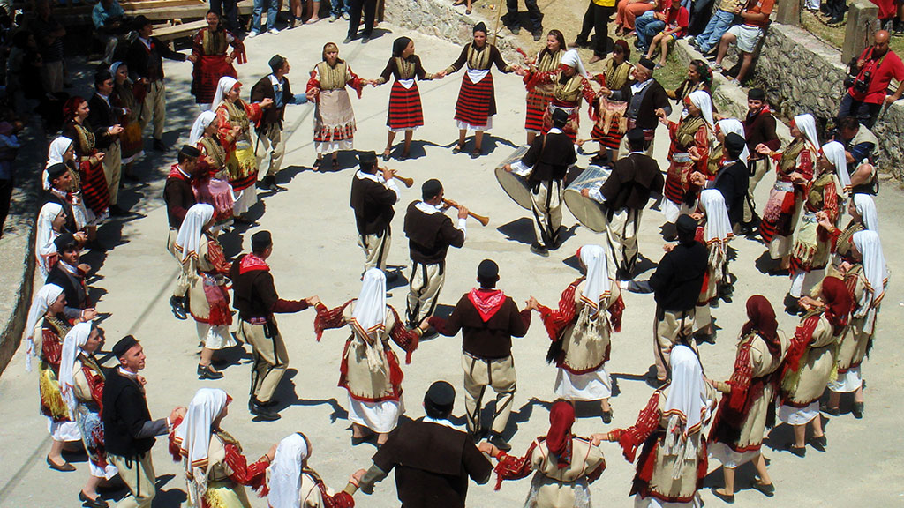
The wedding starts at the groom’s family house. Where they all get together, dress the groom, eat lots of food, dance the traditional dance called ORO and sing Macedonian traditional songs. Accompanied with songs and music they go to the bride’s house.

Slide 6
When they arrive, two girls stay in front of the door and decorate the groom and the godfather with small flowers, man on left and women on right side.
The groomsmen start to bargain with the Bride ‘s family until they agree upon the price. This symbolizes reminiscent of door payments and is a throwback to the day when at the groom literally did buy the Bride – now of course it is just a joke.
One of the bride’s maids puts a ribbon on the best man’s arm and ties it up. The tradition is like a little game where either the boy kisses the bride’s maid or she will give him a small slap on his face, depending on who is faster.
- The brother in law carries the bridal shoes that are one size bigger, he fills shoes with money until they fit well on bride's feet.
When the groom enters the room , he must kiss the bride for three times.
When the couple leaves for the church ceremony the Bride will deliberately kick over a glass of water to symbolize a life as smoothly flowing as the water .

Slide 7
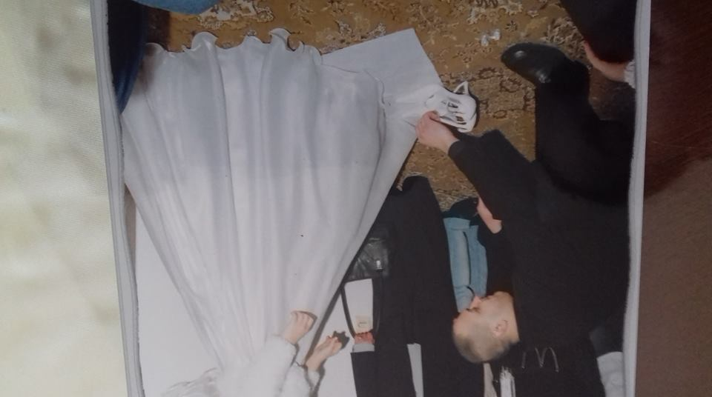
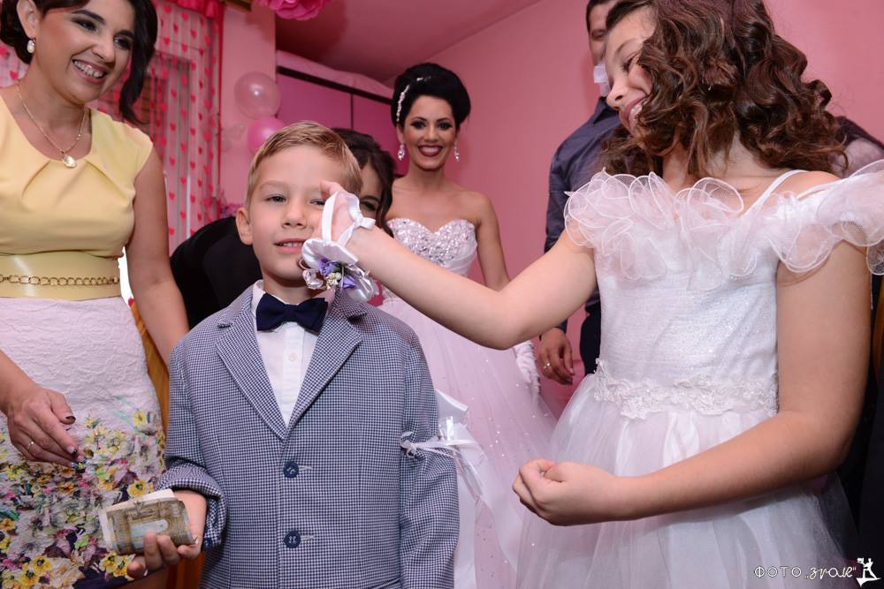
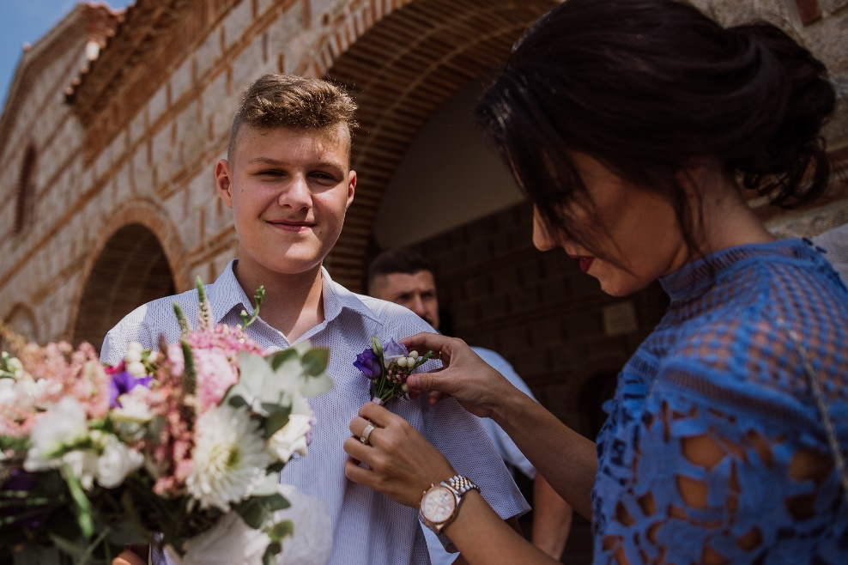

Slide 8
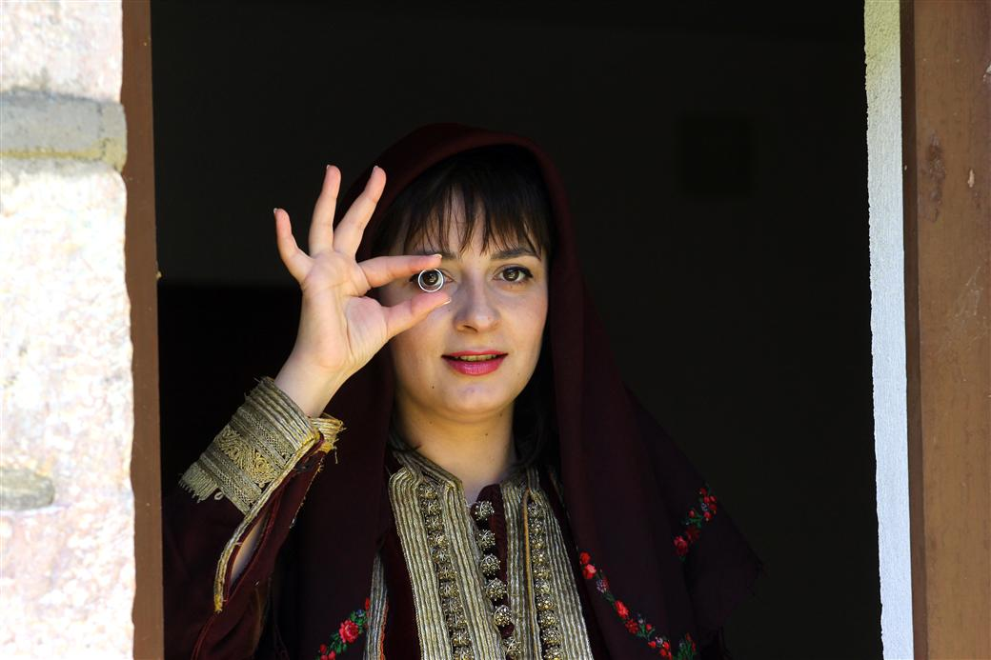
In some places before the groom enters, the bride sees the groom through the wedding ring from the window or door and says three times: "Through ring I see you, in your heart I enter!"

Slide 9
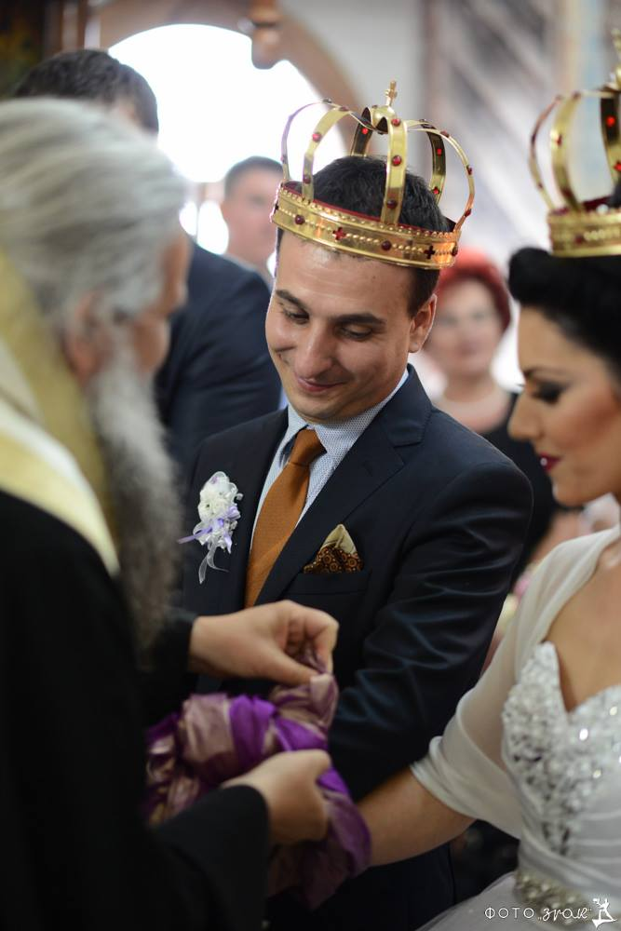
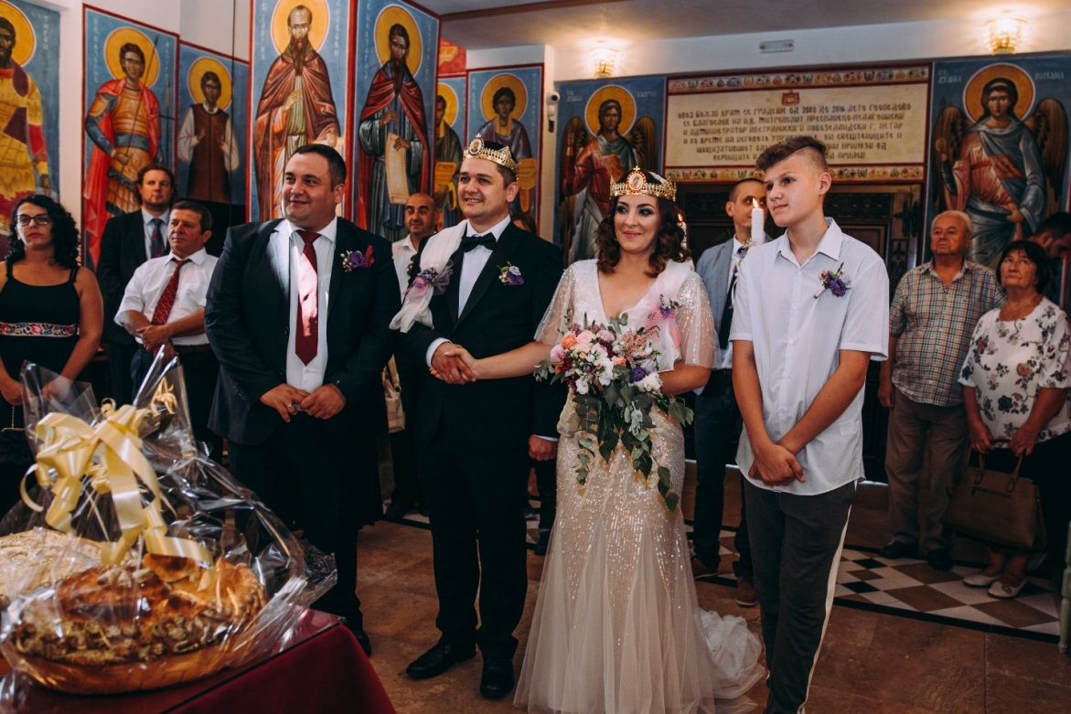
At the church we have traditional Orthodox ceremony.
The most wonderful moment is the crowning of the Bride and the Groom with gold crowns. This symbolises the beginning of new kingdom and honour, that God is present upon them.
The god father brings material or ribbon and he binds around their hands or shoulder which symbolises the eternal commitment. How many times it will bind them that’s how many kids they will have.

Slide 10
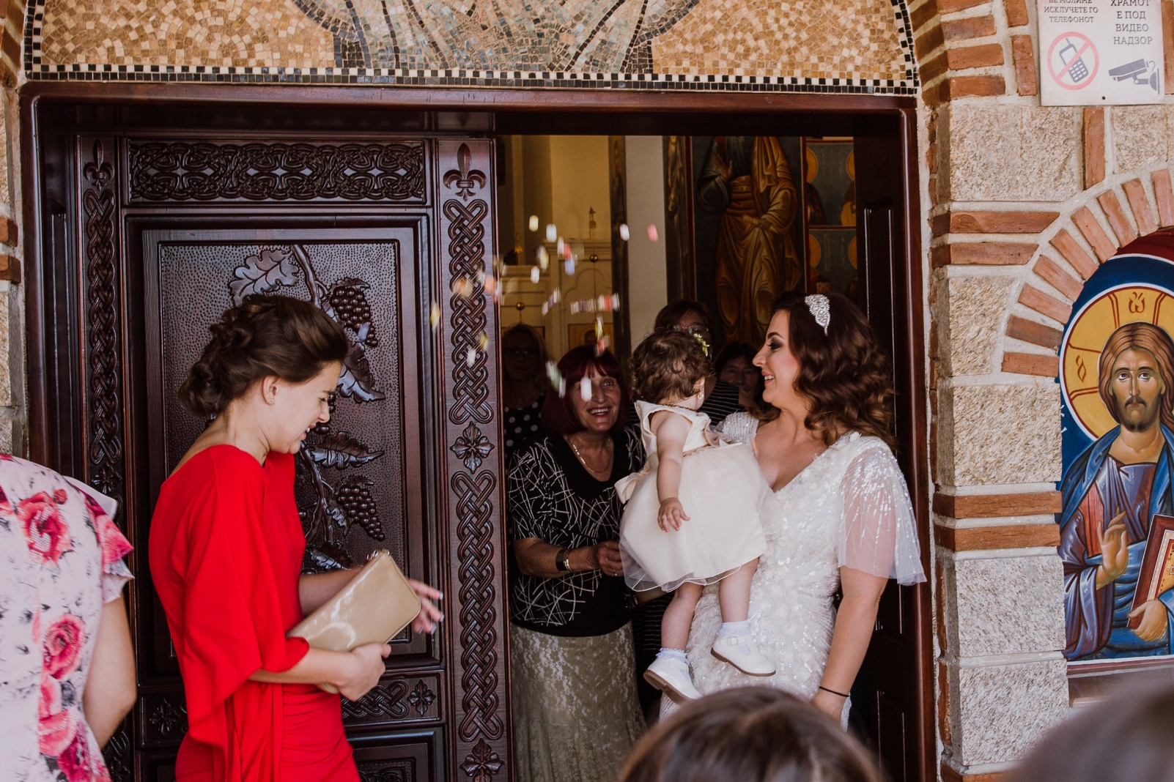
Once the ceremony is finished the groom’s mother throws rice, candies and coins and then the kids collect them as a symbol of wealth and prosperity.

Slide 11
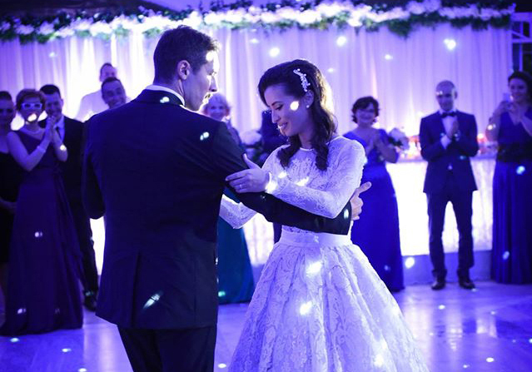
In the restaurant the groom and the bride dance their first waltz on their favorite song.

Slide 12
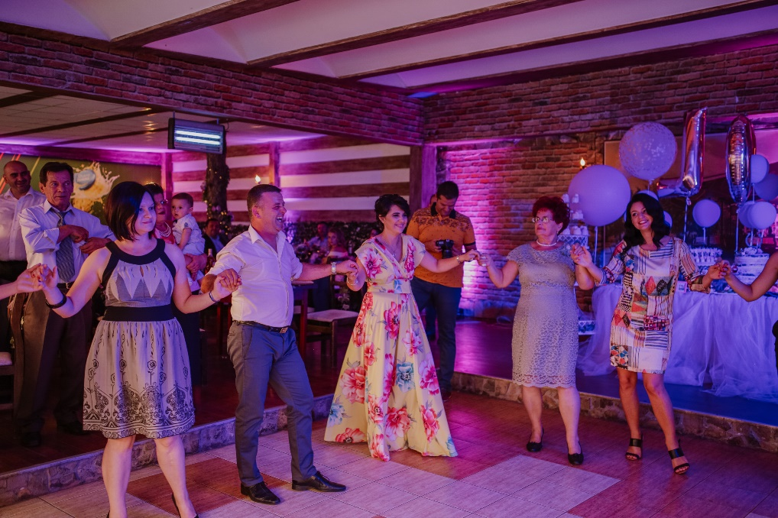
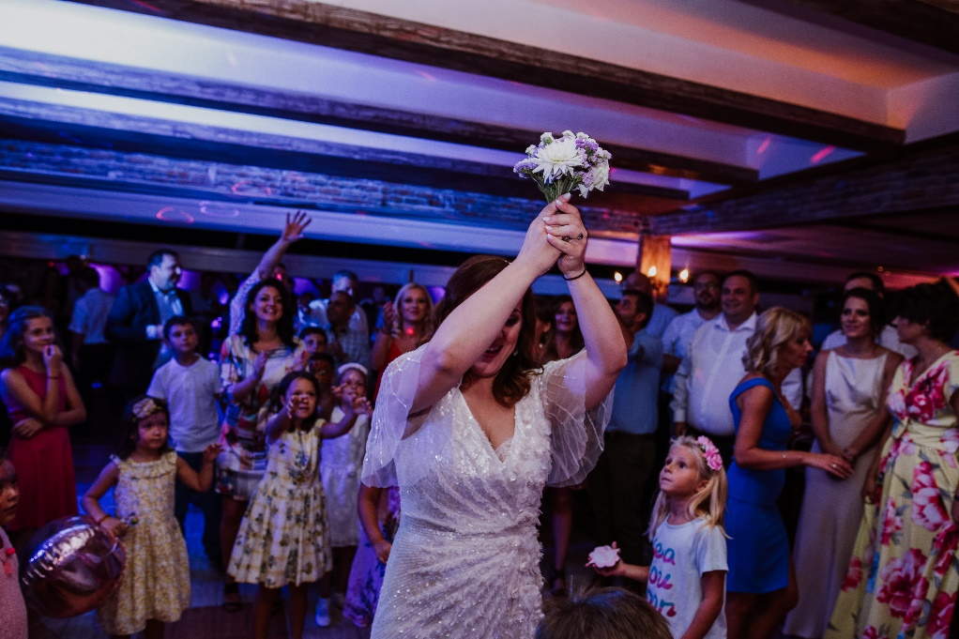
In the restaurant we dance the traditional dance ORO and other dances.
After dinner the couple cut the cake and the bride throws the bouquet. The one who catches the bouquet is believed to be the next who will be married.

Slide 13
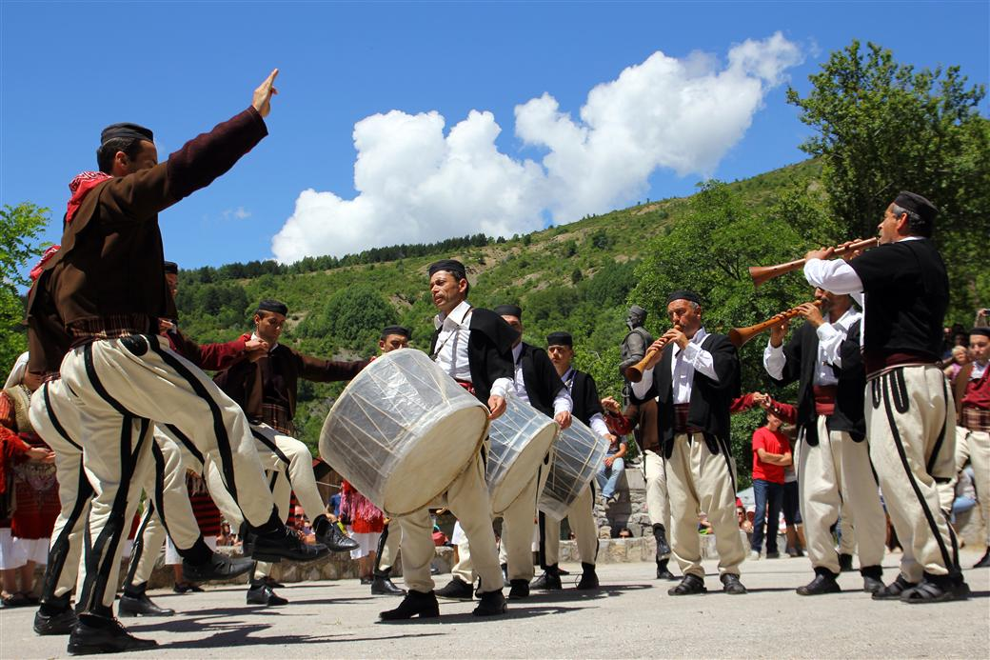
Galicnik Wedding

Slide 14
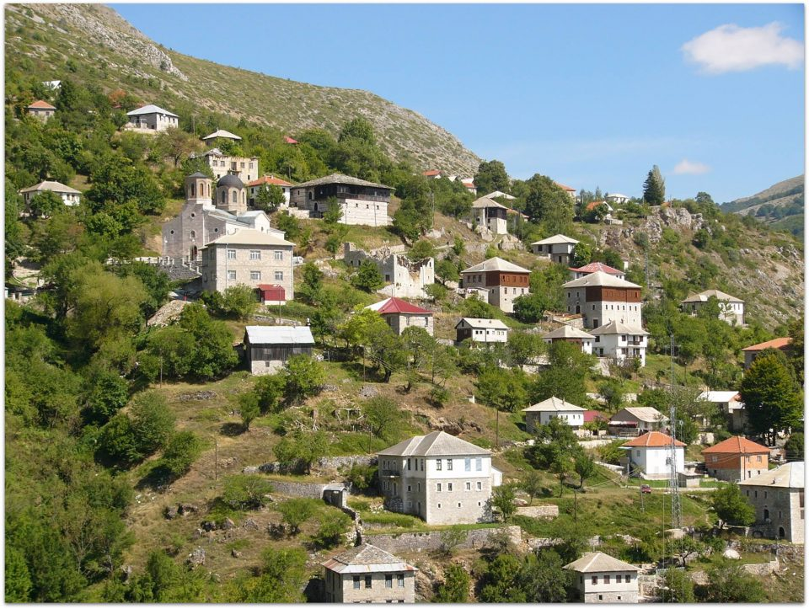
Galicnik Wedding is a manifestation that is held every year on the 12th of July in the village Galicnik on the mountain Bistra.

Slide 15
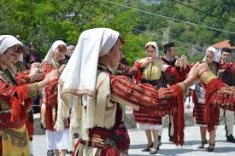
It’s rich with many unique wedding customs and rituals.

Slide 16
Every year during the Galicnik wedding, a number of customs that characterize this wedding are respected as beating the drums, the mother in law dance, the bride’s wedding, the wedding ceremony, the breaking of bread, the wedding in the church “St. Petar and Pavle”, and other customs that slowly die out, but they contain and hide many details of Galicnik’s tradition.

Slide 17
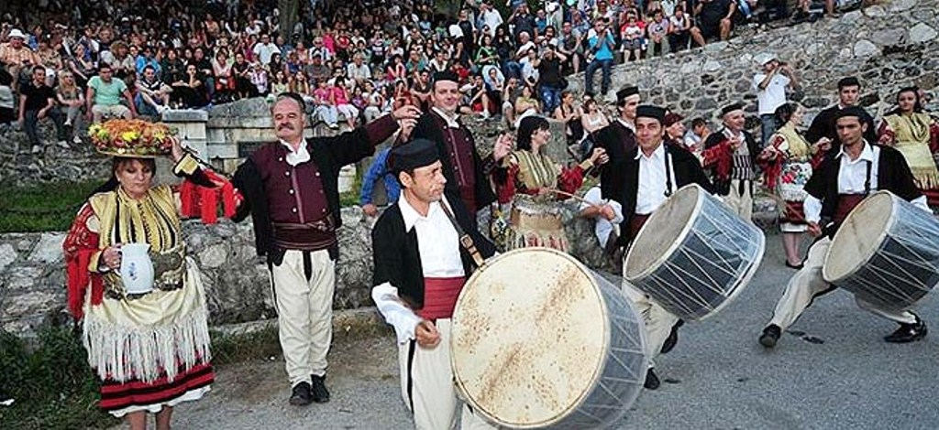
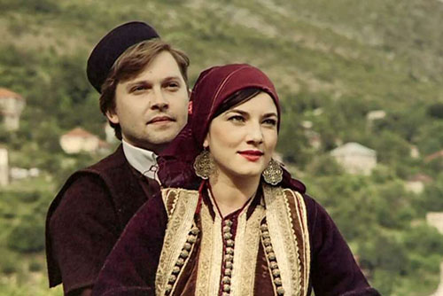

Slide 18
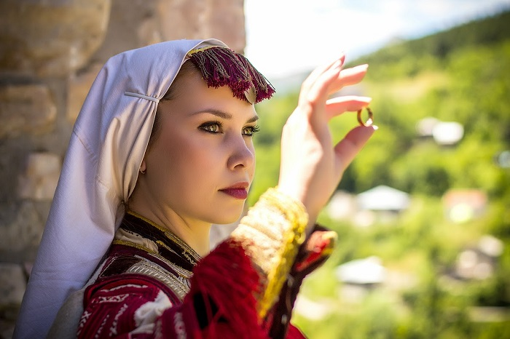
They are now only two residents in Gakicnik, but there are over 5000 visitors and tourists waiting to see the Galicnik wedding.

Slide 19
Worked out by: Eva Kuzeska Emilija Stankoska

