Slide 1
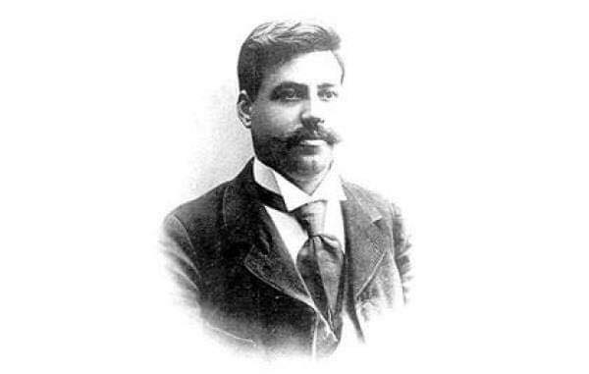
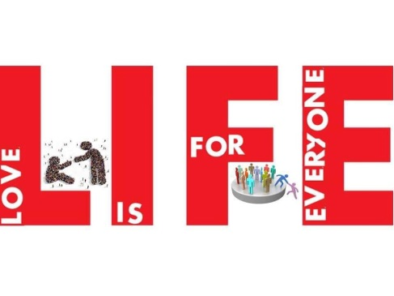
Traditional holidays
Macedonia is a country of traditional values. People appreciate the old-fashioned customs and traditions.

Slide 2
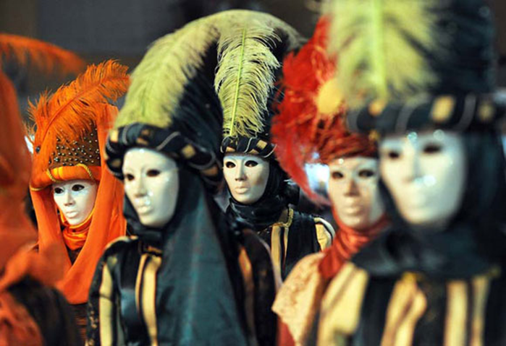
PROCHKA
( Прочка)

Slide 3
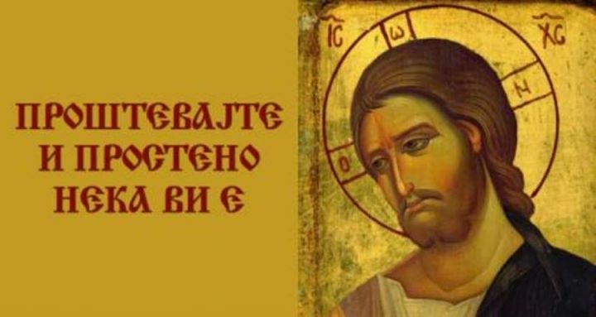
‘Prochka’ is a day of forgiveness in Orthodox Christianity. It is celebrated seven weeks before Easter and the people give forgiveness to each other on this holiday. The youngest seek forgiveness and say “ forgive me” to the older members of the family, and they replay “It’s forgiven by me and by God”.

Slide 4
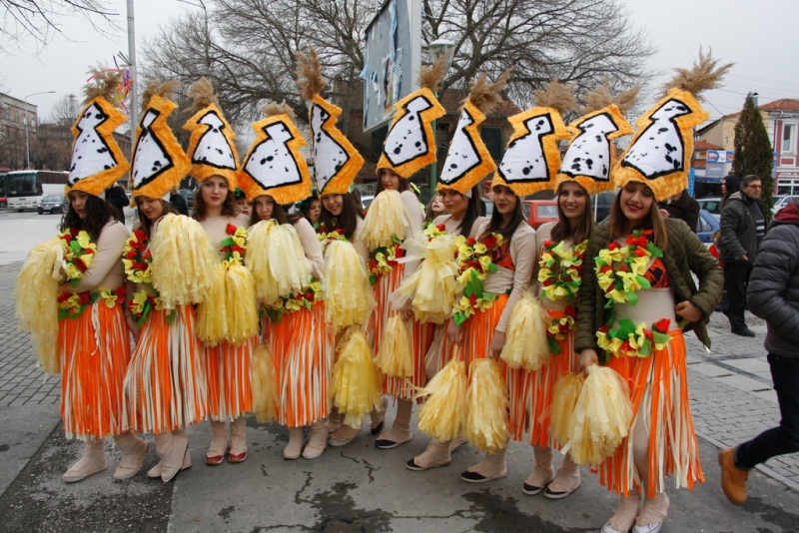
People are dressed in fancy dresses, disguise themselves with different mask, funny and interesting costumes.

Slide 5
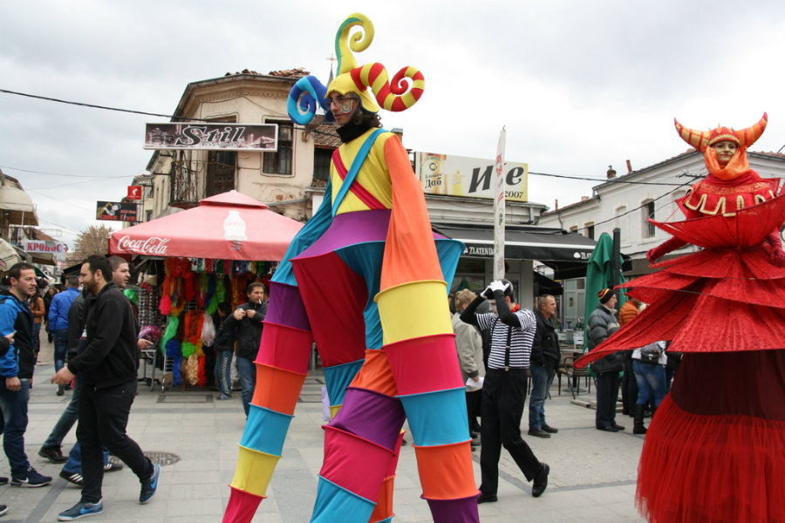
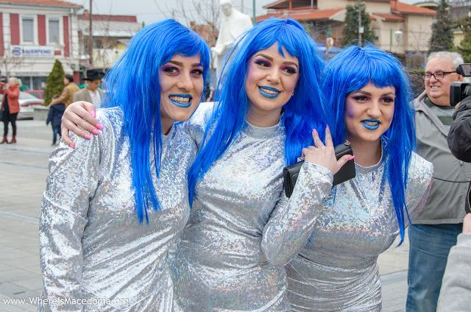

Slide 6
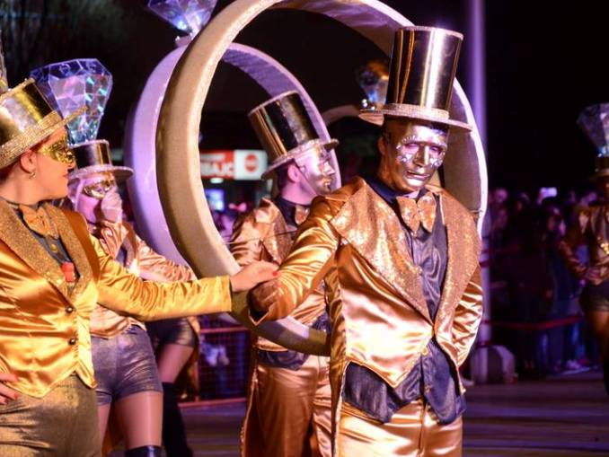
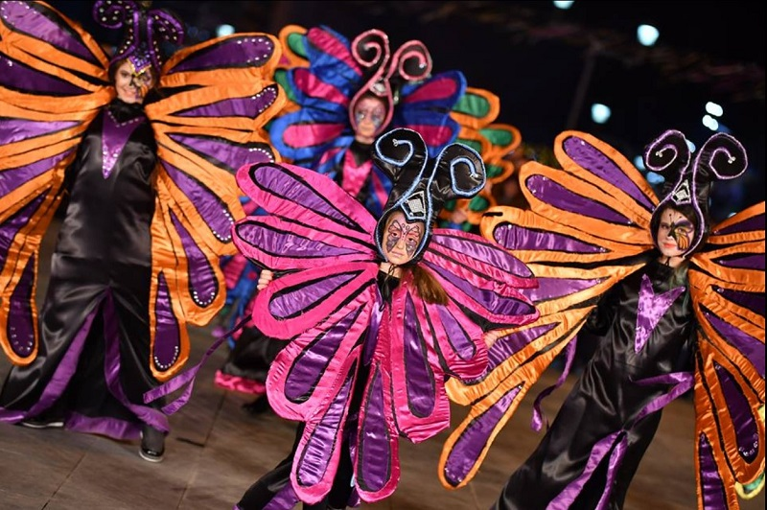
The most famous carnival in our country is the one held in Strumica,known as ‘Strumichki Carnival’ or ‘Trimeri’ and it is in the World’s Calendar for carnivals.

Slide 7
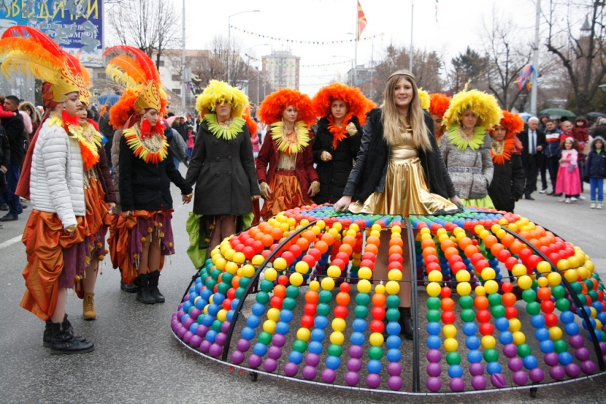
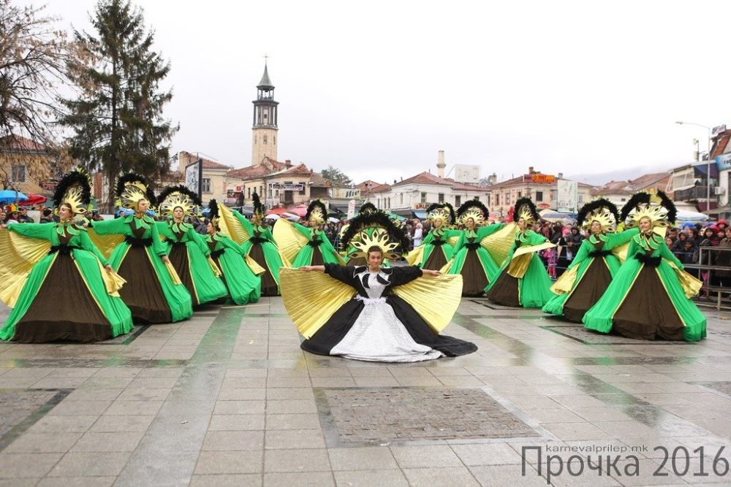
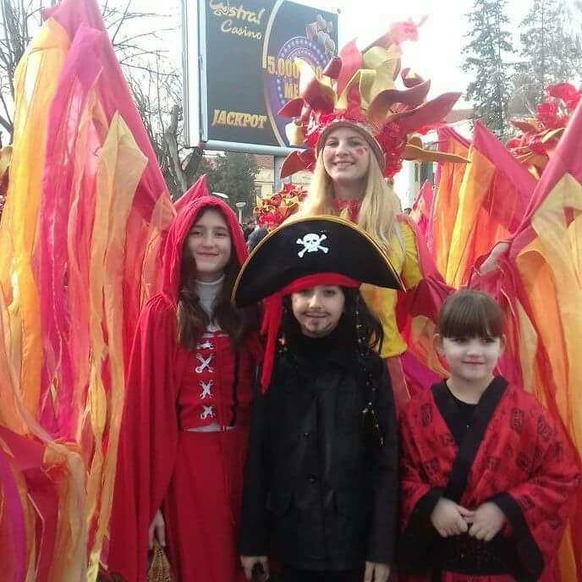
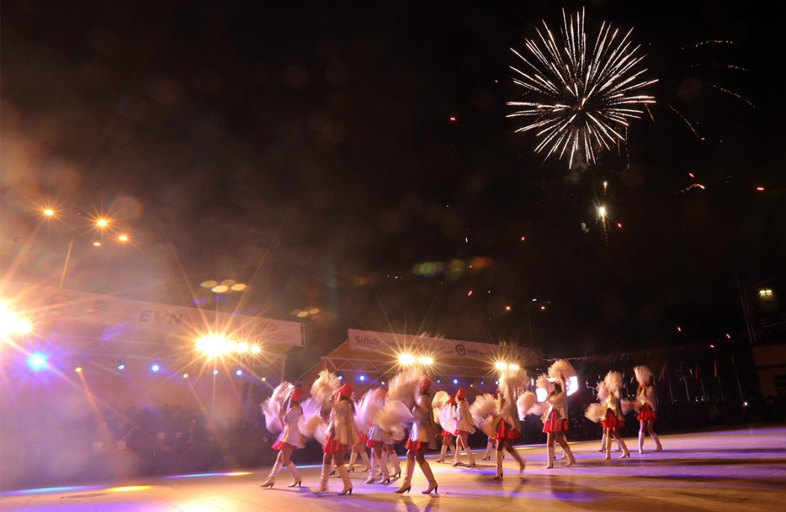

Slide 8
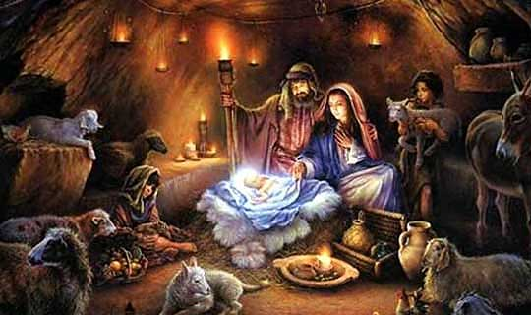
The Christmas Eve is on the 6^{th of} January and it is named “Badnik”. People gather together on this holiday, they prepare a lot of traditional fasting food as “Sarma”, “Zelnik”, “Tavche Gravche” etc.

Slide 9
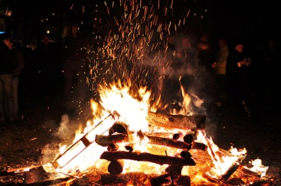
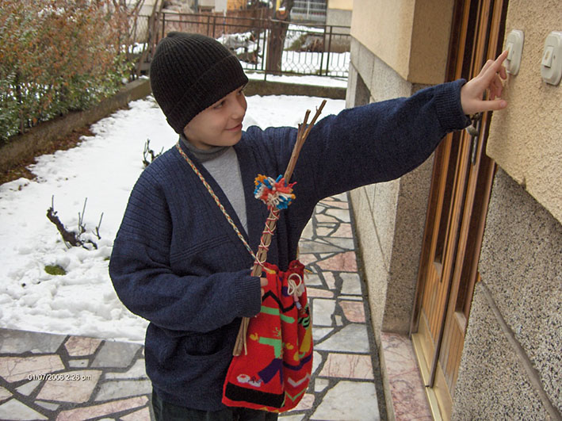
The night before Christmas Eve is called “Kolede” , People gather around the fire, eat and drink and have fun. Early in the morning on the day before Christmas Eve the children sing and go from house to house where they get gifts such as nuts, apples, figs, oranges and other treats. This symbolizes the announcement of the birth of Christ.

Slide 10
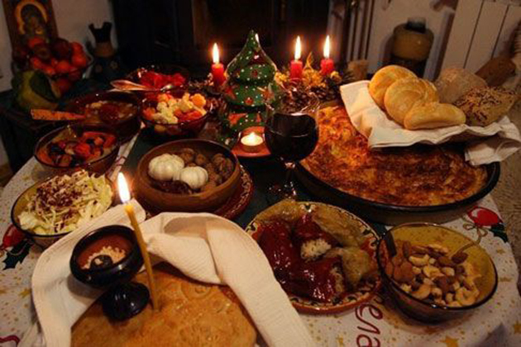
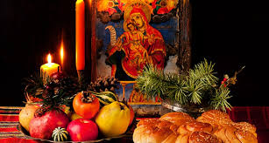
We eat traditional food for Christmas. There is saying that is related to Christmas in our country:”No matter where you are through the year, be home for Christmas”. For all of us this holiday is a time of joy, happiness , laugher and joy. We don’t exchange gifts for Christmas, we exchange gifts for New Year.

Slide 11
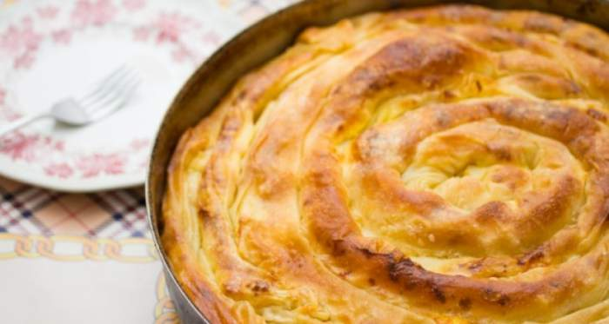
In all parts of Macedonia families make homemade pastry or bread that has a coin inside it. The host of the house, the oldest one, is in charge of breaking and sharing the bread after he blesses the table and everyone gets one peace. The one who gets the coin will have luck, health and wealth during the whole year. The coin is usually kept in a glass of wine as a protector of the house.

Slide 12
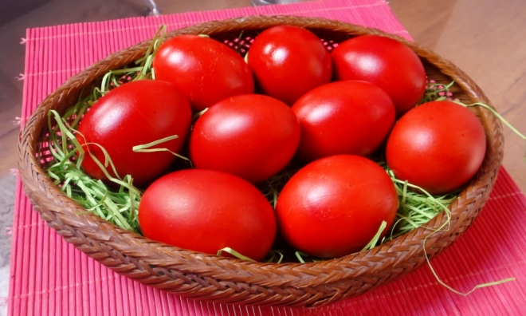
Easter

Slide 13
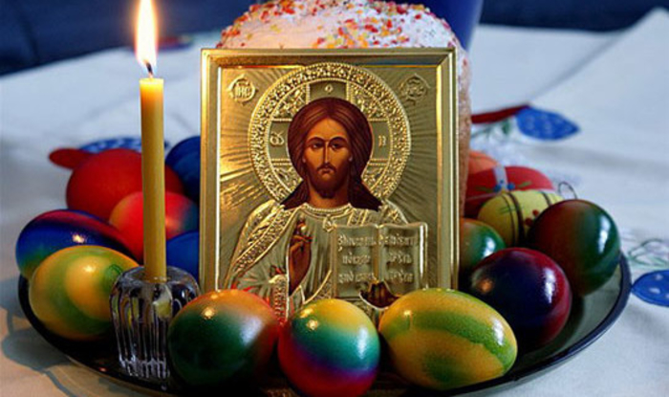
As Christmas, Easter is also the most important holiday in Macedonia and Christian Orthodox Church that people celebrate with great pleasure and joy.

Slide 14
It celebrates the resurrection of Jesus Christ and the belief that he rose from the dead and continued of helping people and making good deeds. The egg is a symbol of new life, so on good Thursday or the Holy Thursday the housewives dye the eggs. The first three eggs has to be in red colour because it signifies the blood of the Christ and must be done before sunrise. Good Friday is the day when Jesus was crucified so Christians avoid eating anything else, but fruit, vegetable and nuts. It’s a very strict feast day. At midnight on Saturday everybody goes to the local church holding a burning candles in their hands, as the priests say the final prayers to celebrate the risen of Jesus and this is when they break the first eggs. -On Sunday the house is ready for guests, it’s a day of sharing love, happiness, respect, we visit friends and relatives, collect eggs and play a game with them. We greet the guest with the phrase “Christ has risen” and the other person will says “he has indeed risen”. -We eat traditional Easter Sunday dishes.

Slide 15
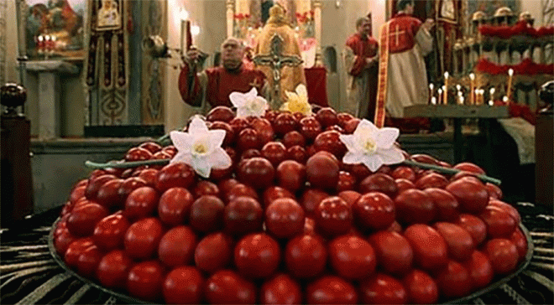
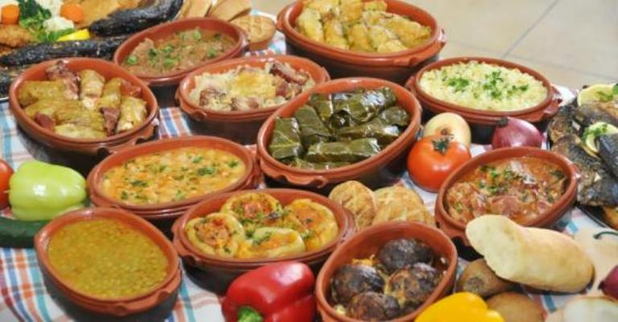
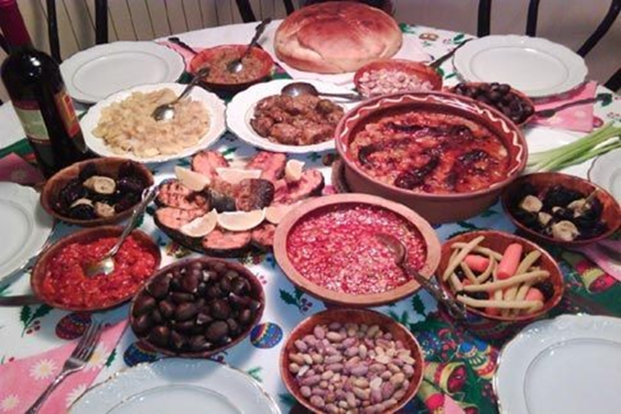
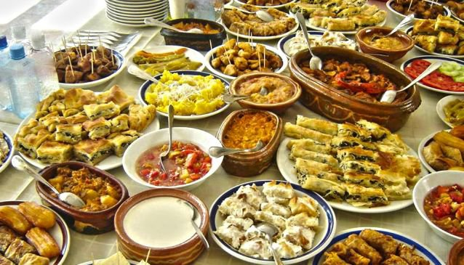

Slide 16
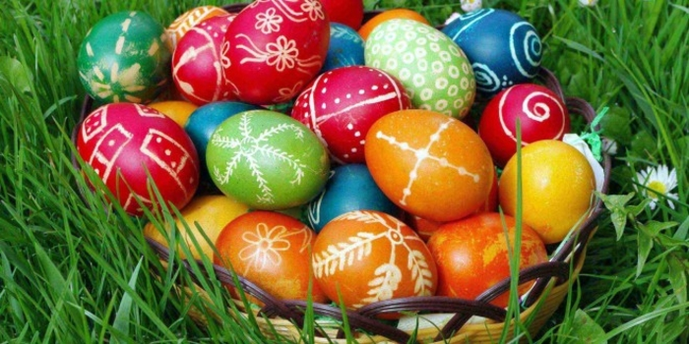
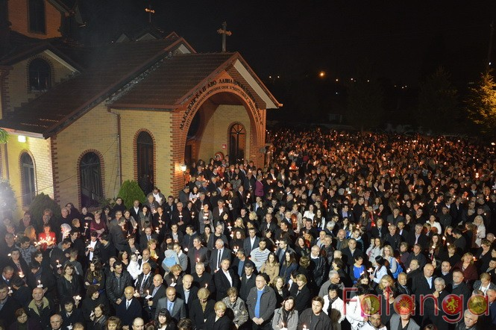
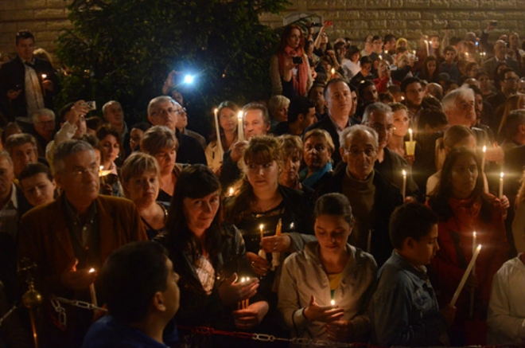

Slide 17
Worked out by: Eva Kuzeska Emilija Stankoska

