Slide 1
RELIGIOUS TRADITIONS

Slide 2
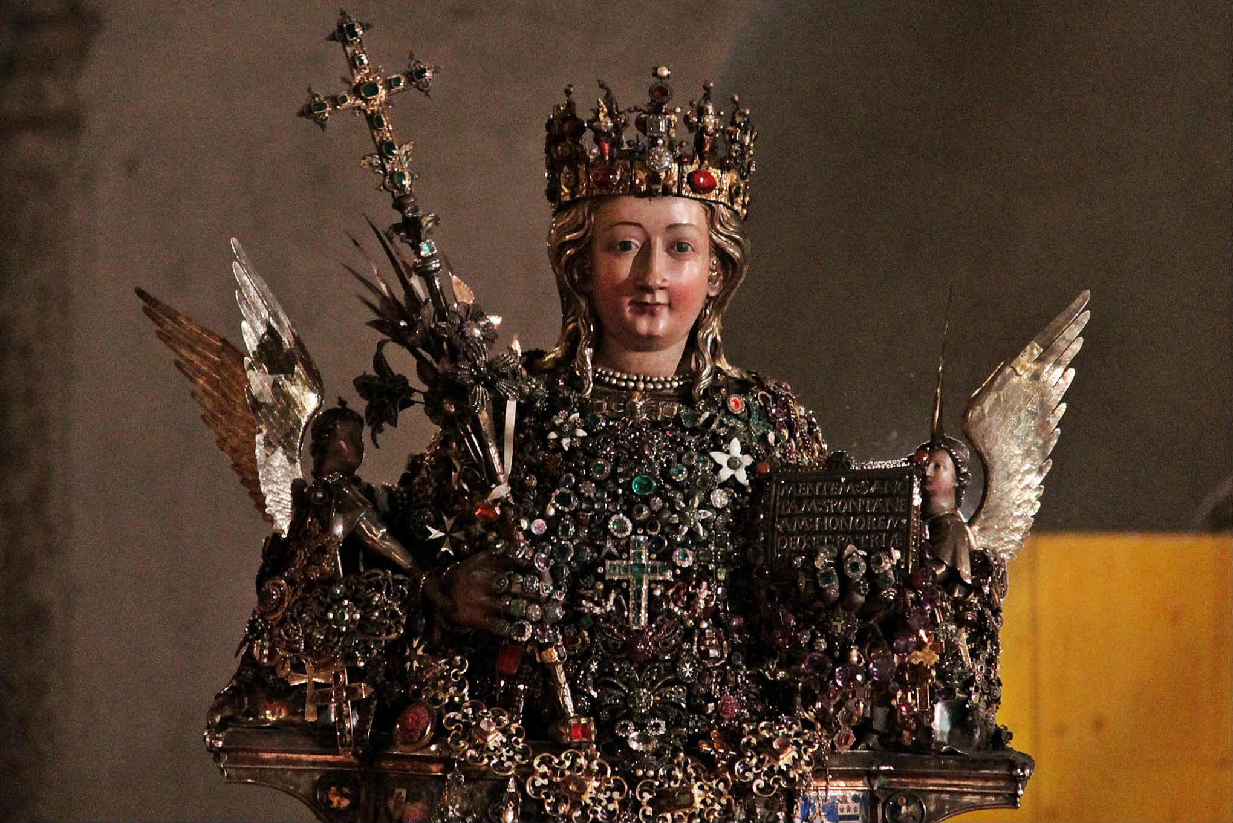
SAINT AGATA
Saint Agata is one of the most famous saints in the world. She is the patron saint of Catania and is remembered on February 5th.

Slide 3
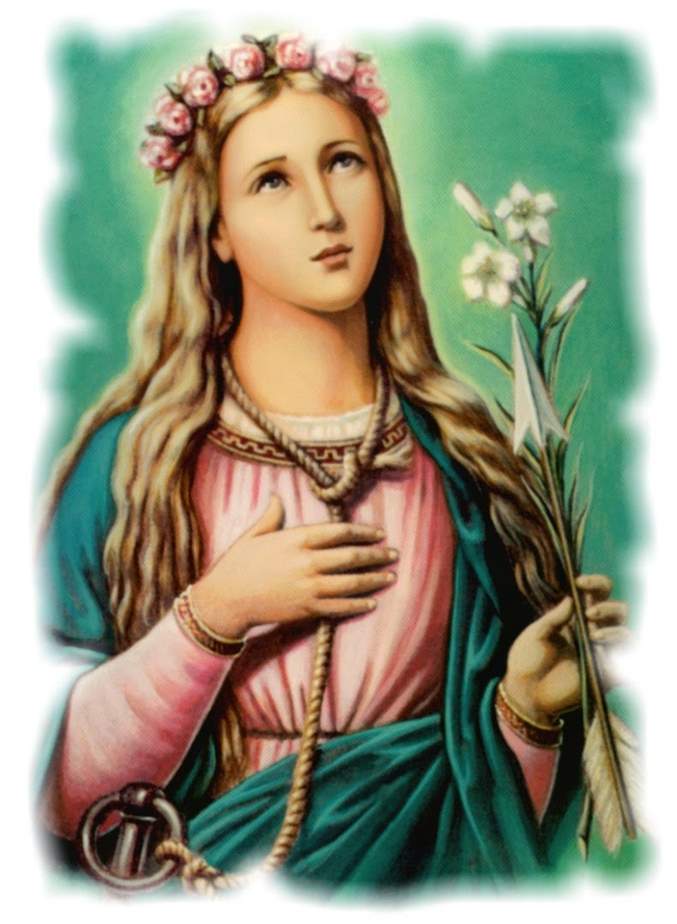
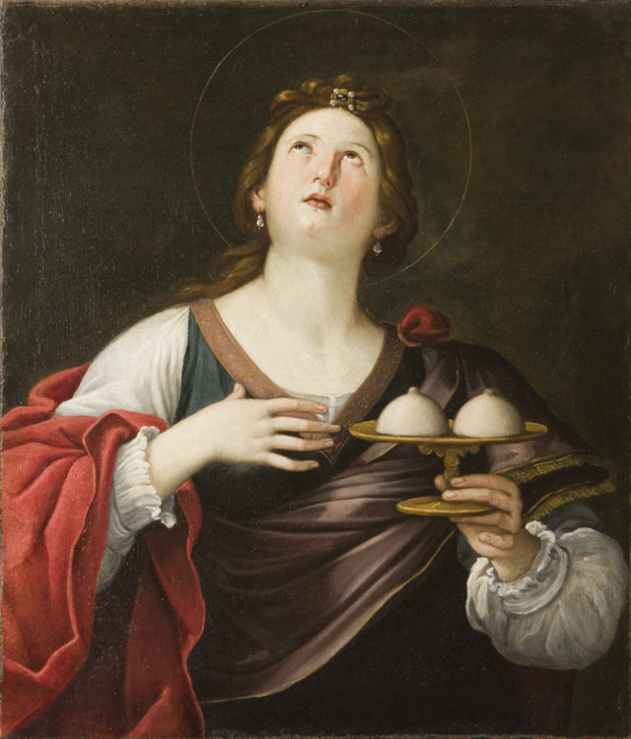
SAINT AGATA’S LIFE
Saint Agata was born in 235 A.D. in Catania into a noble and rich family. When the proconsul of the city saw Agata, he became infatuated with her but his attempts of seduction failed and as a revenge, he accused her of despising the state religion, so she was brought to the praetorian palace. Furious, the man tortured and pulled her breasts. But Agata, after a vision, was healed. He then ordered Agata to be burned, but a strong earthquake avoided the execution. The proconsul removed Agata from the embers and brought her agonizing back to the cell, where she died in 251 a.C.

Slide 4
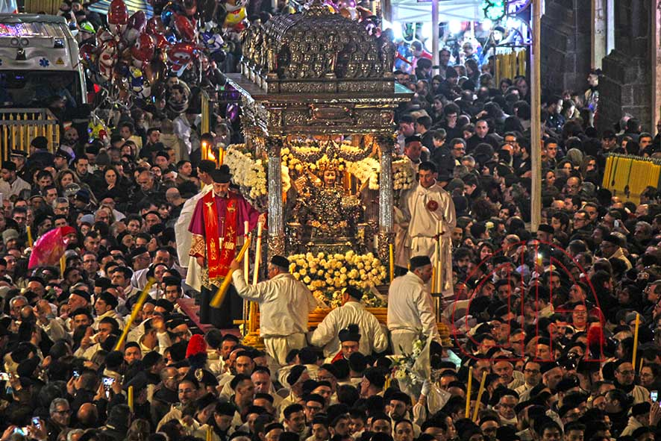
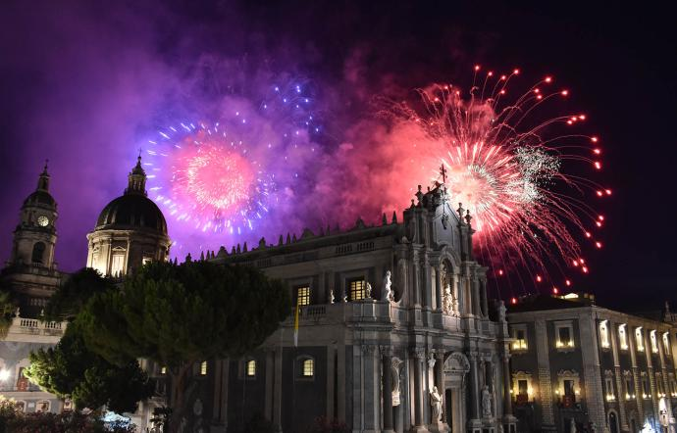
SAINT AGATA’S FEAST
The celebrations take place every year in Catania from the 3rd to the 5th of February.
The 3rd of February starts with the procession for the offering of candles and ends in the evening in Duomo Square with the fireworks show.
The second day the procession of the reliquary bust of the saint takes place around the city until late at night.
The last day the holy mass is celebrated, and finally in the afternoon the last procession is held in the city center.

Slide 5
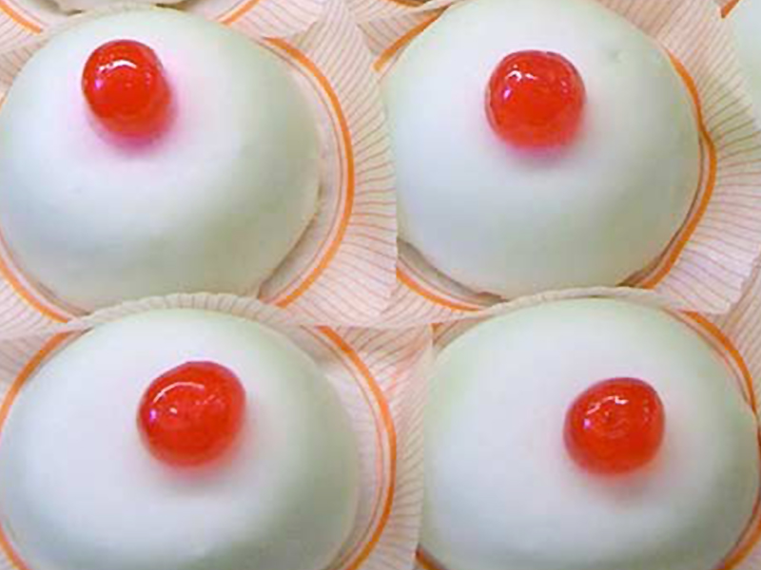
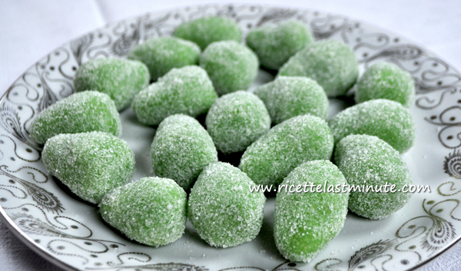
SAINT AGATA’S DESSERTS
The traditional Saint Agata’s desserts are the “Minnuzzi ri Sant’Ajita”, and the “Aliveddi ri Sant’Ajita”.

Slide 6
Aidone preserves many traditions; the most important of these are:
The feast of St. Philip is celebrated on May 1st.
The feast of St. Lawrence, who is the patron saint, is celebrated on August 10th.

Slide 7
During these festivities there are: fireworks, stalls and even shows; many tourists come to celebrate and visit
Aidone.

Slide 8
THE TABLES OF SAN JOSEPH
The tables of San Giuseppe are a popular Sicilian tradition. They consist of tables of various kinds of food , offered as a vow to St. Joseph during the celebrations of March 19, father’s Day.
It is a true culinary art spread in the towns of the Sicilian hinterland, where the devotion to the putative father of Jesus is particularly felt.

Slide 9
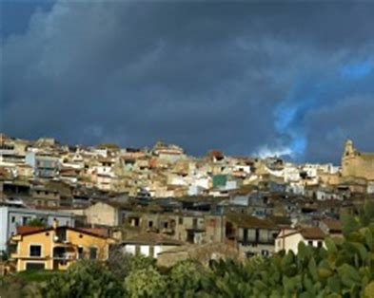
San Cono and… …its patronal feastival

Slide 10
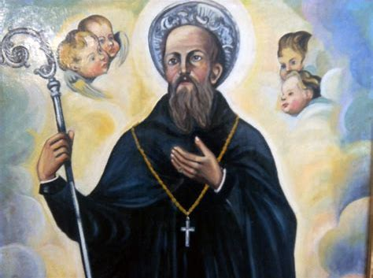
San Cono abate Naso (1285 – 1382)

Slide 11
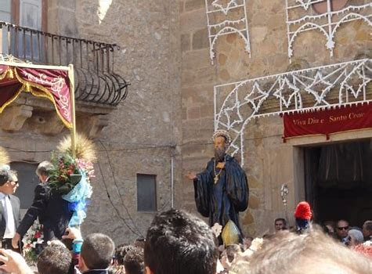
The festivity starts with the traslation of the simulacrum of the Saint that, from the church of San Cono, is carried on the shoulders of the faithful throught the streets of the town and then to the main church.

Slide 12
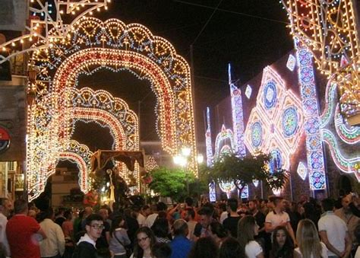
The central square and all the streets are decorated with lights, the bells ring and there are also fireworks.

Slide 13
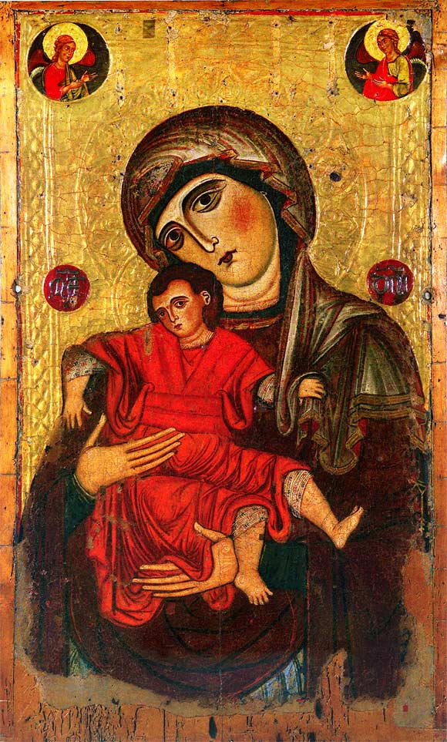
Every year, in Piazza Armerina, on 15th of August Maria Santissima delle Vittorie is celebrated.
THE VIRGIN MARY IN PIAZZA ARMERINA

Slide 14
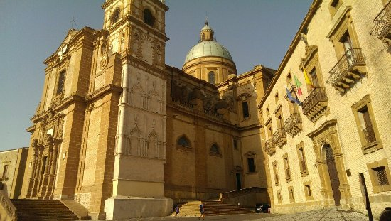
At 8 o’clock in the morning the bells of the city ring to announce that St. Mary’s day has finally arrived.

Slide 15
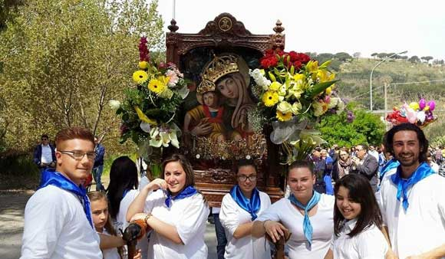
At 8 pm the solemn procession takes place for the streets of the city with the sacred image of Maria SS.

Slide 16
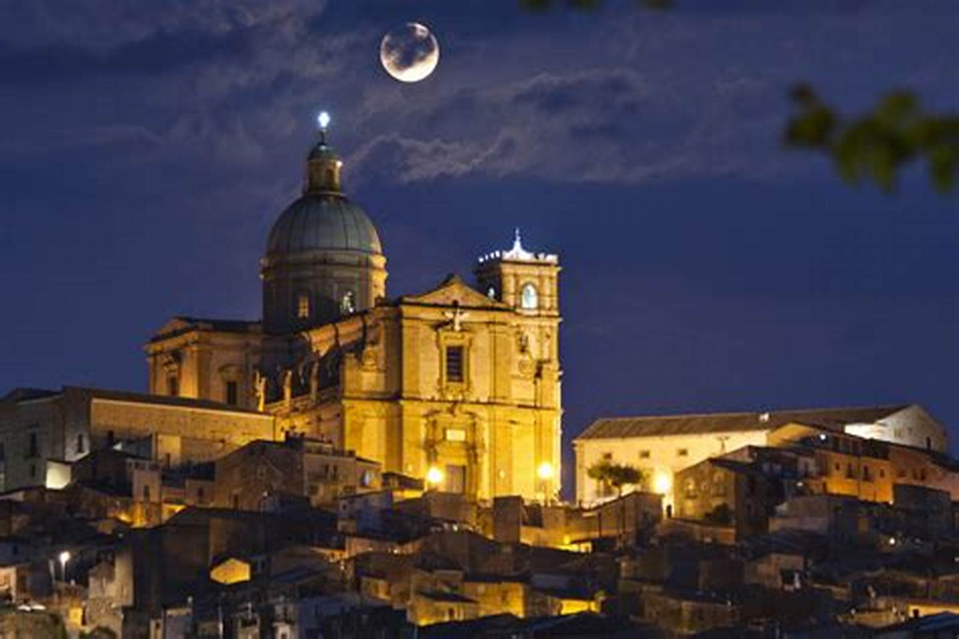
After the procession the Virgin is brought back to the Cathedral and at midnight there are fireworks.

Slide 17
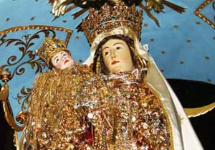
ENNA:FEAST OF MADONNA DELLA VISITAZIONE
The feast of ‘Madonna della Visitazione’ is the most important in Enna. It takes place the 2nd of July and it is generally celebrated in the many squares of the city. This feast has mediaval origins.

Slide 18
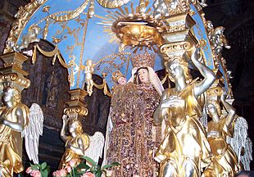
THE CELEBRATION OF THE 2nd OF JULY
The celebrations begin with the Holy Mass at 6.30 and continue in the cathedral all day.

Slide 19
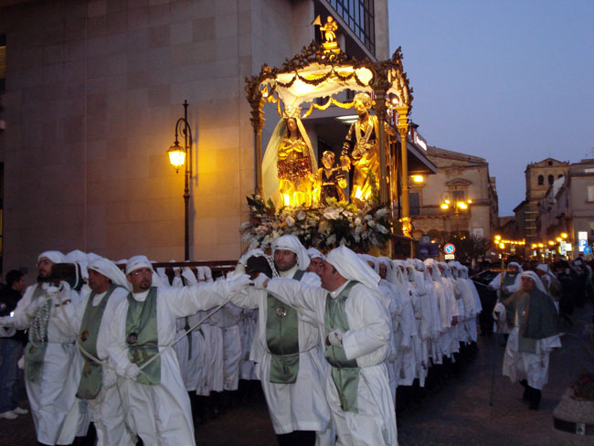
THE CELEBRATIONS CONTINUE IN THE AFTERNOON!
The statue of the Madonna is decorated with precious gold jewelery, enamels and precious stones.
Then the statue is carried in procession along all the main streets of the city to the Church of Montesalvo, which greets her with fireworks.

Slide 20
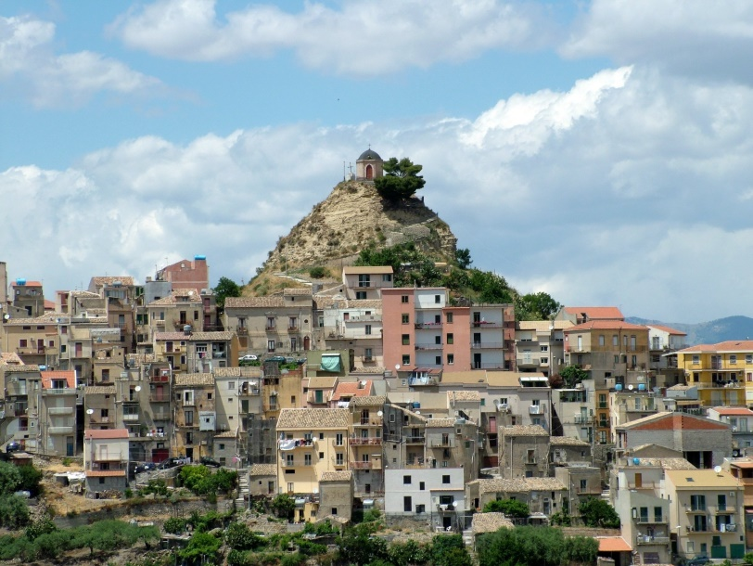
THE END OF THE FESTIVITIES
The following Sunday the celebrations end with the Holy Mass at 8 p.m. , followed by the last rite of the Great Festivities, returning the statue to the main altar of Cappella dei Marmi.

